Slide 1
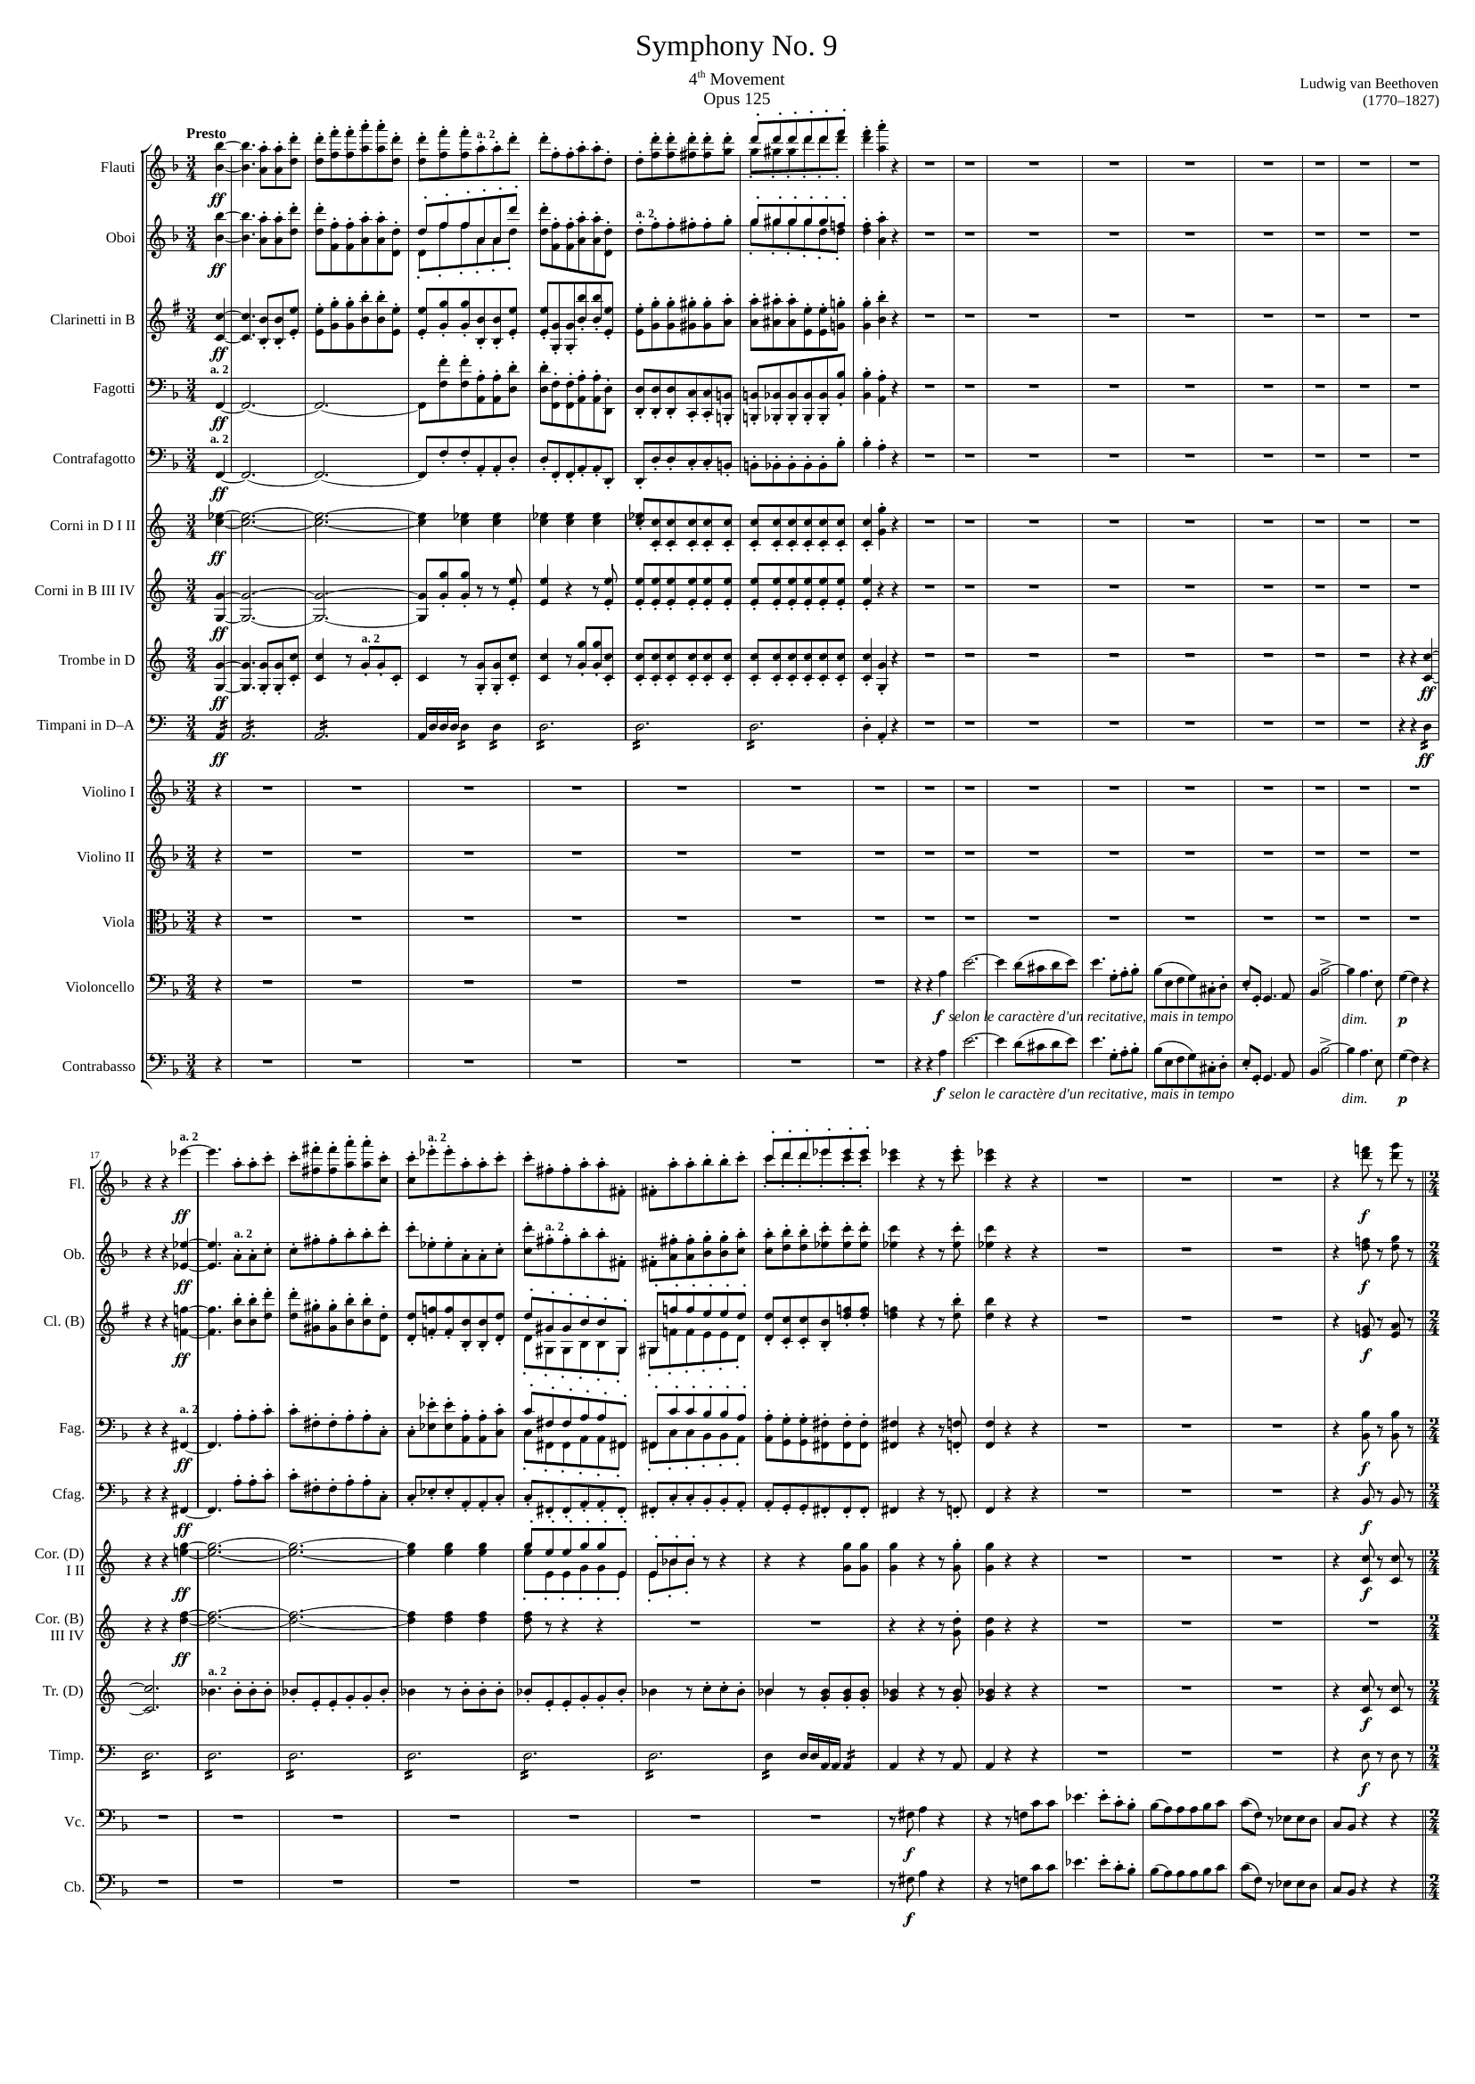
0
mel
22
49
mel
mel
harm
mel
harm
mel
harm
rhythm
harm
rhythm
rhythm
rhythm
mel
mel
49
70
mel+rhythm
mel+rhythm
88
mel
mel
mel+rhythm
mel+rhythm
mel
mel+rhythm
mel+rhythm
mel
mel+rhythm
mel+rhythm
mel
mel+rhythm
mel+rhythm
harm
rhythm
mel+rhythm
mel+rhythm
harm
rhythm
mel+rhythm
rhythm
mel+rhythm
mel+rhythm
rhythm
mel+rhythm
mel+rhythm
mel+rhythm
mel
mel+rhythm
mel

Slide 2
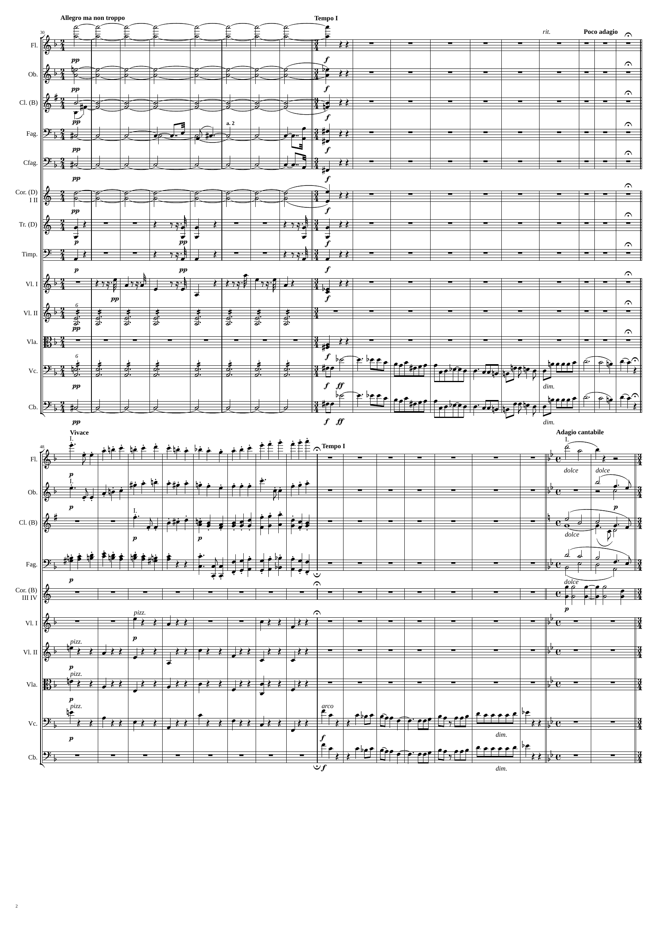
88
104
134
harm
harm
harm
harm
harm
harm
mel+rhythm
mel+rhythm
mel+rhythm
harm
rhythm
harm
mel
harm
mel
134
158
179
187
mel
mel+harm
mel
mel+harm
mel
mel+harm
mel+rhythm
mel
mel+harm
harm
rhythm
rhythm
rhythm
rhythm
mel
mel

Slide 3
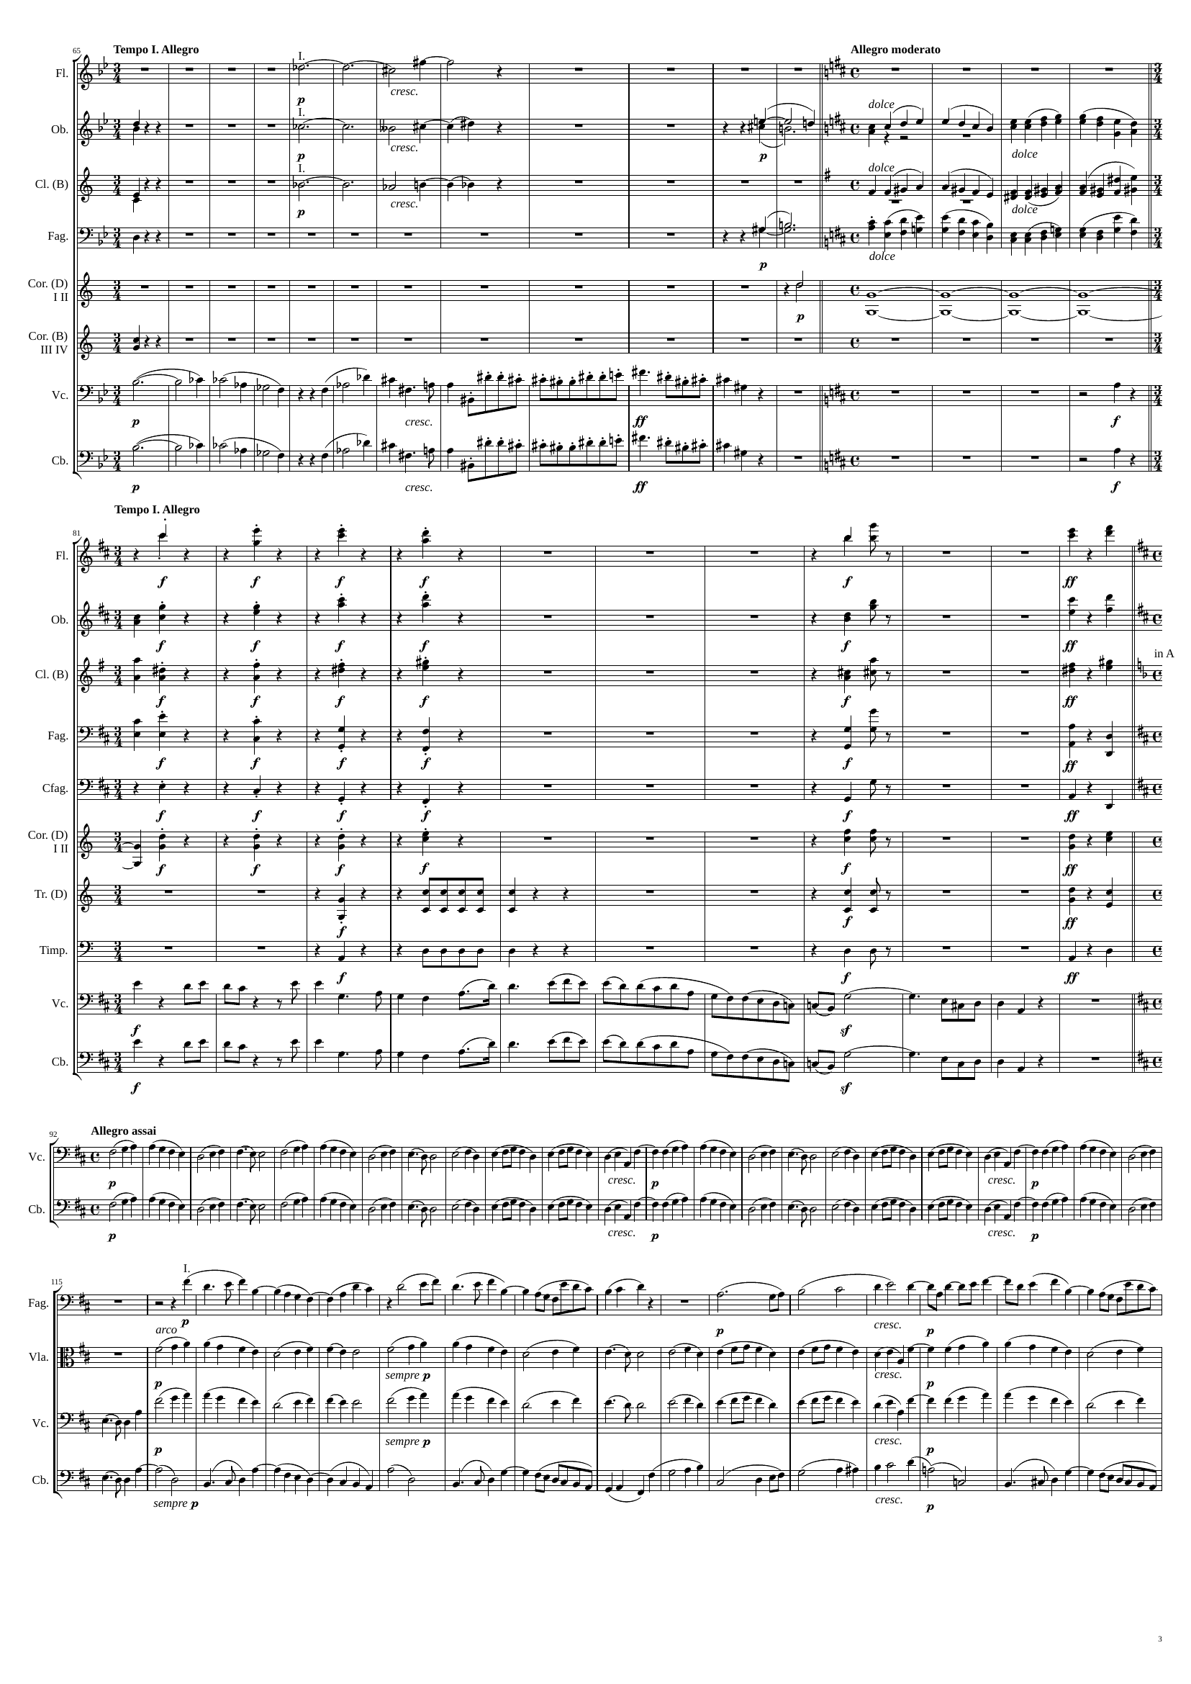
187
199
211
223
239
harm
mel+harm
harm
harm
mel
mel+harm
harm
mel
mel+harm
harm
mel
harm
harm
mel+harm
mel
mel
mel+harm
mel
mel
239
rhythm
251
mel+rhythm
263
rhythm+harm
272
mel
rhythm
mel+rhythm
rhythm+harm
mel
rhythm
mel+rhythm
rhythm+harm
mel
rhythm
rhythm
rhythm+harm
rhythm
rhythm
rhythm+harm
harm
rhythm
rhythm
rhythm+harm
rhythm
rhythm
rhythm+harm
rhythm
rhythm
rhythm+harm
mel
mel
272
364
mel
mel
364
368
428
mel+rhythm
mel
mel
mel
mel
mel+rhythm

Slide 4
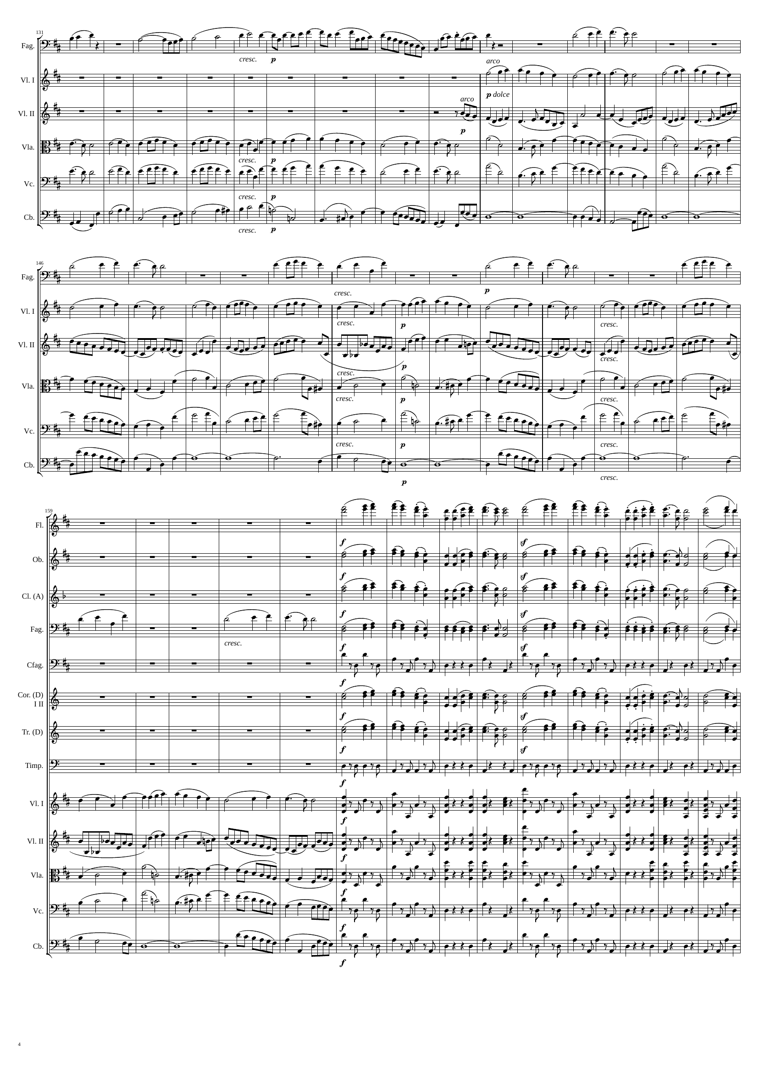
428
464
488
mel+rhythm
mel
mel
mel+rhythm
mel
mel+rhythm
mel
mel+rhythm
mel+rhythm
harm
488
mel
540
mel
mel+rhythm
mel+rhythm
mel+rhythm
mel+rhythm
harm
mel+rhythm
harm
mel+rhythm
harm
mel+rhythm
540
560
mel
596
mel
mel
mel
mel
rhythm
mel
mel
rhythm
mel
rhythm+harm
mel+rhythm
rhythm+harm
mel+rhythm
rhythm+harm
mel+rhythm
rhythm
mel+rhythm
harm
mel+rhythm
rhythm

Slide 5
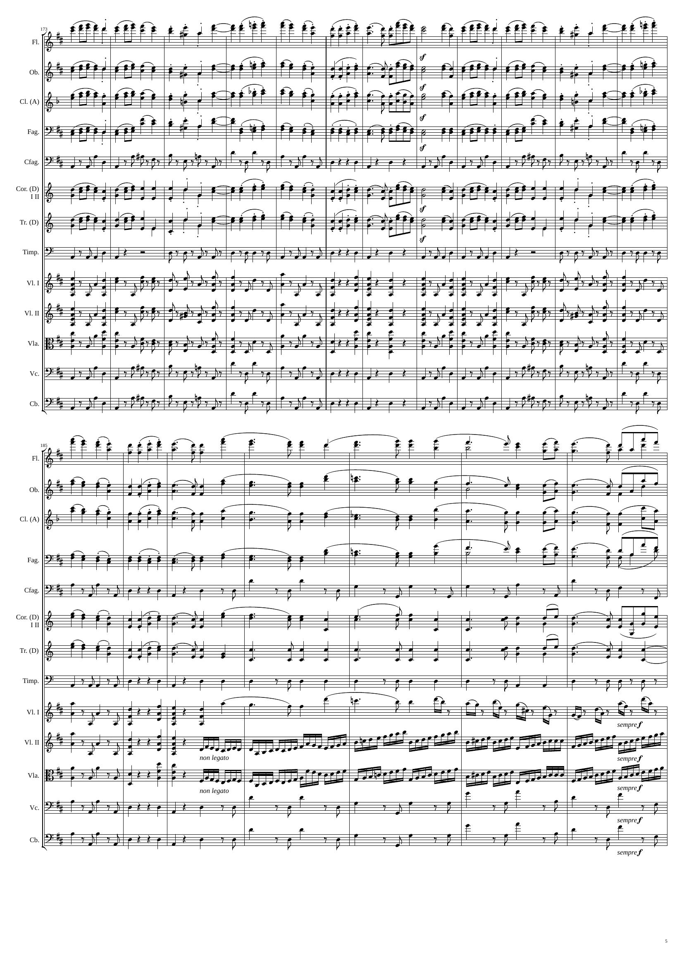
596
mel
644
mel
mel
mel
rhythm
mel
mel
rhythm
rhythm+harm
rhythm+harm
rhythm+harm
rhythm
rhythm
644
652
672
mel
mel
mel
mel
rhythm
mel
mel
rhythm
rhythm+harm
mel
rhythm
rhythm+harm
rhythm
rhythm+harm
rhythm
rhythm
rhythm
rhythm
rhythm

Slide 6
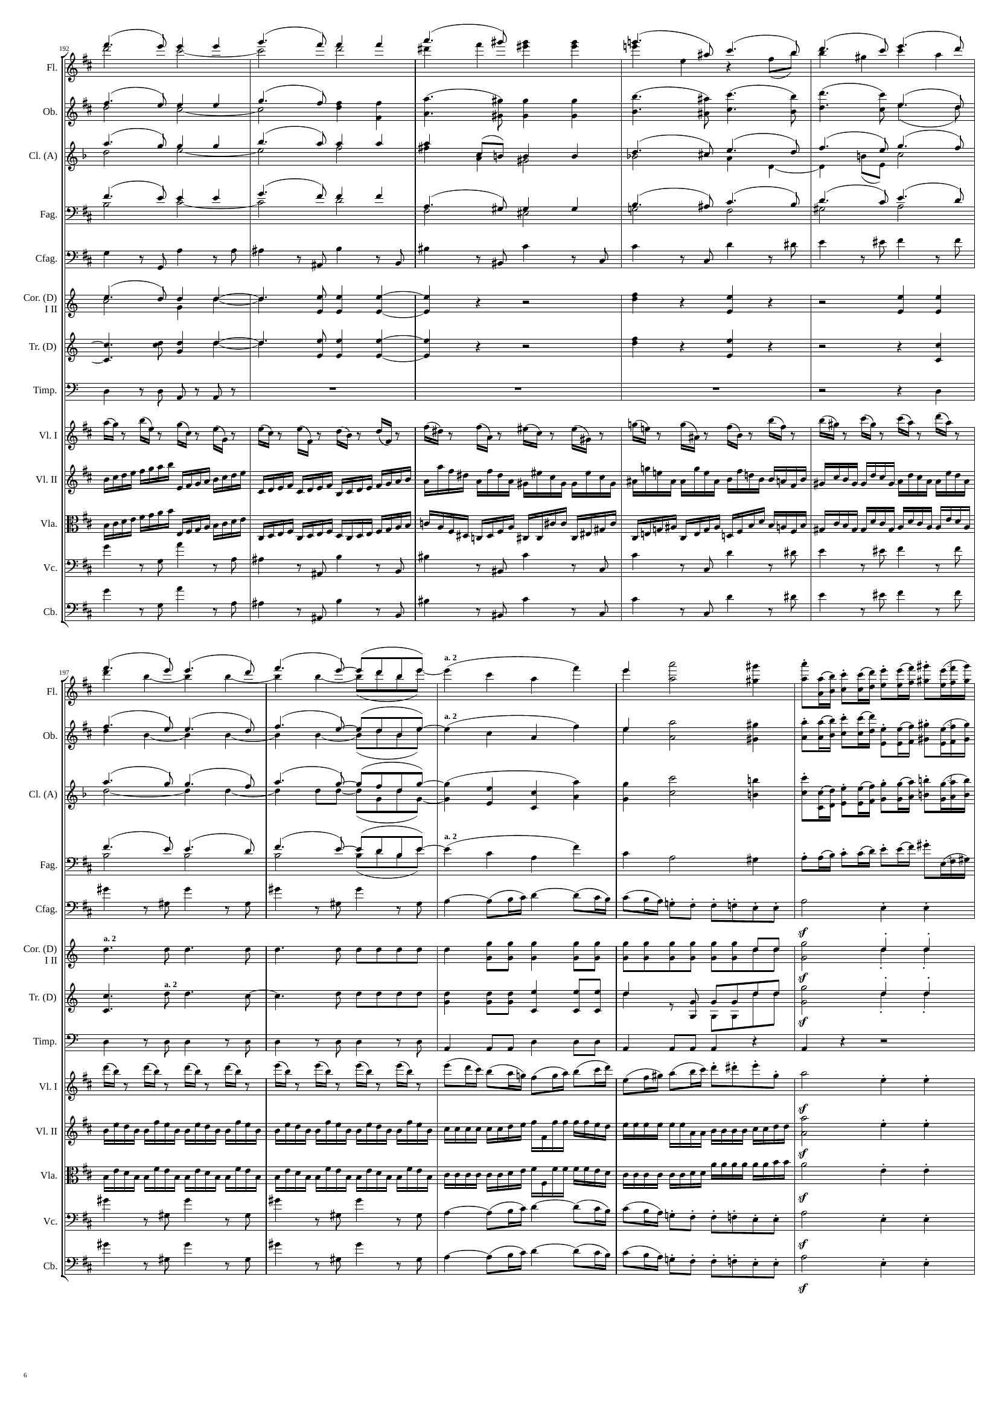
672
mel
680
mel
mel
692
harm
harm
mel
mel
harm
mel
mel
mel
harm
harm
mel
harm
rhythm
mel
rhythm
mel
rhythm
rhythm
rhythm
rhythm
rhythm
rhythm
rhythm
rhythm
692
mel
mel
708
712
harm
rhythm
mel
mel
rhythm
harm
mel
mel
rhythm
harm
mel
mel
rhythm
harm
rhythm
mel
rhythm
mel
rhythm
mel
rhythm
rhythm
mel
rhythm
mel
rhythm
mel
rhythm
mel
rhythm
mel

Slide 7
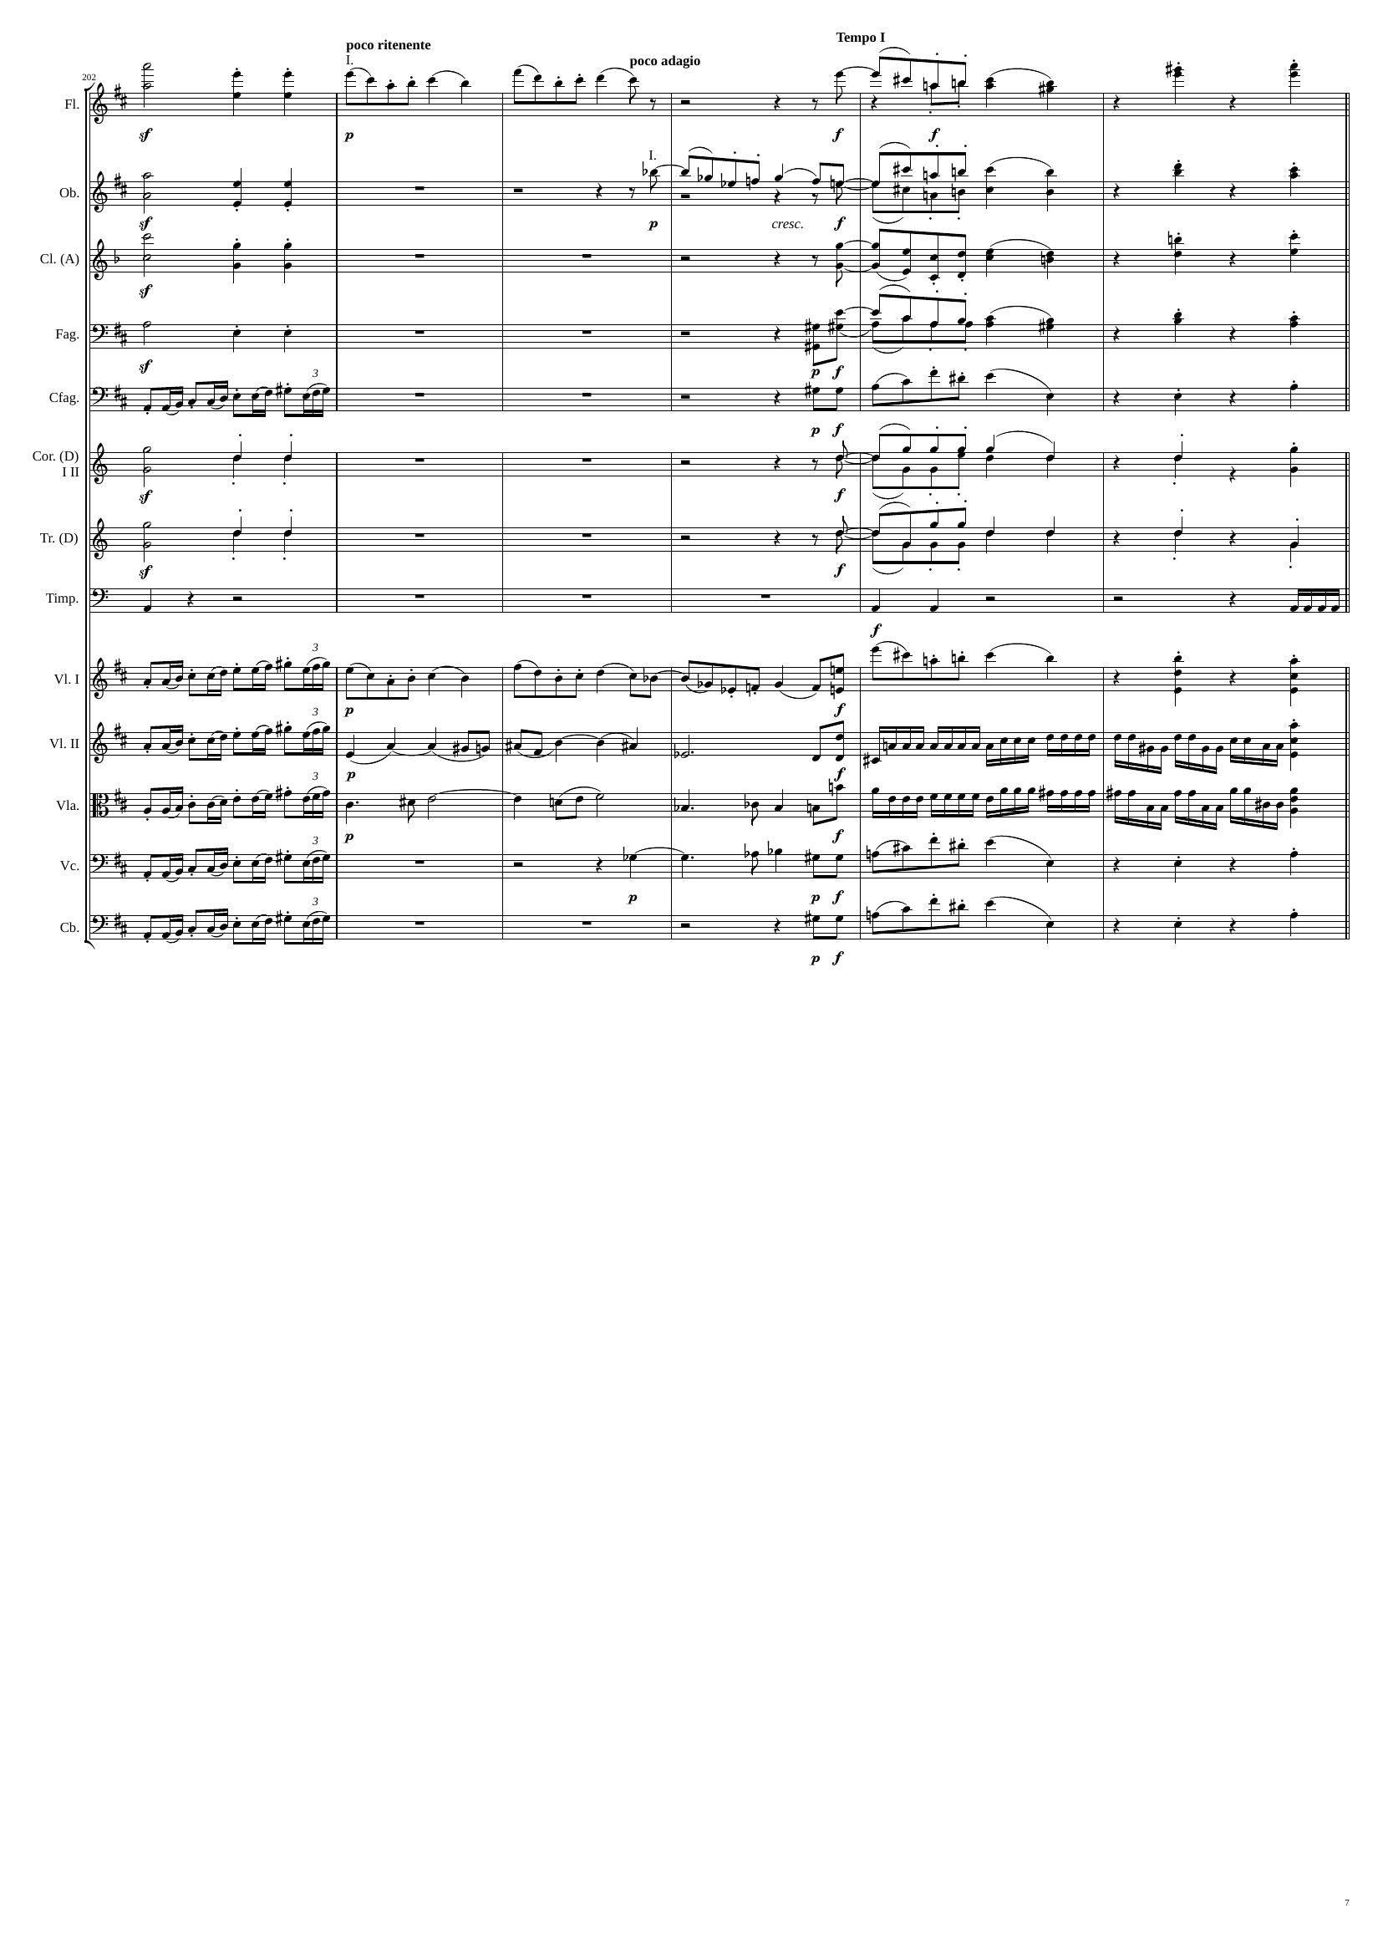
712
716
732
736
mel
mel
rhythm+harm
mel
mel
rhythm+harm
mel
mel
rhythm+harm
mel
mel
rhythm+harm
rhythm
mel
rhythm+harm
mel
mel
rhythm+harm
mel
mel
rhythm+harm
rhythm
rhythm
rhythm
mel
rhythm+harm
rhythm
mel+harm
rhythm
rhythm
mel+harm
rhythm
rhythm
mel+harm
mel
rhythm+harm
rhythm
mel
rhythm+harm

Slide 8
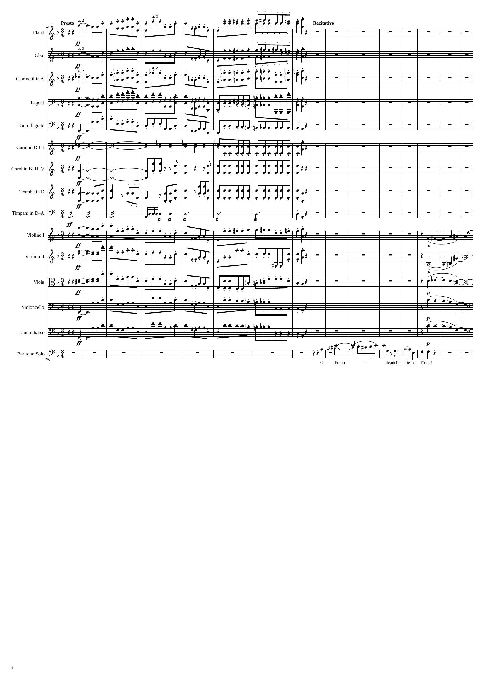
736
760
775
784
mel
mel
mel
mel
mel
rhythm
rhythm
mel
rhythm
rhythm
mel
mel+harm
mel
mel+harm
mel
mel+harm
mel
mel+harm
mel
mel+harm
mel

Slide 9
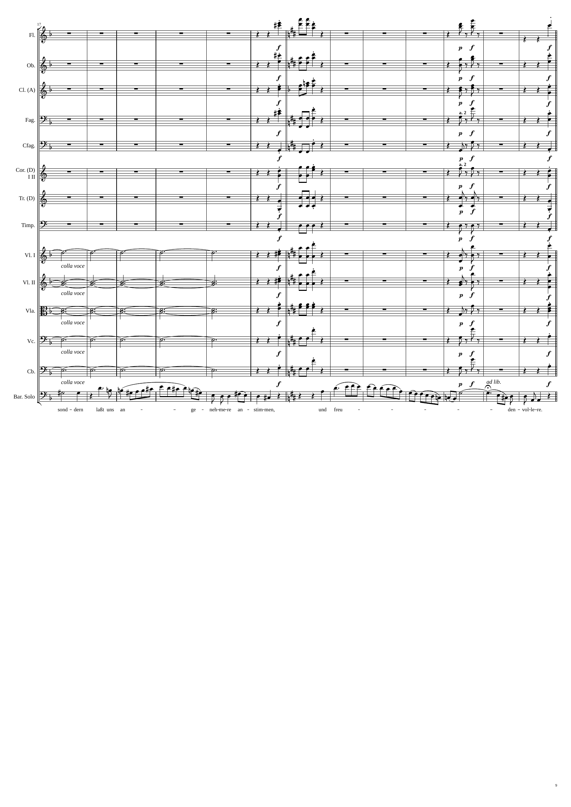
784
799
rhythm+harm
814
rhythm+harm
823
rhythm+harm
rhythm+harm
rhythm+harm
rhythm+harm
rhythm+harm
rhythm+harm
rhythm+harm
rhythm+harm
rhythm+harm
rhythm+harm
rhythm+harm
rhythm+harm
rhythm+harm
rhythm+harm
rhythm+harm
rhythm+harm
rhythm+harm
rhythm+harm
rhythm+harm
rhythm+harm
rhythm+harm
rhythm+harm
harm
rhythm+harm
rhythm+harm
rhythm+harm
harm
rhythm+harm
rhythm+harm
rhythm+harm
harm
rhythm+harm
rhythm+harm
rhythm+harm
harm
rhythm+harm
rhythm+harm
rhythm+harm
harm
rhythm+harm
rhythm+harm
rhythm+harm
mel
mel

Slide 10
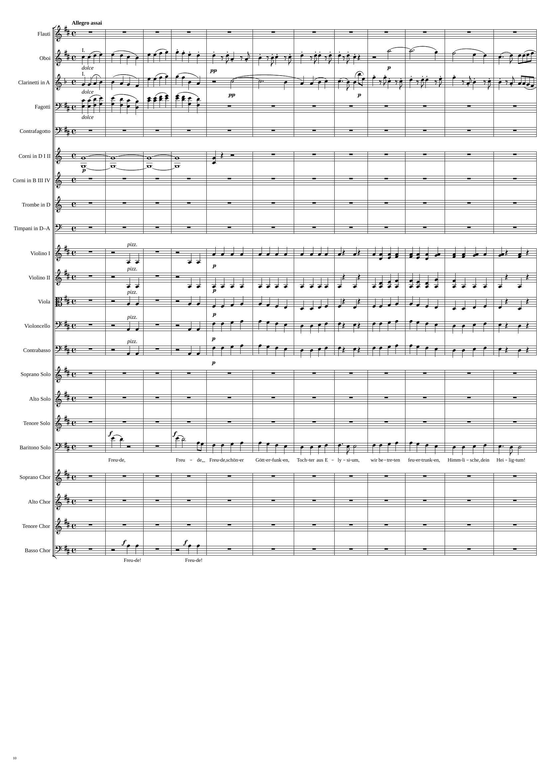
823
839
855
871
mel
rhythm
mel+harm
rhythm
mel
harm
rhythm
mel
harm
rhythm
mel+harm
rhythm
mel+harm
rhythm
rhythm
mel
rhythm
mel
rhythm
mel
mel
mel

Slide 11
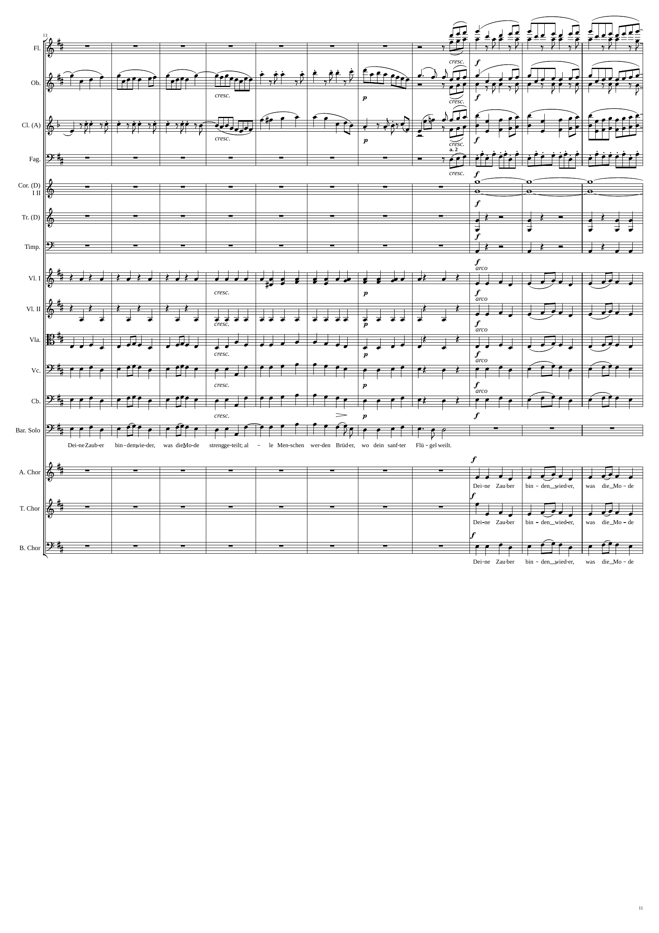
871
903
915
rhythm
rhythm
rhythm
rhythm
rhythm
mel+rhythm
harm
rhythm
rhythm
rhythm
mel+harm
rhythm
mel
rhythm
mel
mel
mel
mel
mel
mel
mel
mel
mel
mel
mel

Slide 12
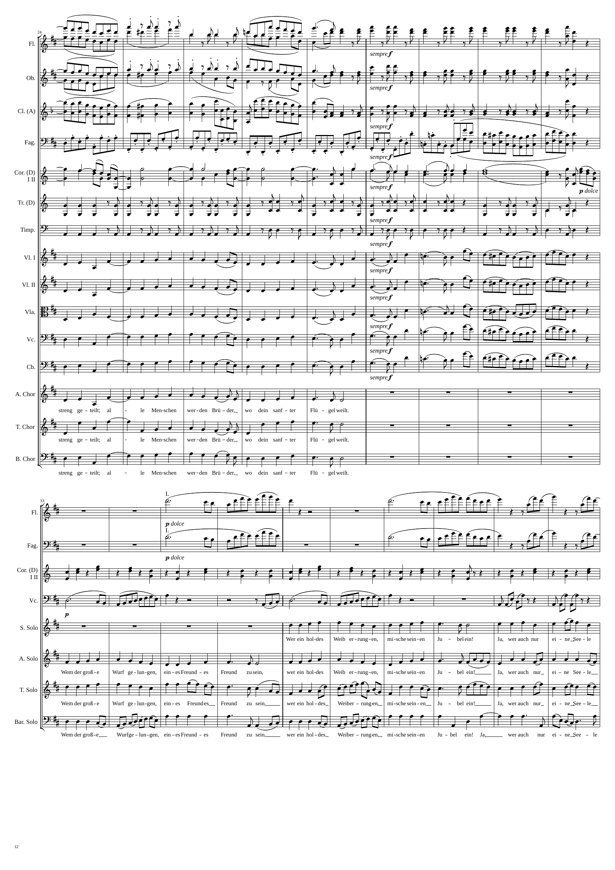
915
rhythm
rhythm
935
951
rhythm
mel
rhythm+harm
rhythm
rhythm
rhythm
rhythm+harm
mel
rhythm
mel
rhythm
rhythm+harm
mel+rhythm
rhythm
mel
rhythm
rhythm
rhythm
rhythm
rhythm
rhythm
mel
mel
mel
mel
mel
mel
mel
mel
mel
mel
mel
mel
mel
951
rhythm
991
rhythm
rhythm+harm
rhythm
mel
mel
mel
mel
mel
mel+rhythm

Slide 13
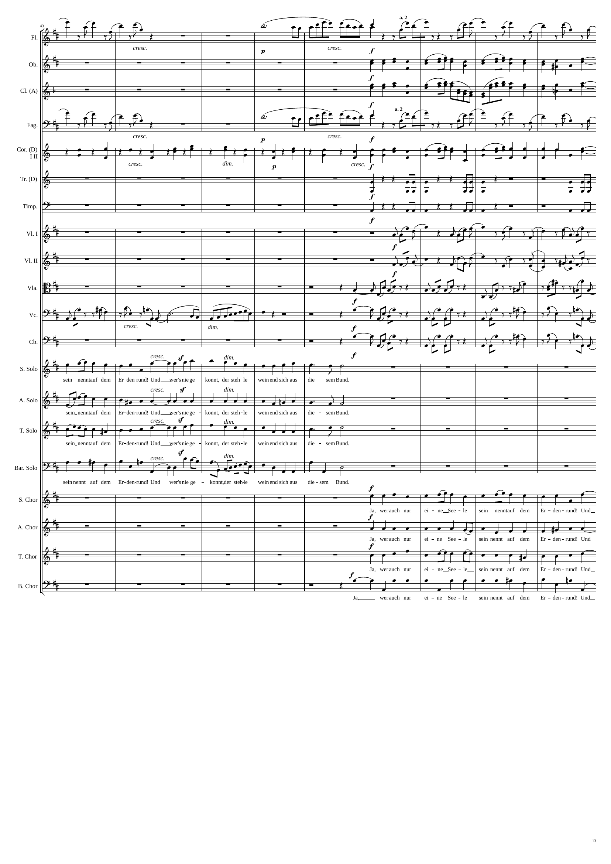
991
1015
1031
rhythm
rhythm
mel
mel
rhythm
rhythm
rhythm+harm
mel
rhythm
rhythm
rhythm
rhythm
rhythm
rhythm
rhythm
rhythm
mel
mel
mel
mel+rhythm
mel
mel+rhythm
mel
mel+rhythm

Slide 14
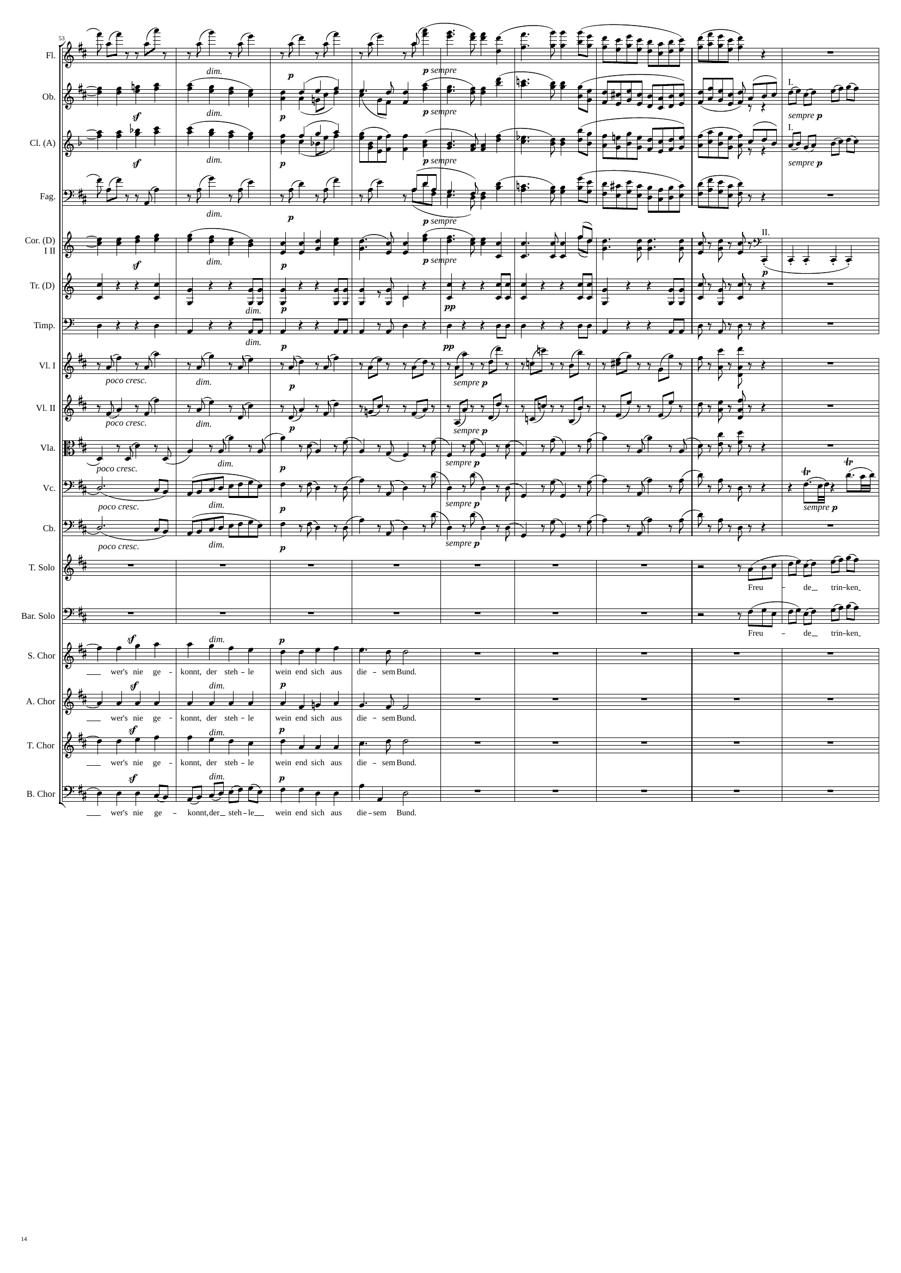
1031
rhythm
1047
1067
mel
mel
mel
mel
mel
mel
mel
rhythm
mel
mel
rhythm
rhythm
rhythm
rhythm
rhythm
rhythm
rhythm
rhythm
rhythm
rhythm
mel
mel
mel
mel+rhythm
mel
mel+rhythm

Slide 15
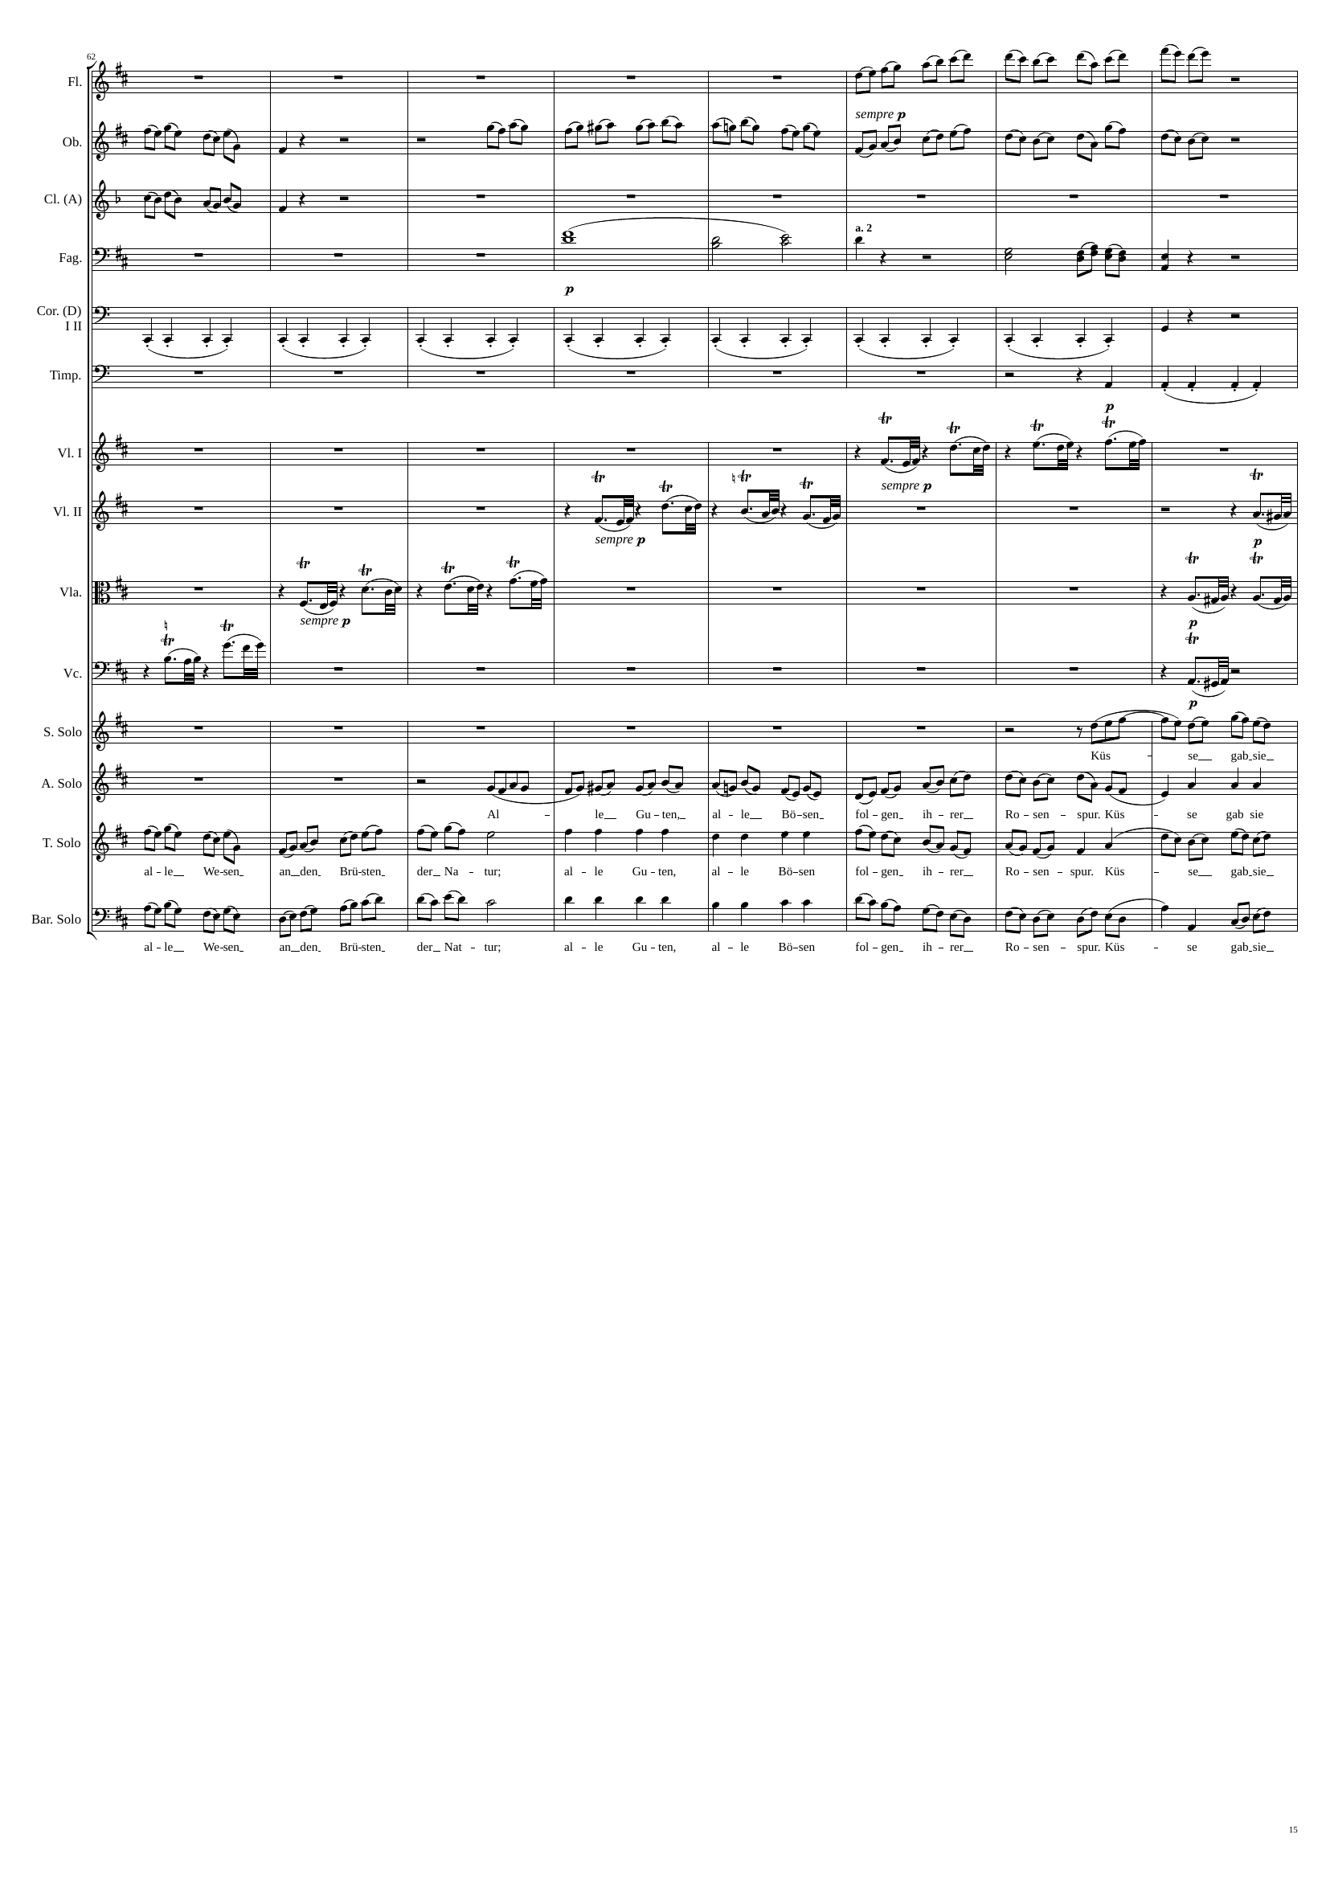
1067
1079
mel
1099
mel
mel
mel
harm
rhythm
rhythm
rhythm
rhythm
rhythm
rhythm
rhythm
rhythm
rhythm
mel
mel
mel
mel+rhythm
mel
mel
mel+rhythm
mel

Slide 16
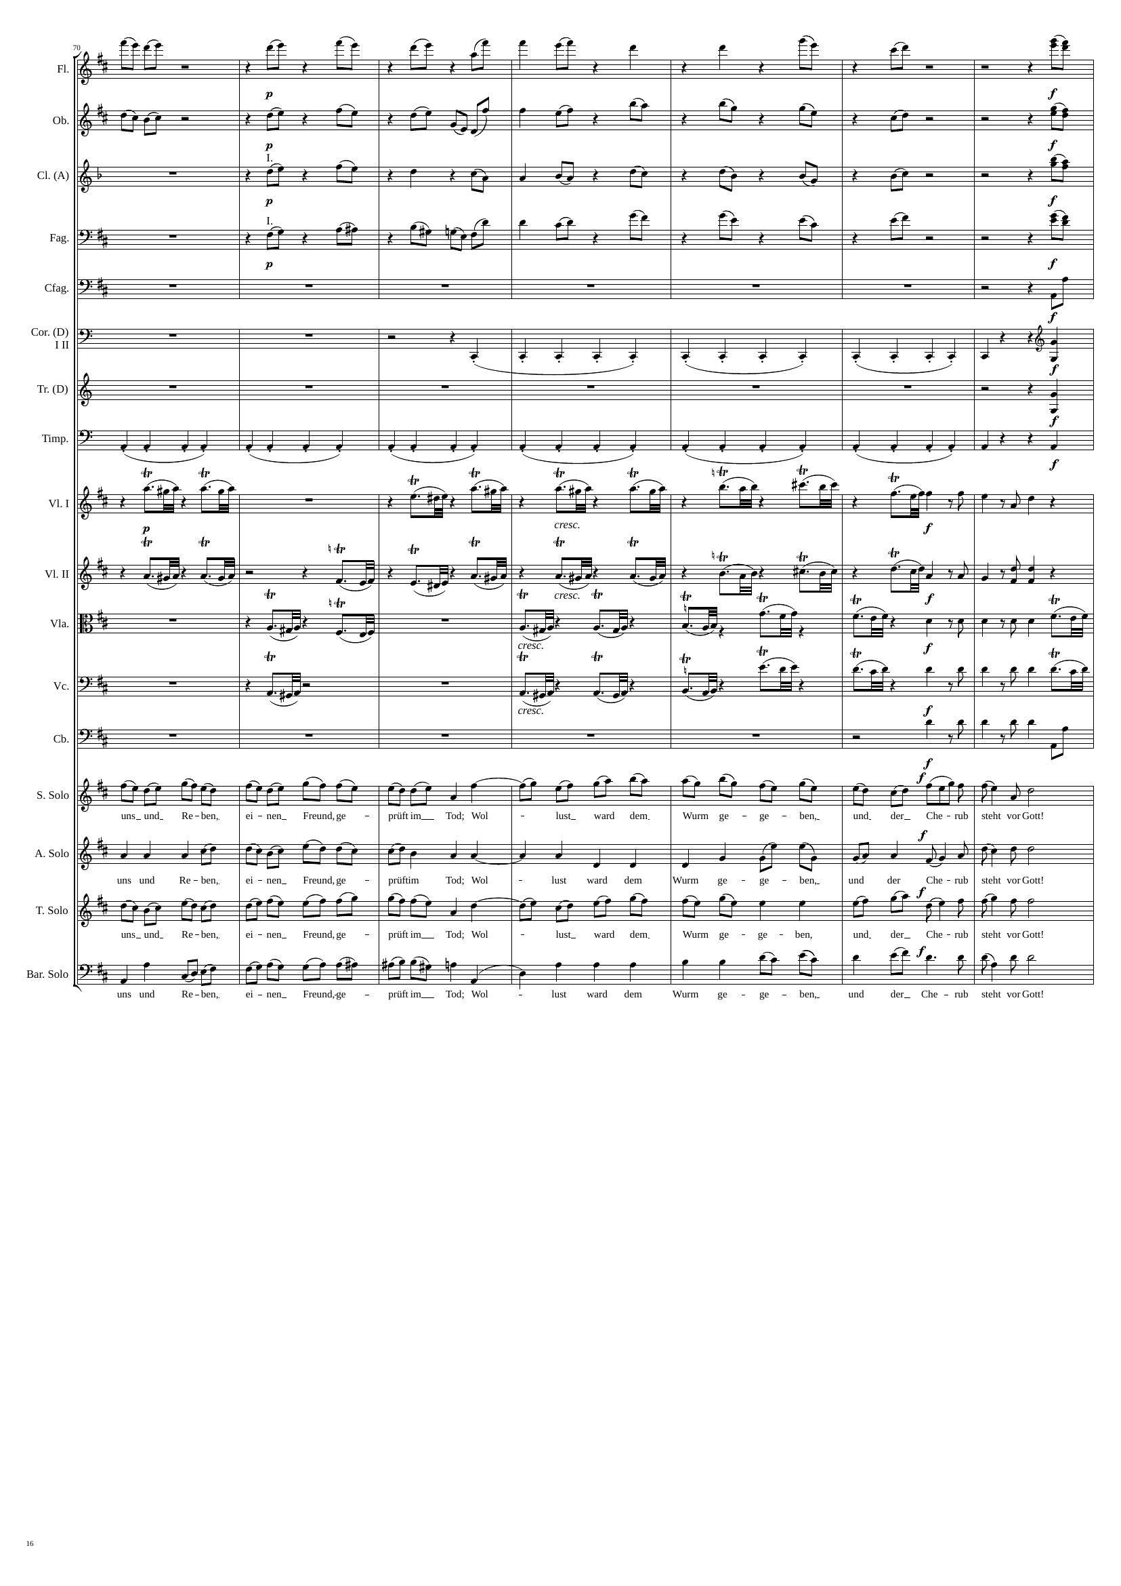
1099
mel
rhythm
mel
1127
mel
rhythm
mel
rhythm
mel
rhythm
mel
rhythm
rhythm
rhythm
rhythm
rhythm
rhythm
rhythm
rhythm
rhythm
mel
mel
mel
mel

Slide 17
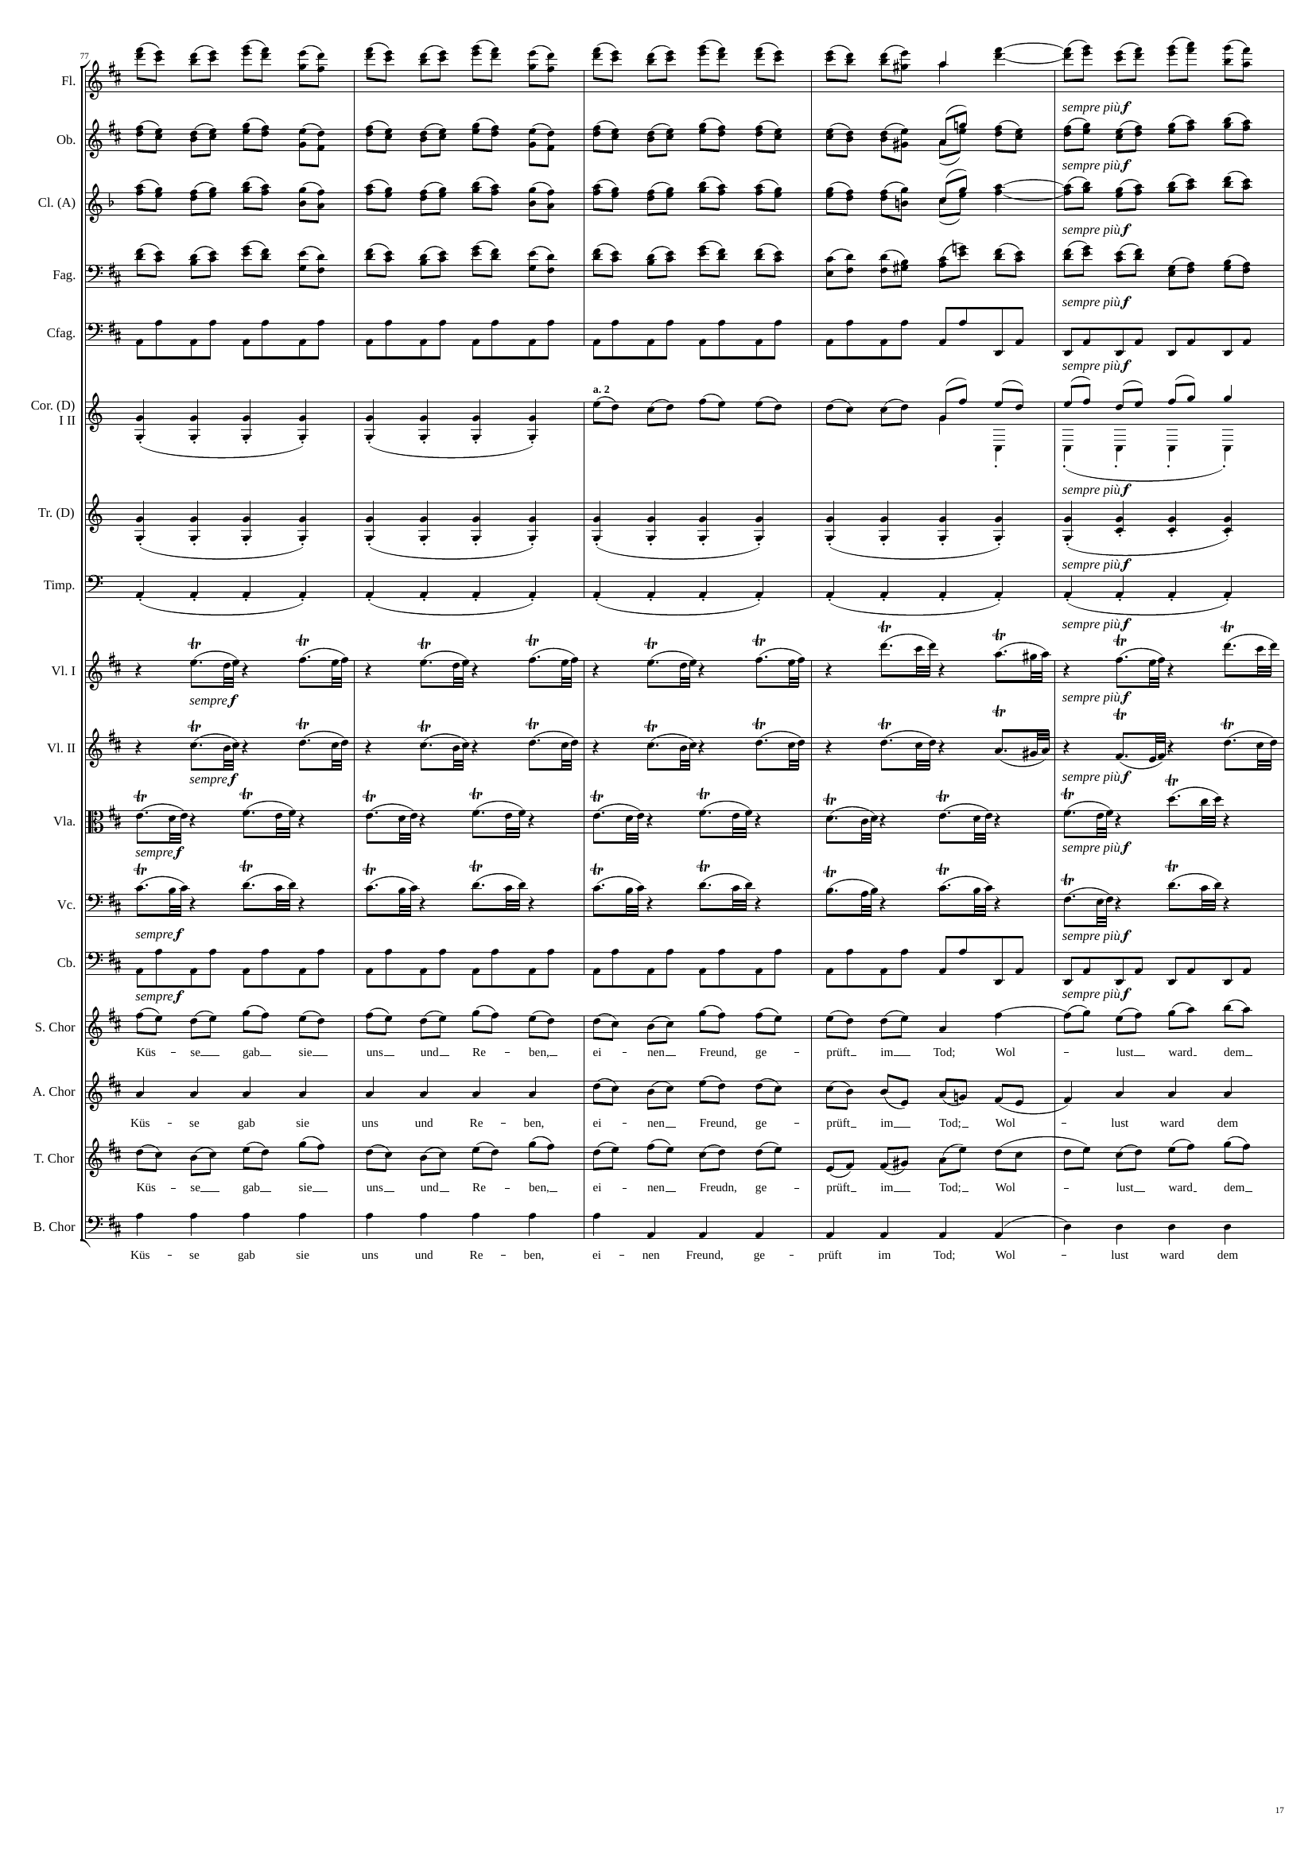
1127
mel
1147
mel
mel
mel
rhythm
rhythm
mel
mel
rhythm
rhythm
rhythm+harm
rhythm
rhythm
rhythm
rhythm
rhythm
rhythm
mel
mel+rhythm
mel
mel
rhythm

Slide 18
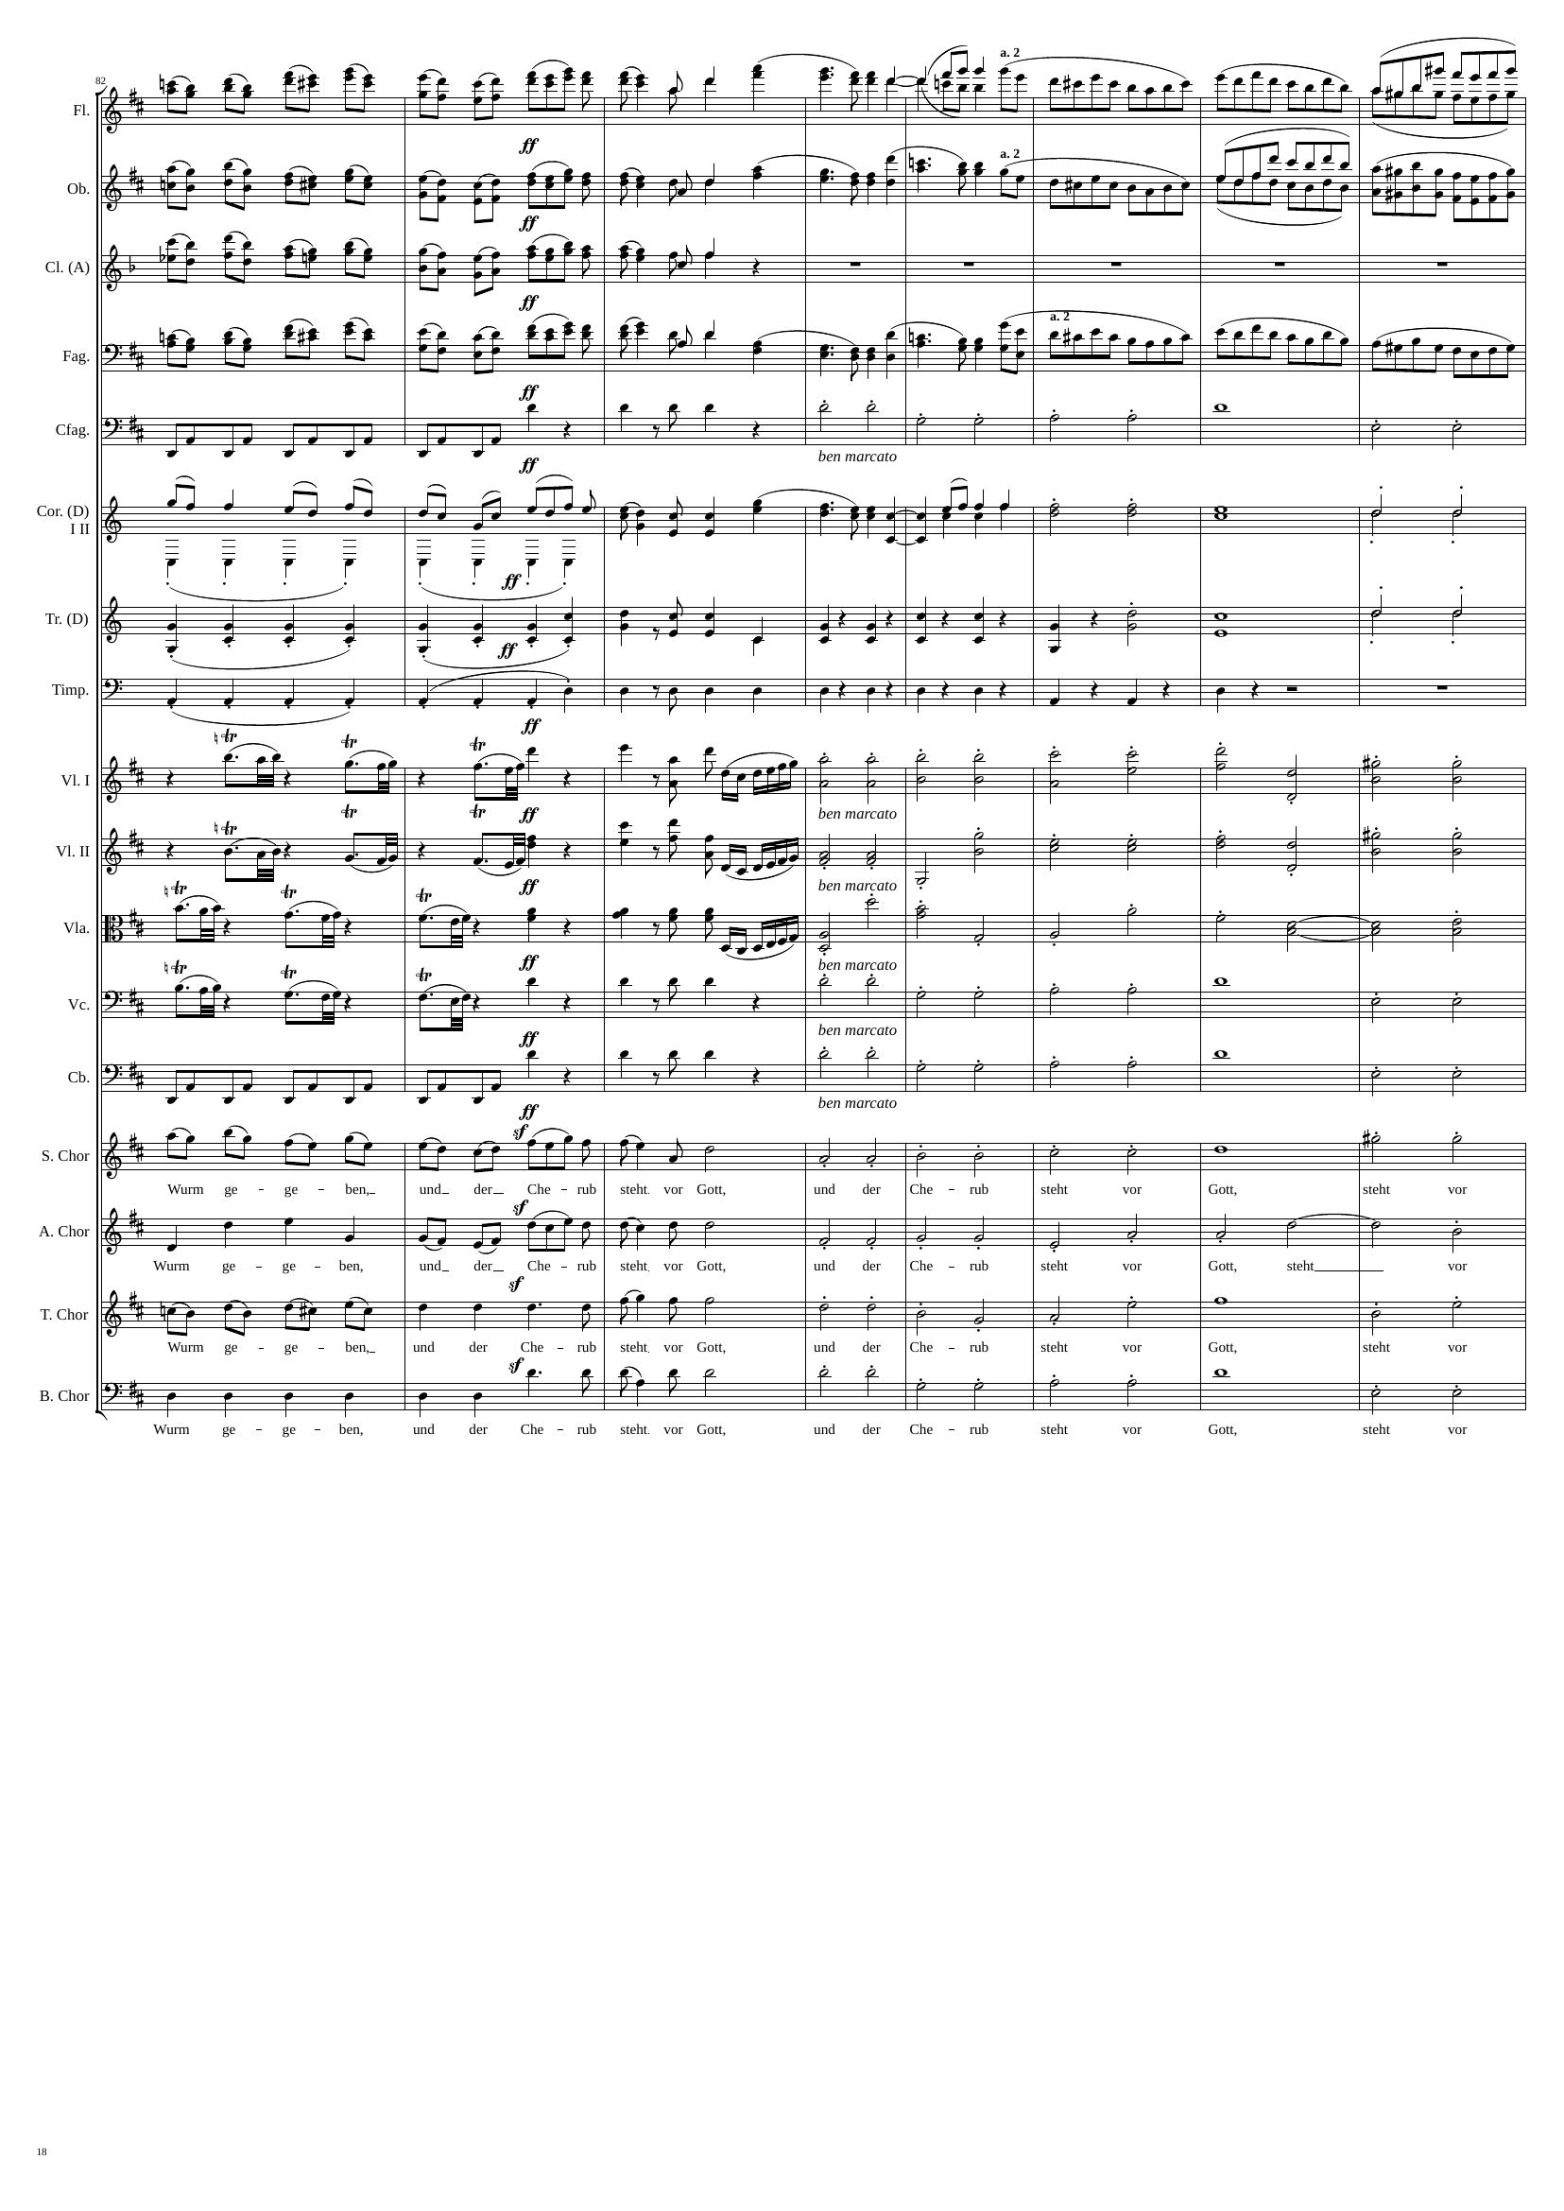
1147
1159
1179
mel
mel
rhythm
mel
mel
rhythm
mel
mel
mel
rhythm
rhythm
rhythm+harm
mel
mel
mel
rhythm+harm
rhythm
rhythm+harm
rhythm+harm
rhythm
rhythm
rhythm+harm
rhythm
rhythm+harm
rhythm
rhythm+harm
rhythm
rhythm+harm
rhythm
rhythm+harm
mel
rhythm+harm
mel
rhythm+harm
mel
rhythm+harm
rhythm
rhythm+harm

Slide 19
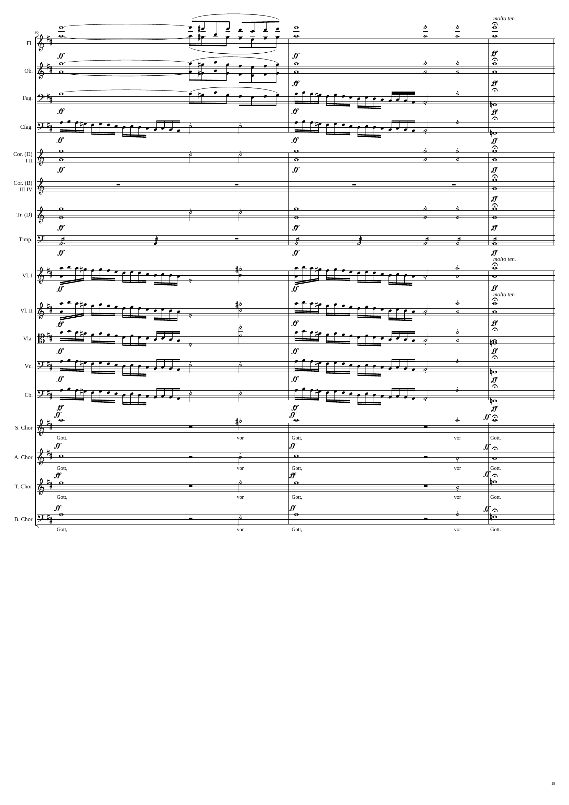
1179
rhythm+harm
rhythm
1199
rhythm+harm
rhythm+harm
rhythm
rhythm+harm
rhythm+harm
rhythm
rhythm+harm
rhythm
rhythm+harm
rhythm
rhythm+harm
rhythm+harm
rhythm+harm
rhythm+harm
rhythm
rhythm+harm
rhythm
rhythm+harm
rhythm
rhythm+harm
rhythm
rhythm+harm
rhythm
rhythm+harm
rhythm
rhythm+harm
rhythm
rhythm+harm
rhythm
rhythm+harm
rhythm
rhythm+harm
rhythm
rhythm+harm
rhythm
rhythm+harm
rhythm+harm
rhythm+harm
rhythm+harm
rhythm+harm

Slide 20
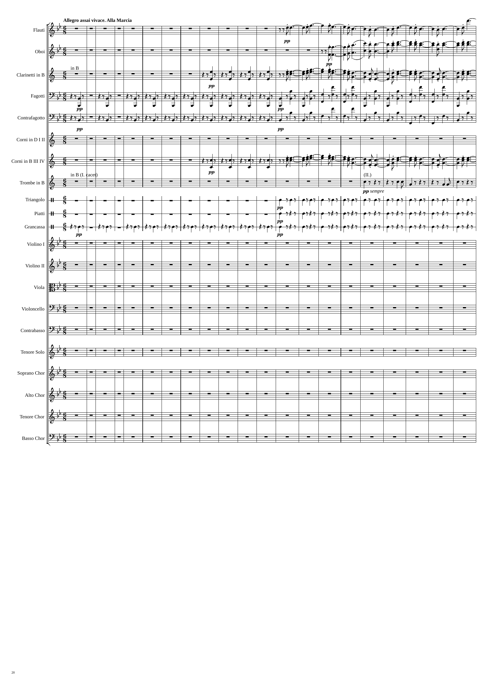
1199
1223
1235
1262
mel
mel
rhythm
mel
rhythm
rhythm
rhythm
mel
rhythm
rhythm
rhythm
rhythm

Slide 21
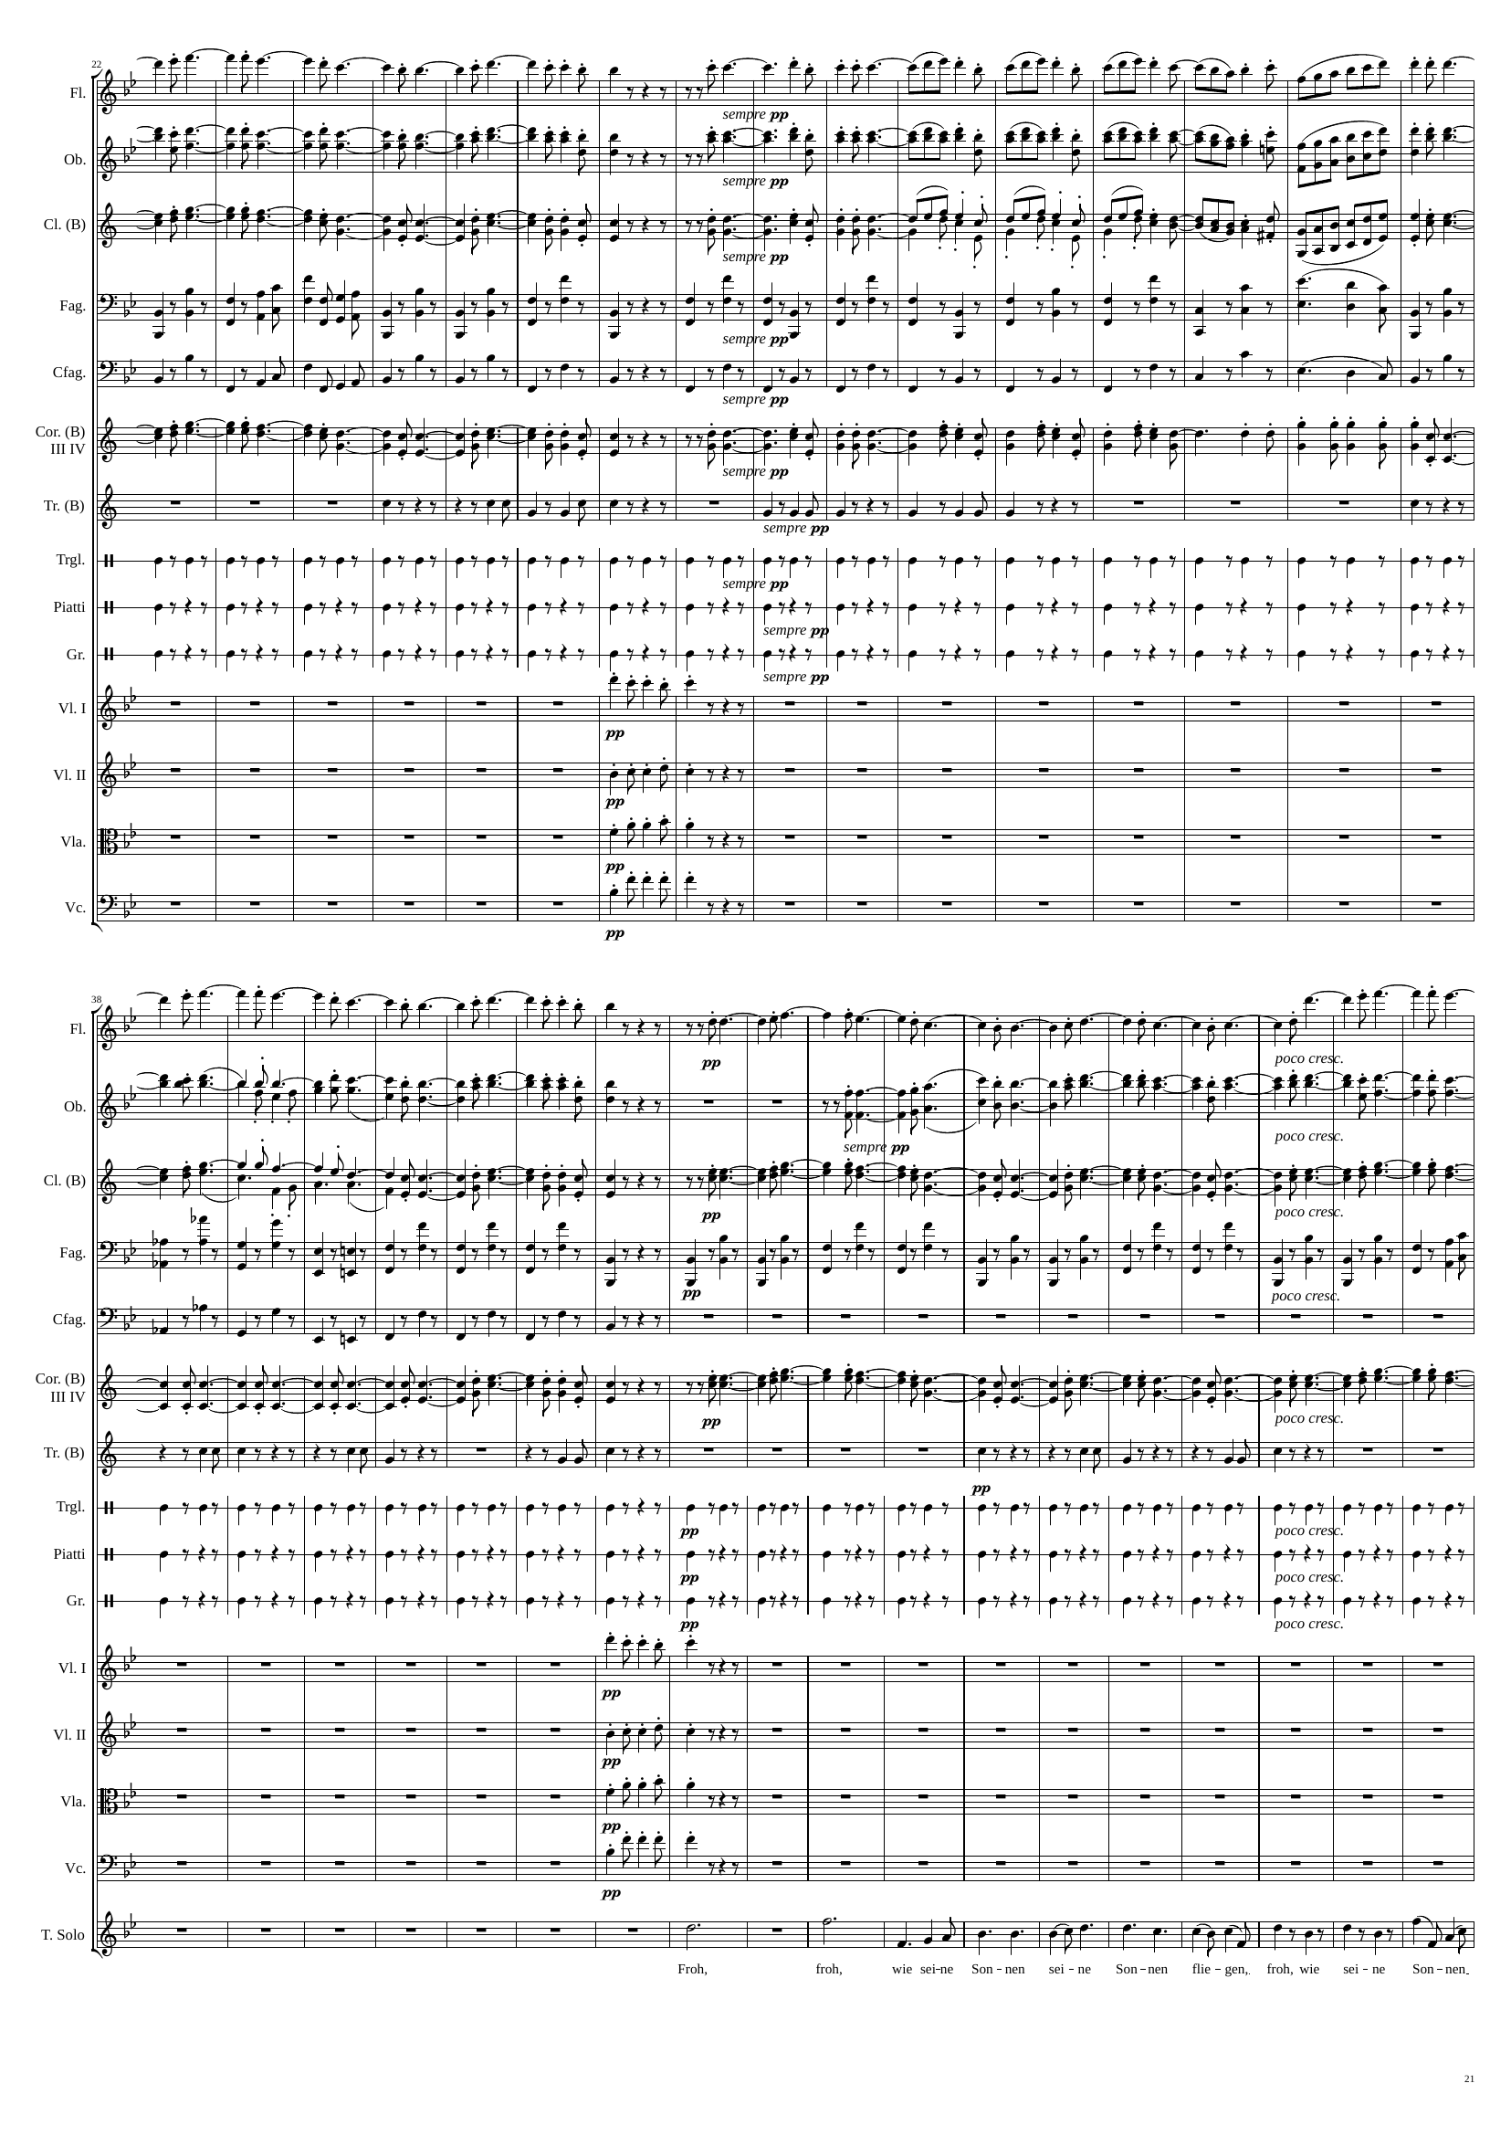
1262
1283
mel
1310
mel
mel
mel
mel
mel
rhythm
rhythm
mel
mel
rhythm
rhythm
rhythm
rhythm
rhythm
mel
mel
mel
mel
1310
1331
mel
1364
mel
mel
mel
mel
mel
rhythm
vv
rhythm
vv
rhythm
vv
rhythm
vv
mel
rhythm
rhythm
vv
rhythm
rhythm
rhythm
mel
mel
mel
mel
mel

Slide 22
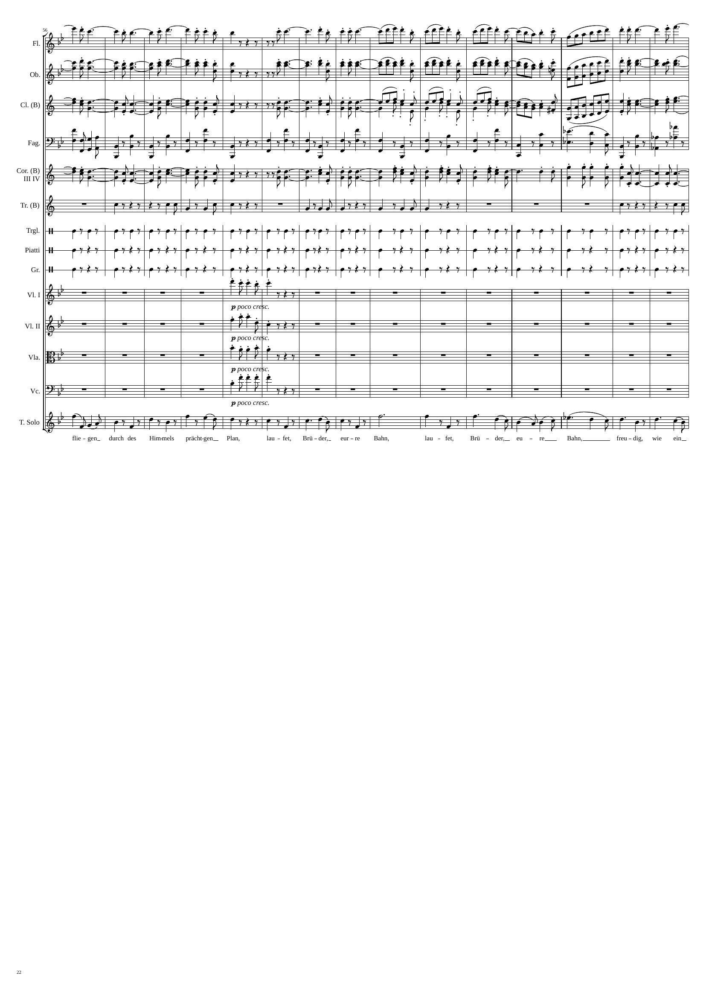
1364
1397
1409
mel
mel
mel
rhythm
mel
rhythm
rhythm
rhythm
rhythm
rhythm
rhythm
mel
mel
mel
mel
mel

Slide 23
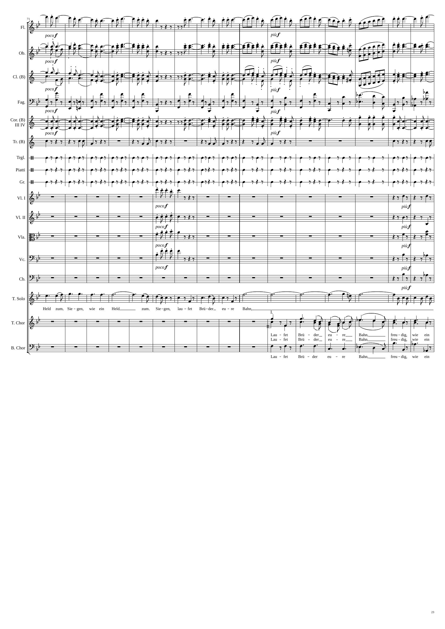
1409
1424
1439
1457
mel
mel
mel
rhythm
rhythm
rhythm
rhythm
rhythm
rhythm
mel
rhythm
mel
rhythm
mel
rhythm
mel
rhythm
rhythm
mel
mel
mel

Slide 24
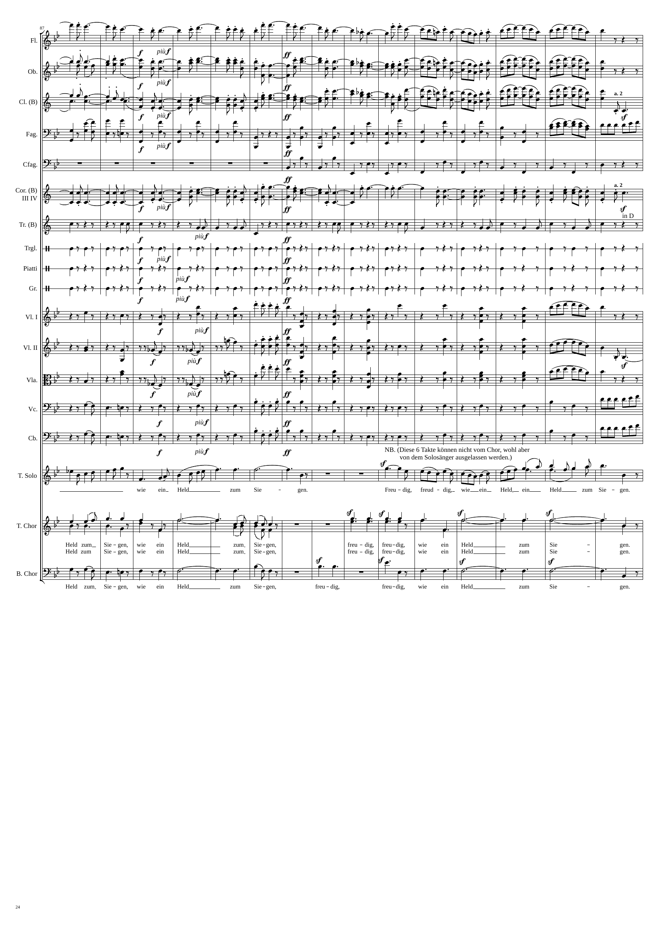
1457
1475
1493
1502
mel
rhythm
mel
rhythm
mel
rhythm
rhythm
rhythm
rhythm
rhythm
rhythm
rhythm
rhythm
rhythm
rhythm
rhythm+harm
rhythm
rhythm
rhythm+harm
rhythm
rhythm
rhythm+harm
rhythm
rhythm
rhythm
rhythm
rhythm
rhythm
rhythm
mel
mel
mel

Slide 25
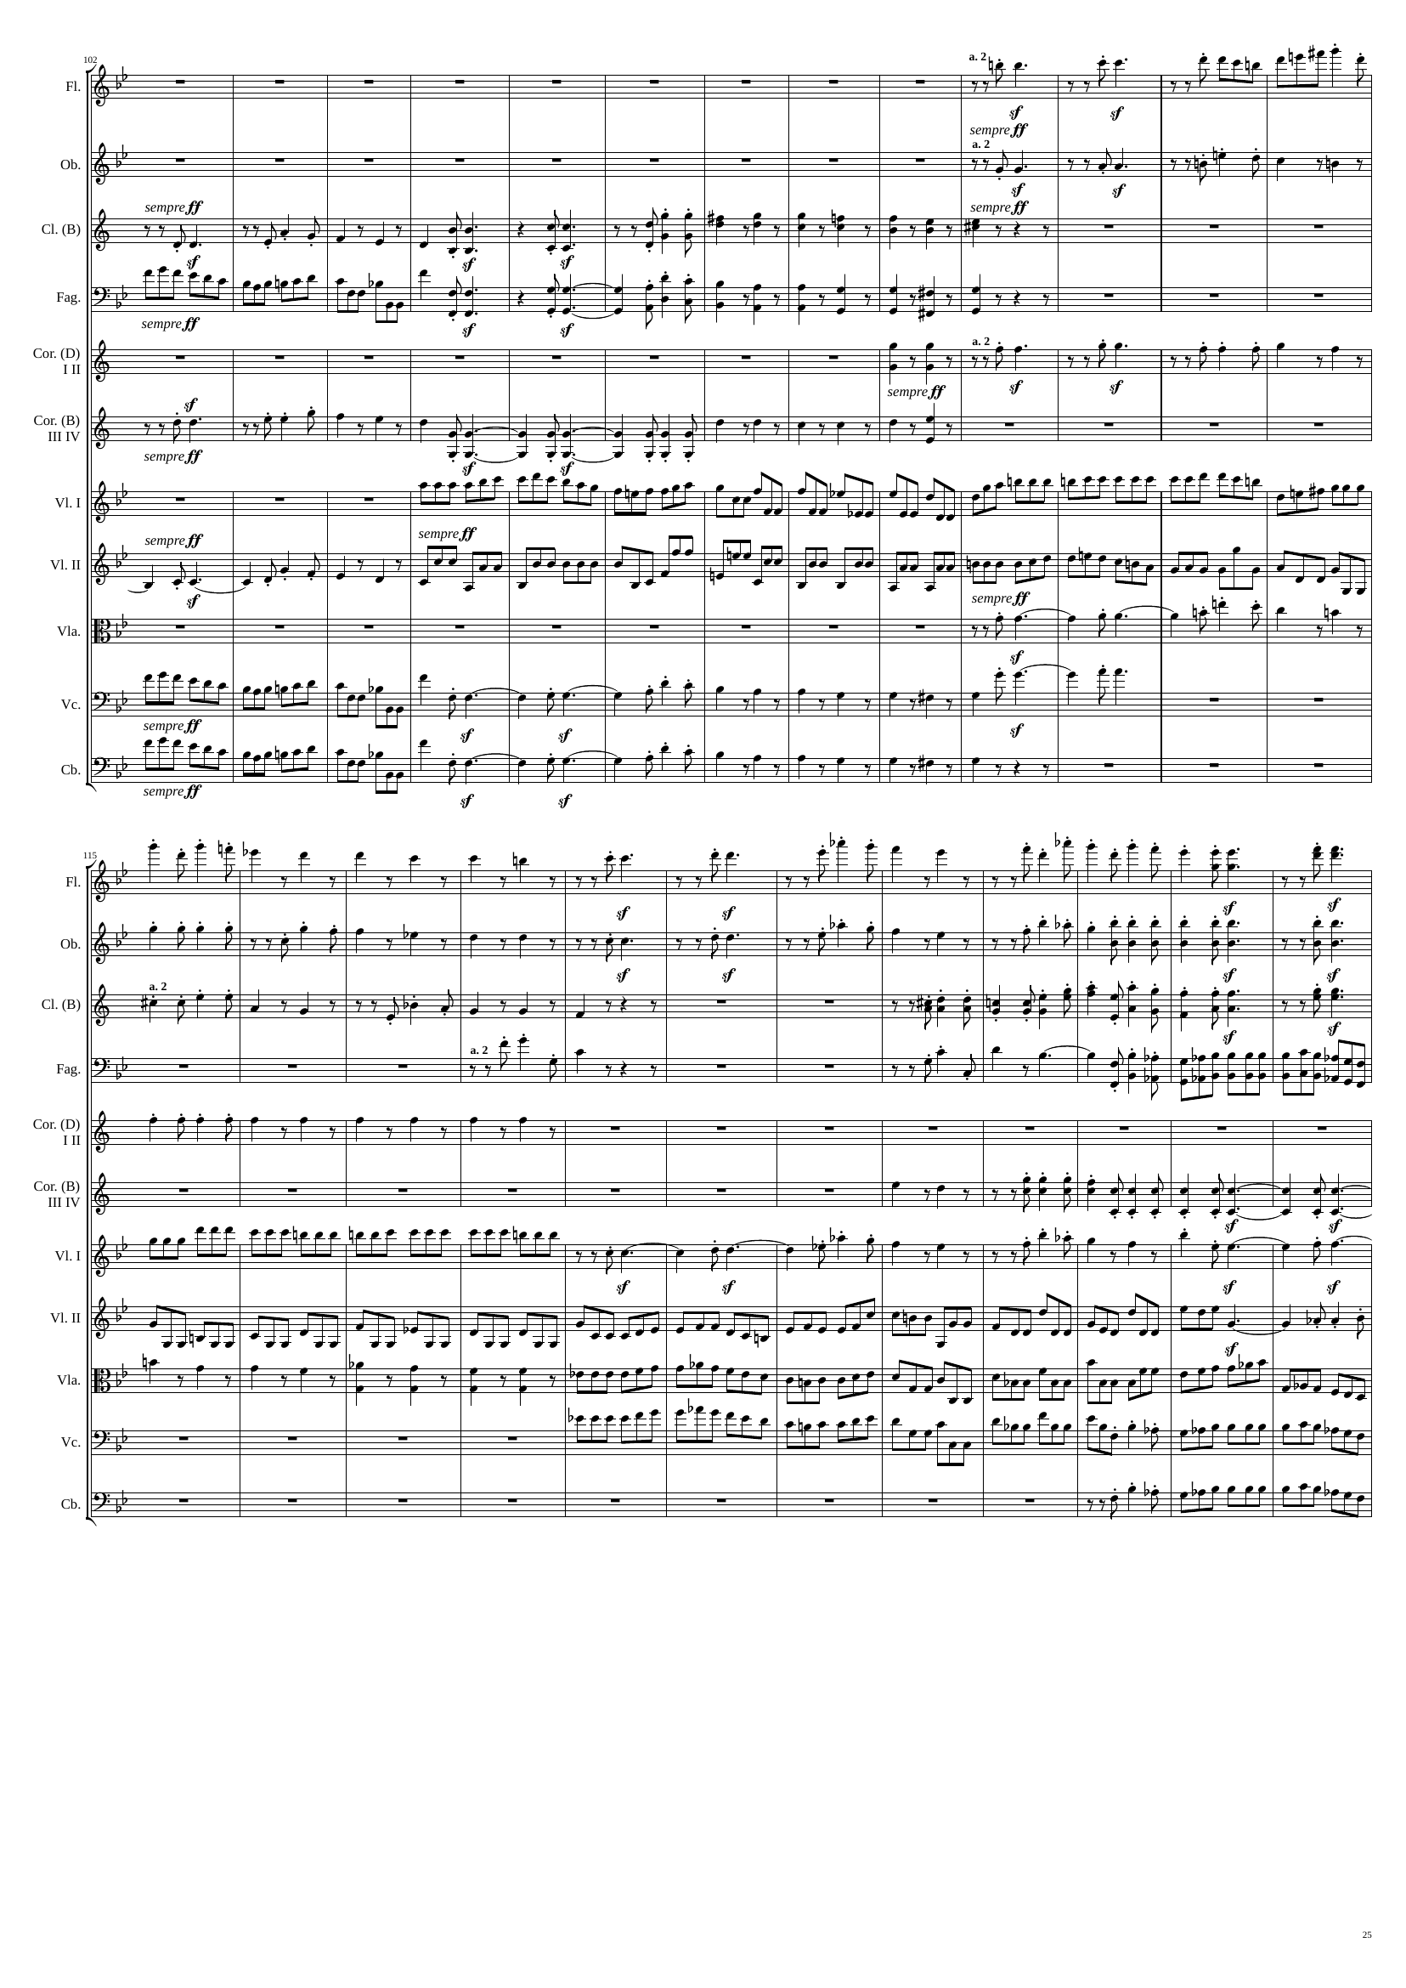
1502
1511
1529
1541
mel
mel
mel
rhythm
mel
rhythm
mel
rhythm
mel+rhythm
mel
mel+rhythm
mel
rhythm
mel
rhythm
mel
1541
1553
1577
mel
mel
rhythm
mel
rhythm
rhythm
rhythm
rhythm
mel+rhythm
mel
mel+rhythm
rhythm
mel
rhythm
rhythm
rhythm

Slide 26
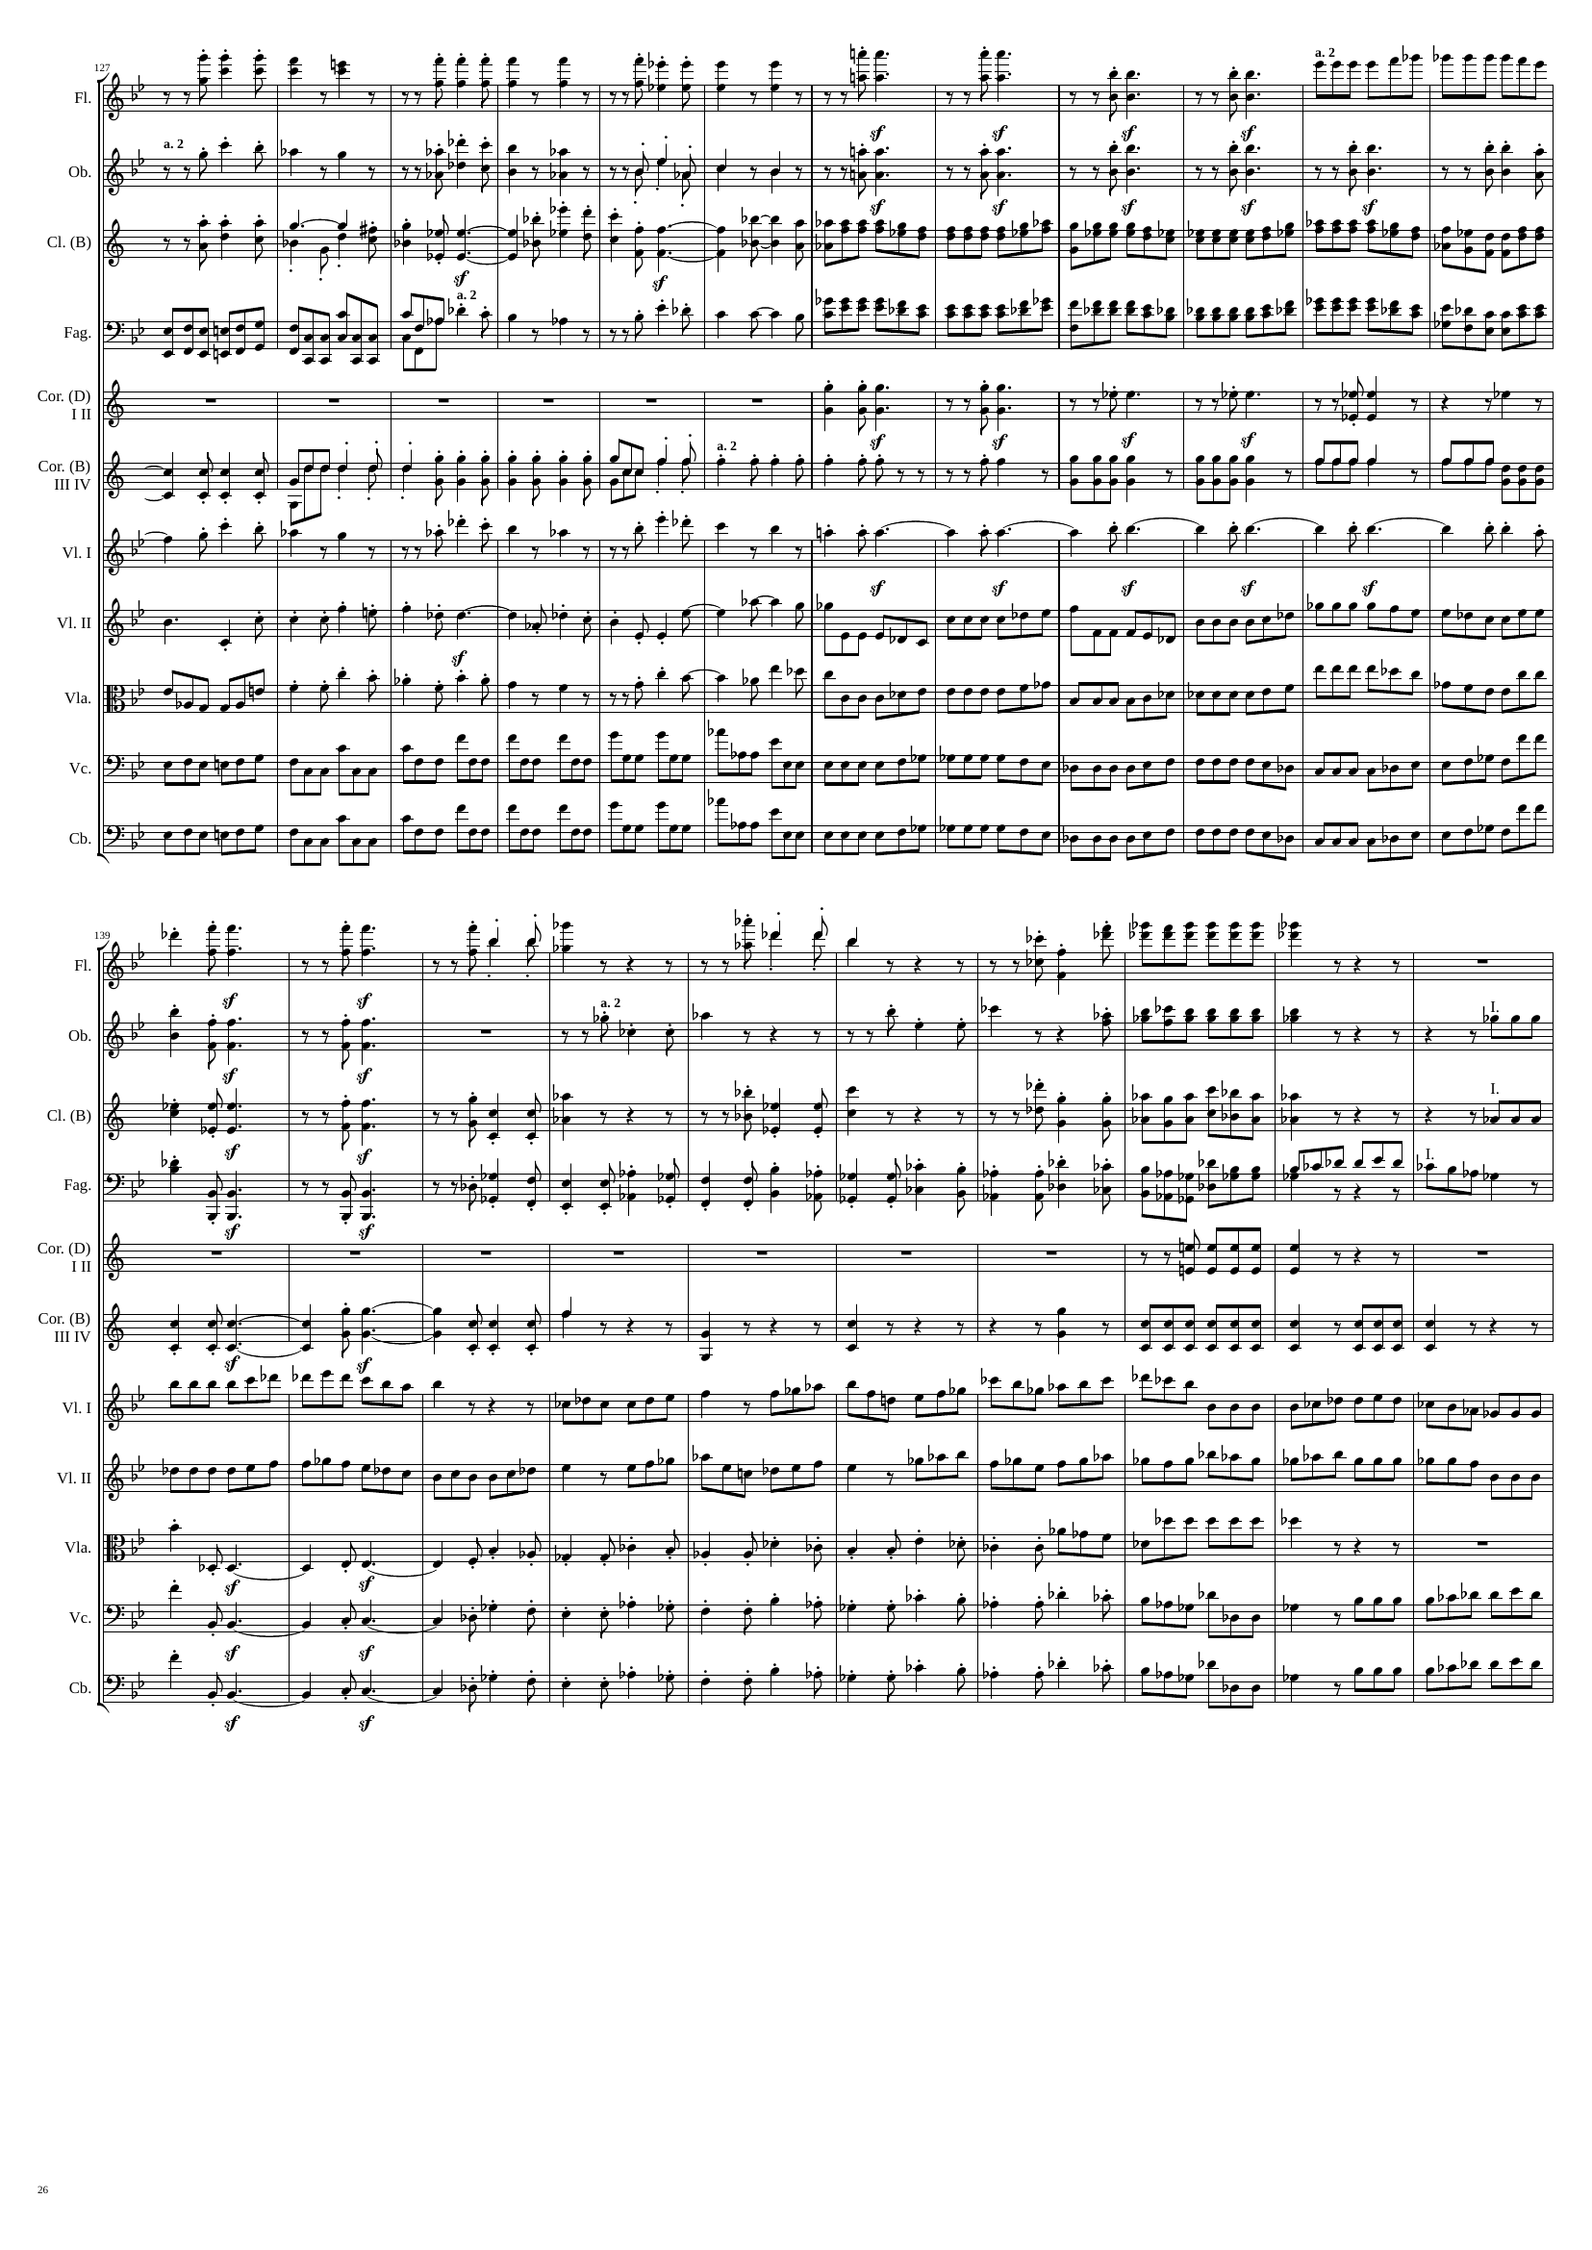
1577
1595
mel
1613
rhythm
rhythm
mel
mel
rhythm
rhythm
rhythm
rhythm
mel
rhythm
rhythm
mel
mel
mel
rhythm
rhythm
mel
rhythm
rhythm
mel+rhythm
rhythm
rhythm
mel+rhythm
rhythm
1613
1619
1637
1643
mel
rhythm
mel
rhythm
rhythm
mel
rhythm
rhythm
mel
rhythm
rhythm
rhythm
rhythm
mel+rhythm
rhythm
mel+rhythm
rhythm
rhythm
rhythm
rhythm
rhythm
rhythm

Slide 27
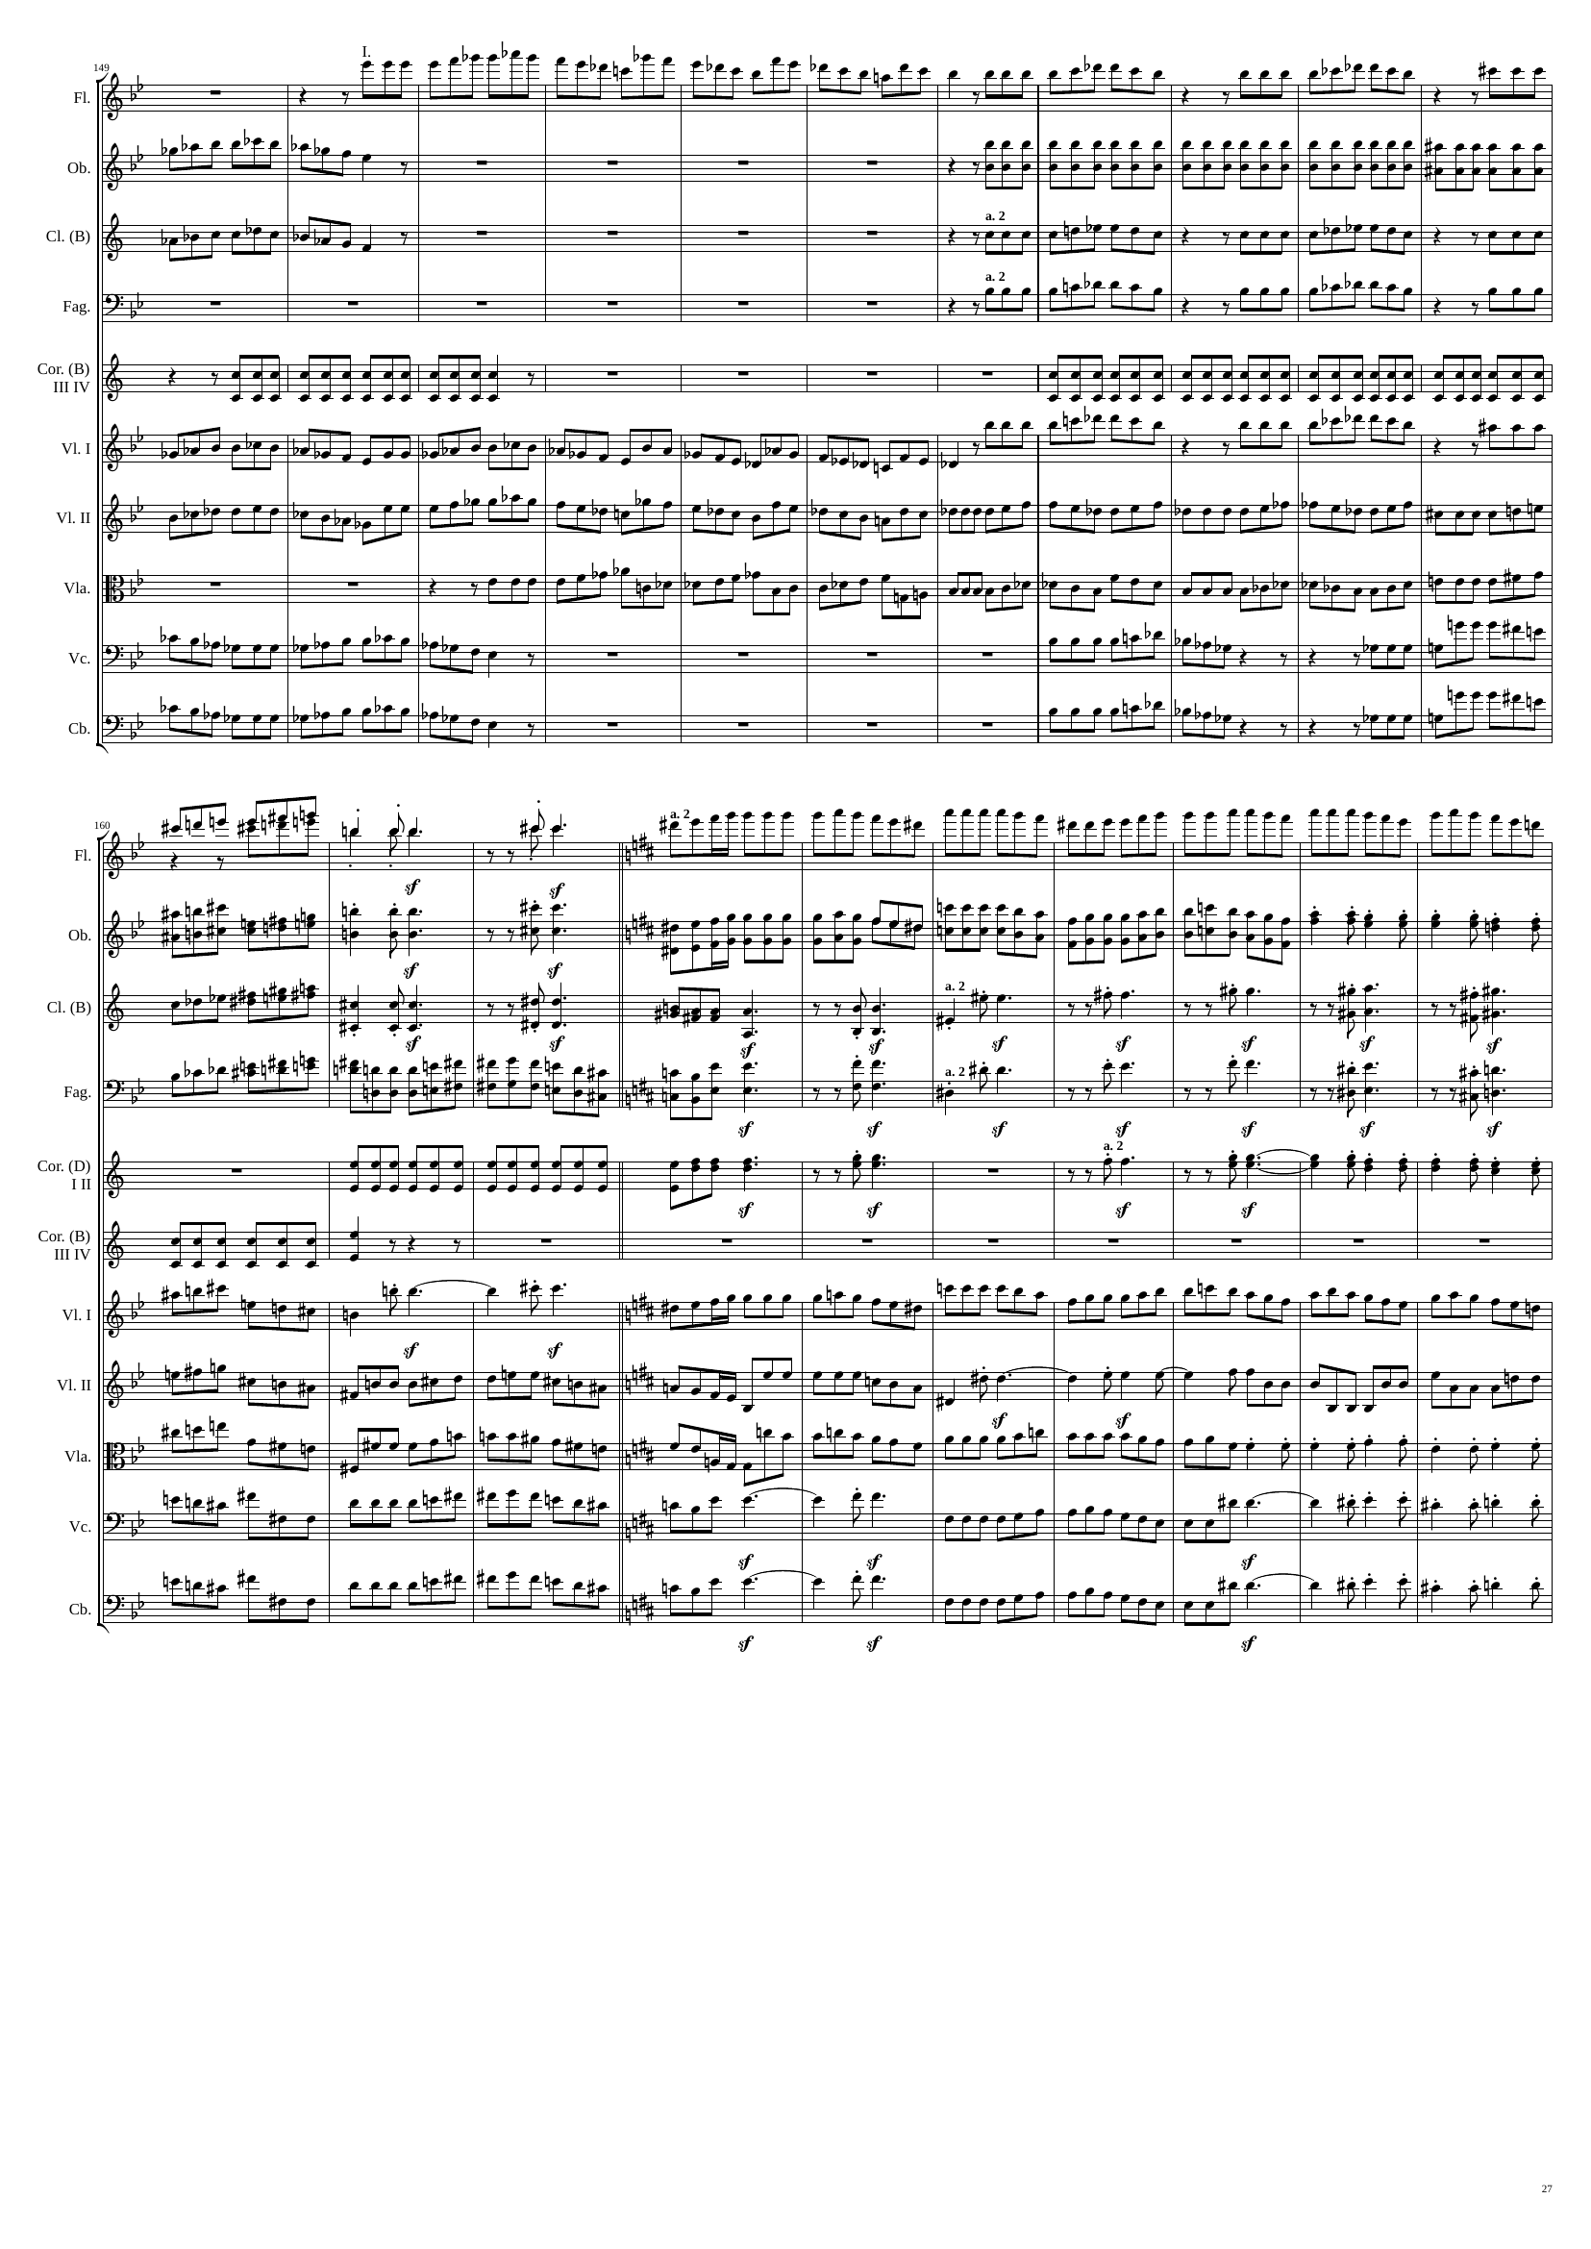
1643
1652
1661
1676
rhythm
mel
rhythm
rhythm
rhythm
mel
mel
rhythm
rhythm
rhythm
mel
rhythm
rhythm
rhythm
rhythm
rhythm
mel
rhythm
rhythm
mel
rhythm
1676
mel
1685
1706
rhythm
mel
rhythm
mel
mel
rhythm
mel
rhythm
rhythm
rhythm
mel
rhythm
rhythm
rhythm
rhythm
rhythm
rhythm
mel
rhythm
mel+rhythm
rhythm
rhythm
mel
rhythm
mel+rhythm
rhythm

Slide 28
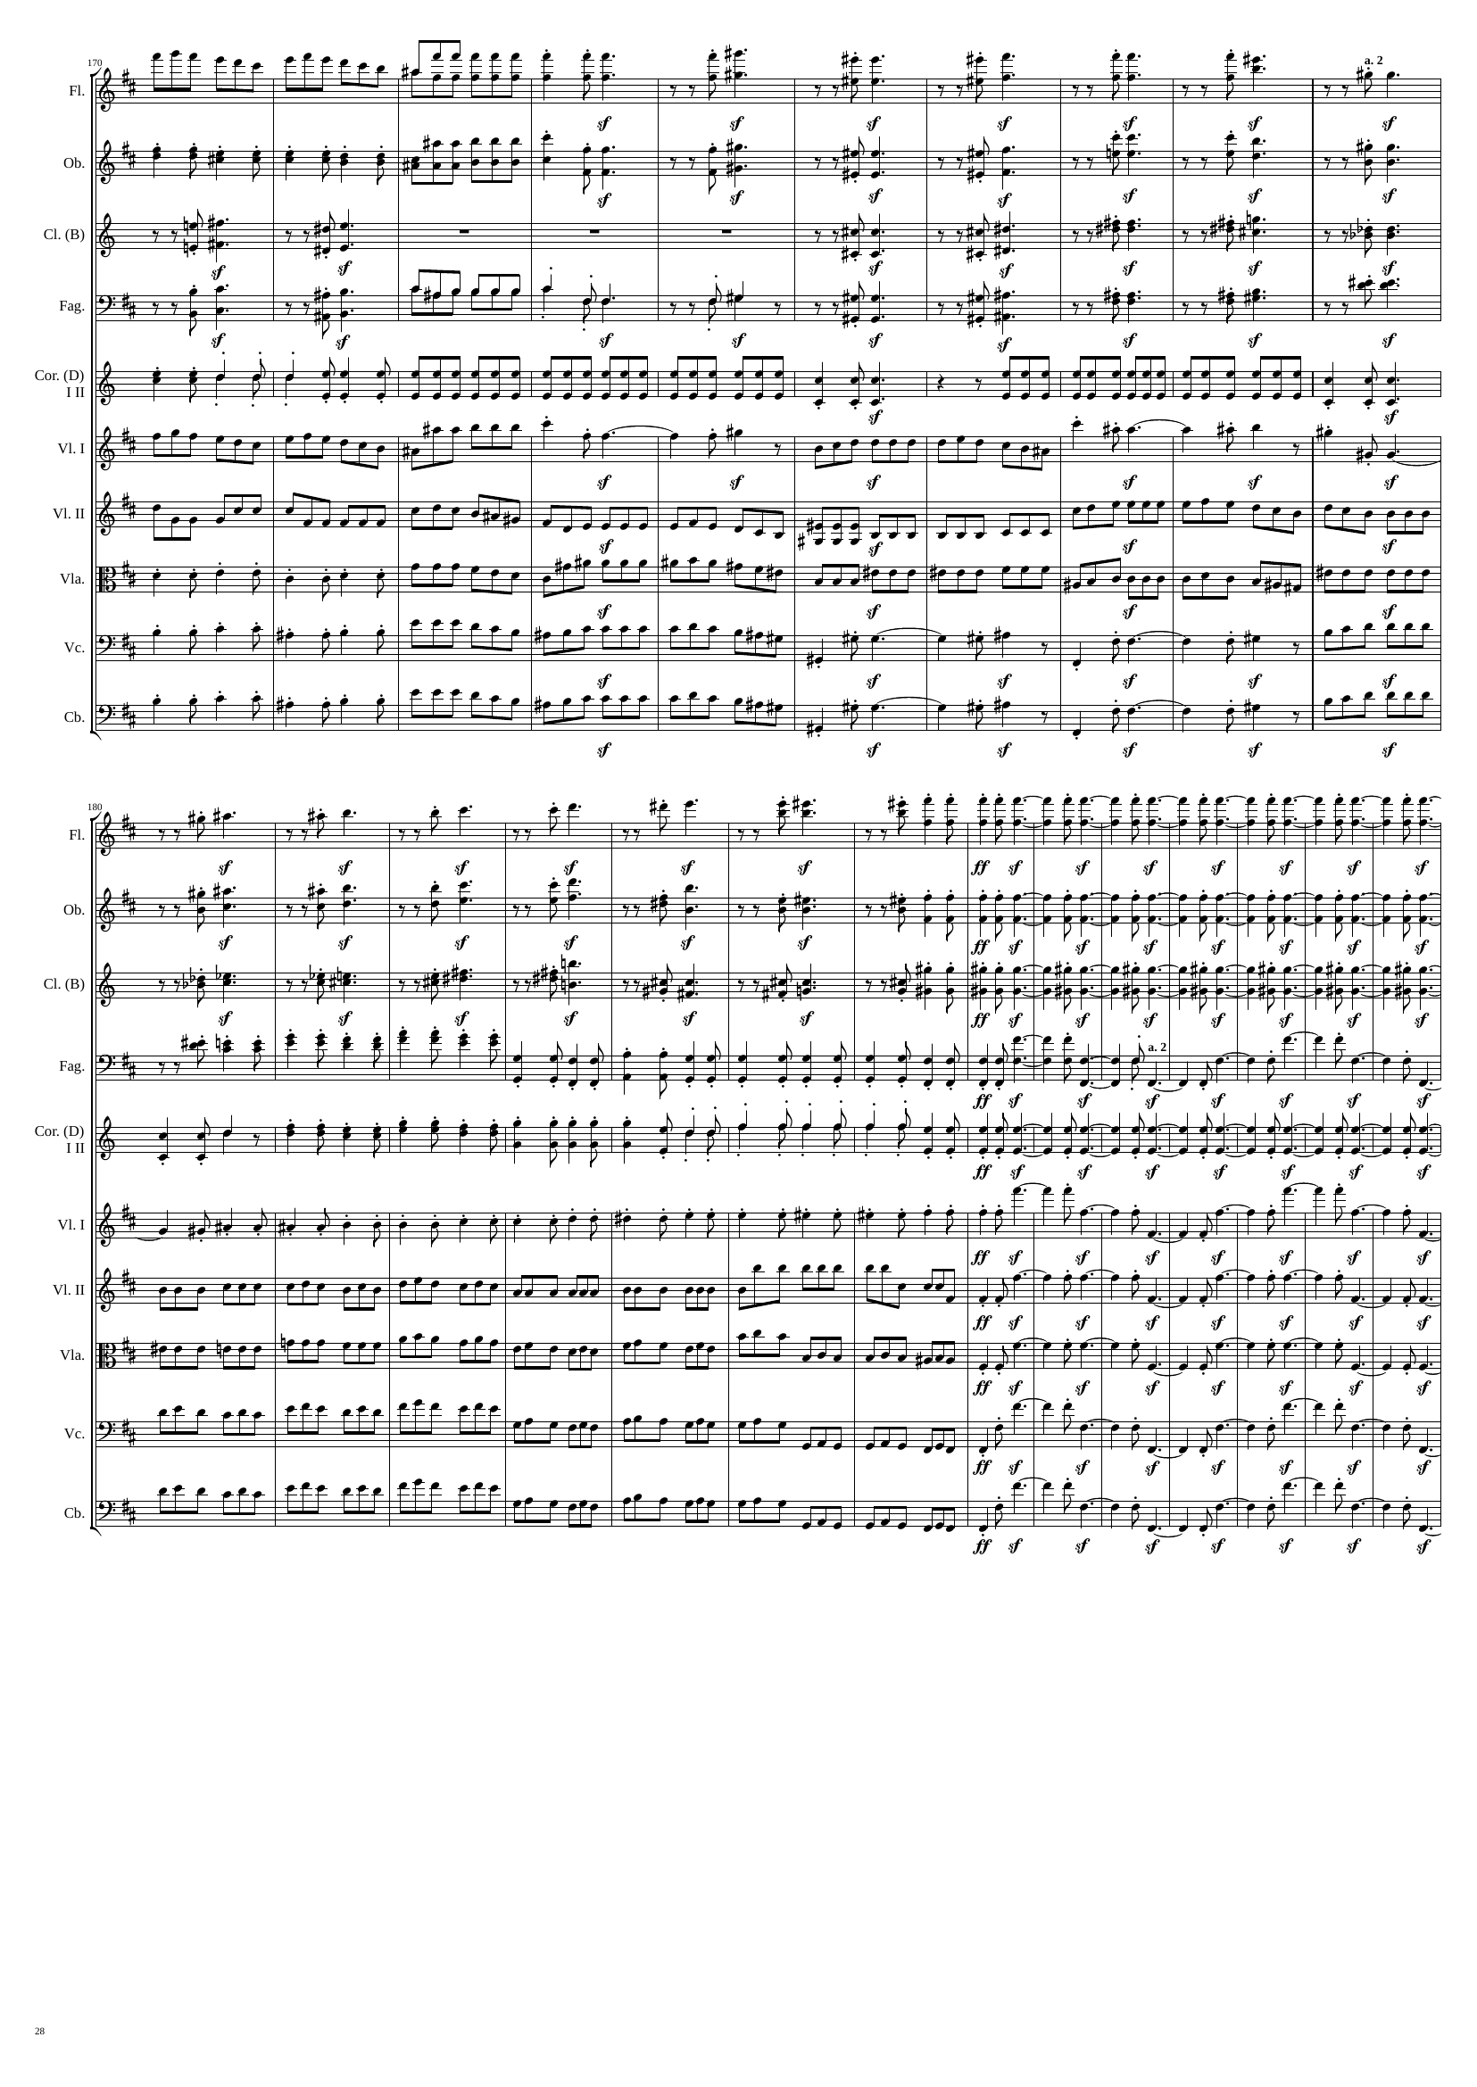
1706
rhythm
1715
1736
mel
rhythm
mel
mel
mel
mel
mel
rhythm
rhythm
mel
rhythm
mel
rhythm
rhythm
rhythm
rhythm
rhythm
rhythm
mel
rhythm
rhythm
rhythm
mel
rhythm
1736
1757
1778
mel
rhythm
mel
rhythm
mel
rhythm
rhythm
rhythm
rhythm
rhythm
mel
rhythm
rhythm
rhythm
rhythm
rhythm
rhythm
rhythm
rhythm
rhythm
rhythm

Slide 29
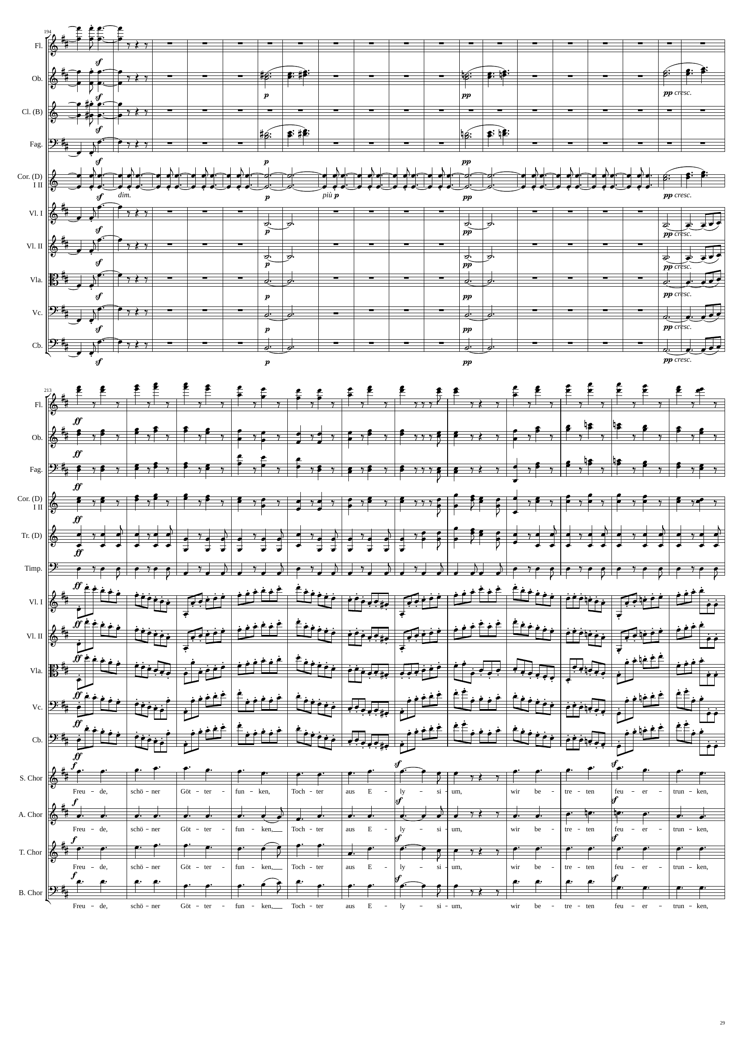
1778
rhythm
z
1793
1811
1829
1835
rhythm
mel
mel
mel
rhythm
zzzzzzzz
rhythm
mel
mel
rhythm
mel
rhythm
z
harm
harm
harm
rhythm
z
harm
harm
harm
rhythm
harm
harm
harm
rhythm
zzzzzzzz
harm
harm
harm
rhythm
harm
harm
harm
1835
1856
1871
mel
mel
mel
mel
rhythm
mel
rhythm
rhythm
rhythm
rhythm
rhythm
rhythm
rhythm
mel
mel
mel
mel

Slide 30
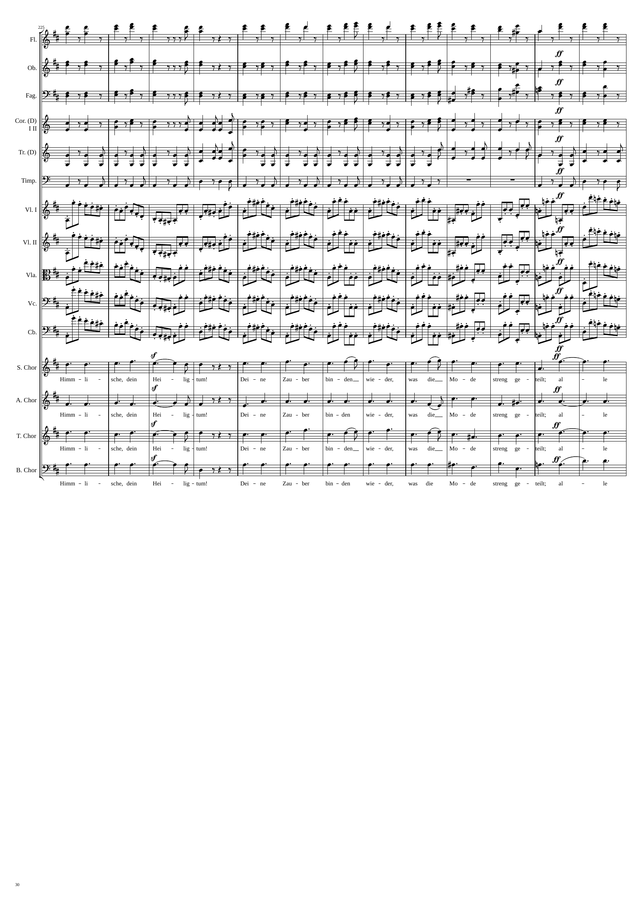
1871
mel
1910
mel
mel
mel
rhythm
mel
rhythm
rhythm
rhythm
rhythm
rhythm
rhythm
rhythm
mel
mel
mel
mel

Slide 31
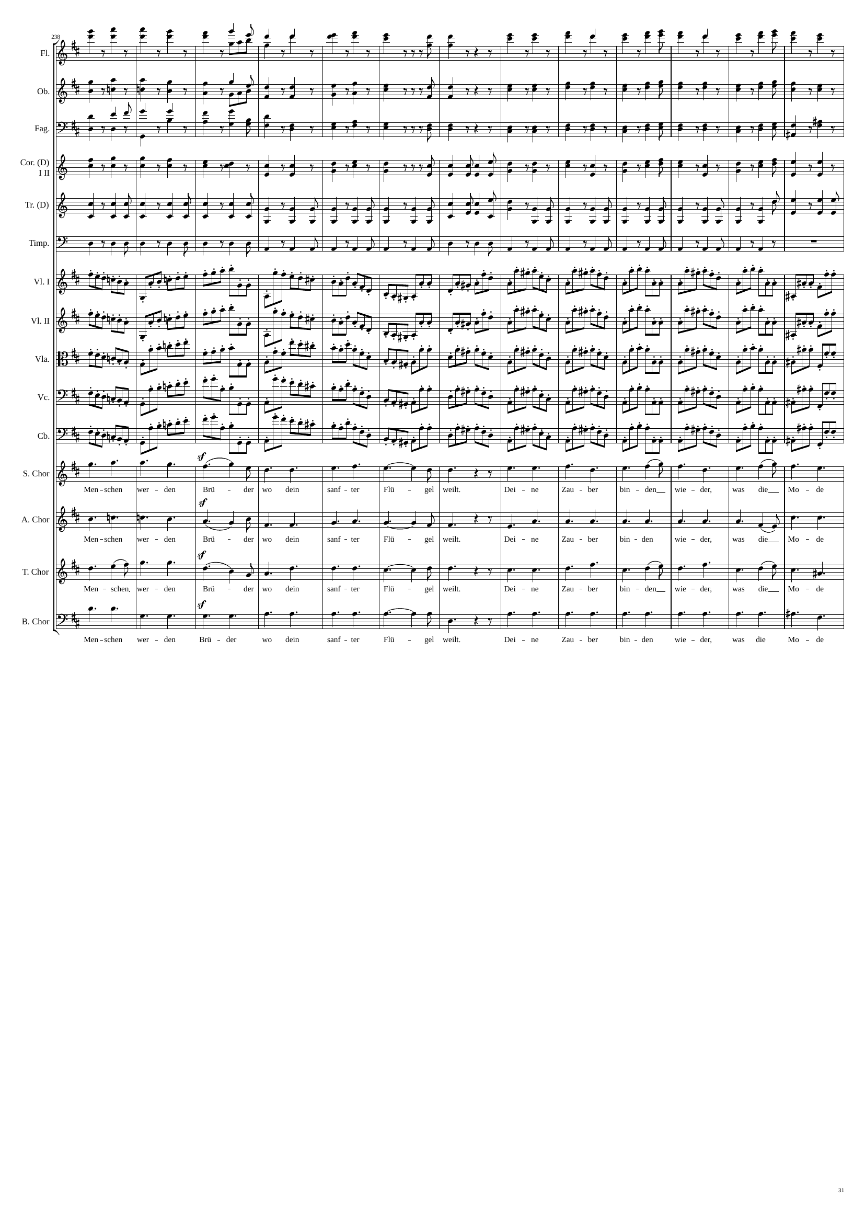
1910
mel
1949
mel
mel
mel
rhythm
mel
rhythm
rhythm
rhythm
rhythm
rhythm
rhythm
rhythm
mel
mel
mel
mel

Slide 32
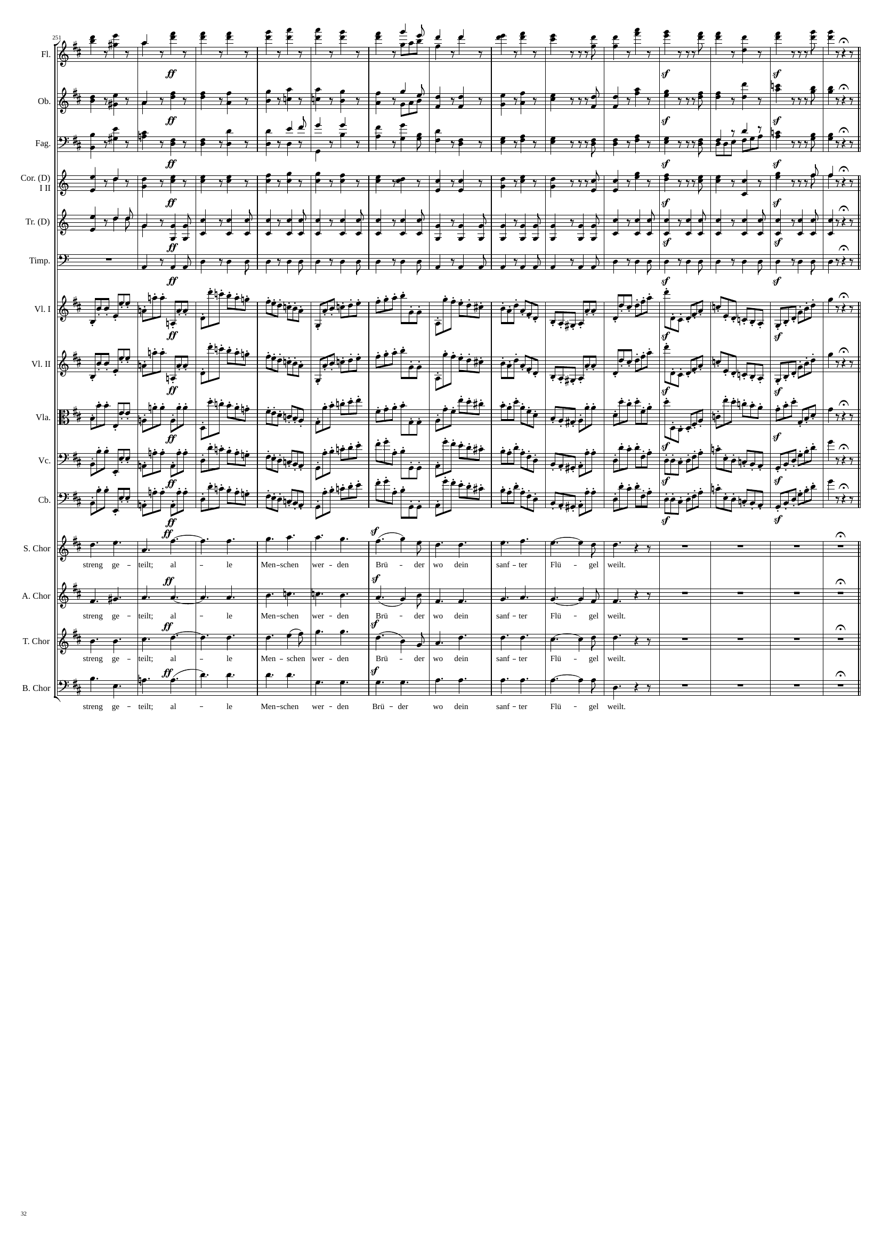
1949
mel
1991
mel
mel
mel
rhythm
rhythm
rhythm
rhythm
rhythm
rhythm
rhythm
mel
mel
mel
mel

Slide 33
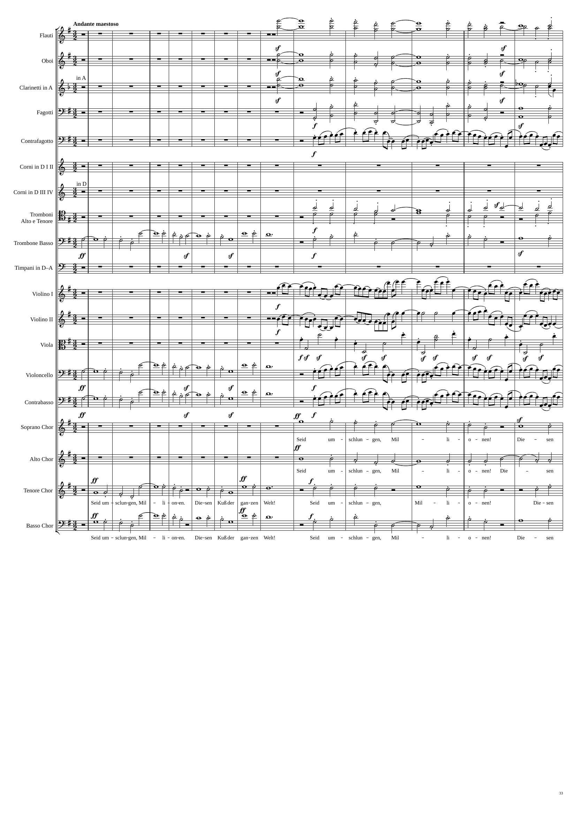
mel+harm
mel+harm
mel+harm
mel+harm
rhythm
mel+harm
mel
mel+harm
rhythm
rhythm
rhythm
mel
rhythm
mel
rhythm
mel+harm
mel+harm
mel
mel+harm
mel
mel+harm
1991
1993
2041
2071

Slide 34
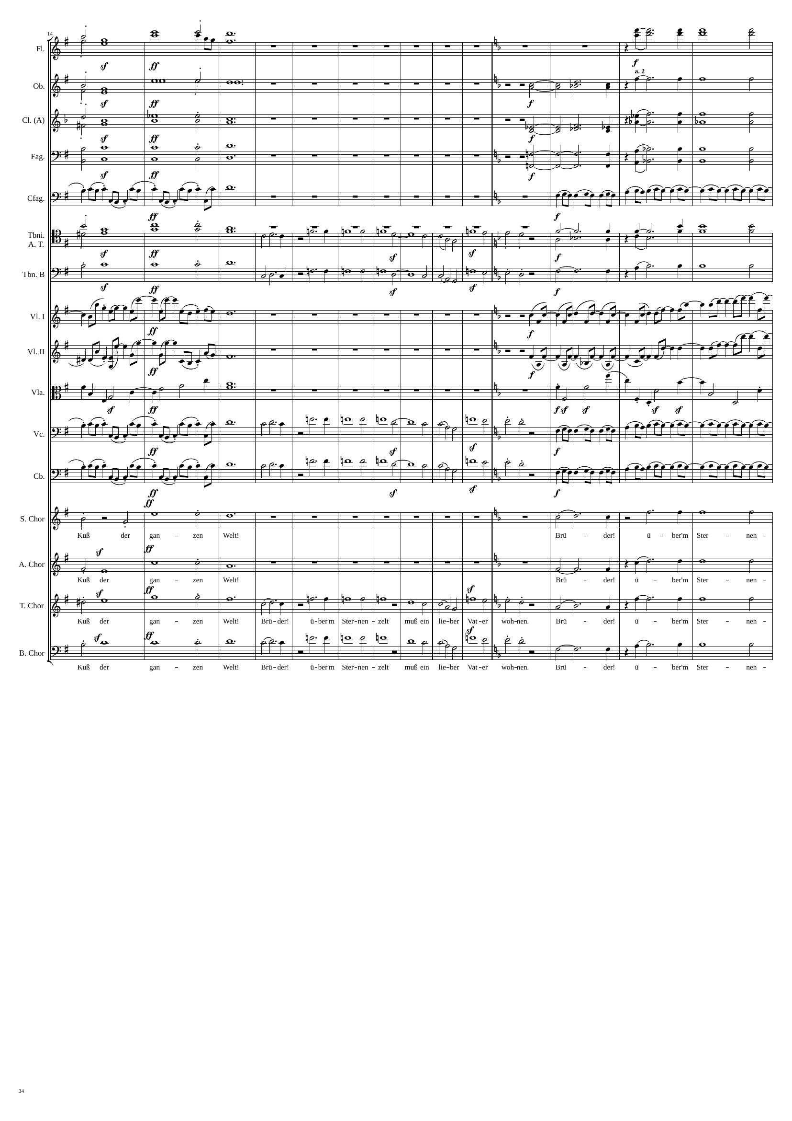
mel+harm
mel+harm
mel+harm
mel+harm
mel+harm
mel+harm
mel+harm
mel+harm
rhythm
rhythm
mel+harm
mel
mel+harm
mel+harm
mel
mel+harm
rhythm
rhythm
rhythm
rhythm
rhythm
rhythm
rhythm
mel
rhythm
rhythm
mel
rhythm
mel+harm
mel+harm
mel+harm
mel+harm
mel+harm
mel
mel+harm
mel+harm
mel
mel+harm
2071
2089
2137
2155

Slide 35
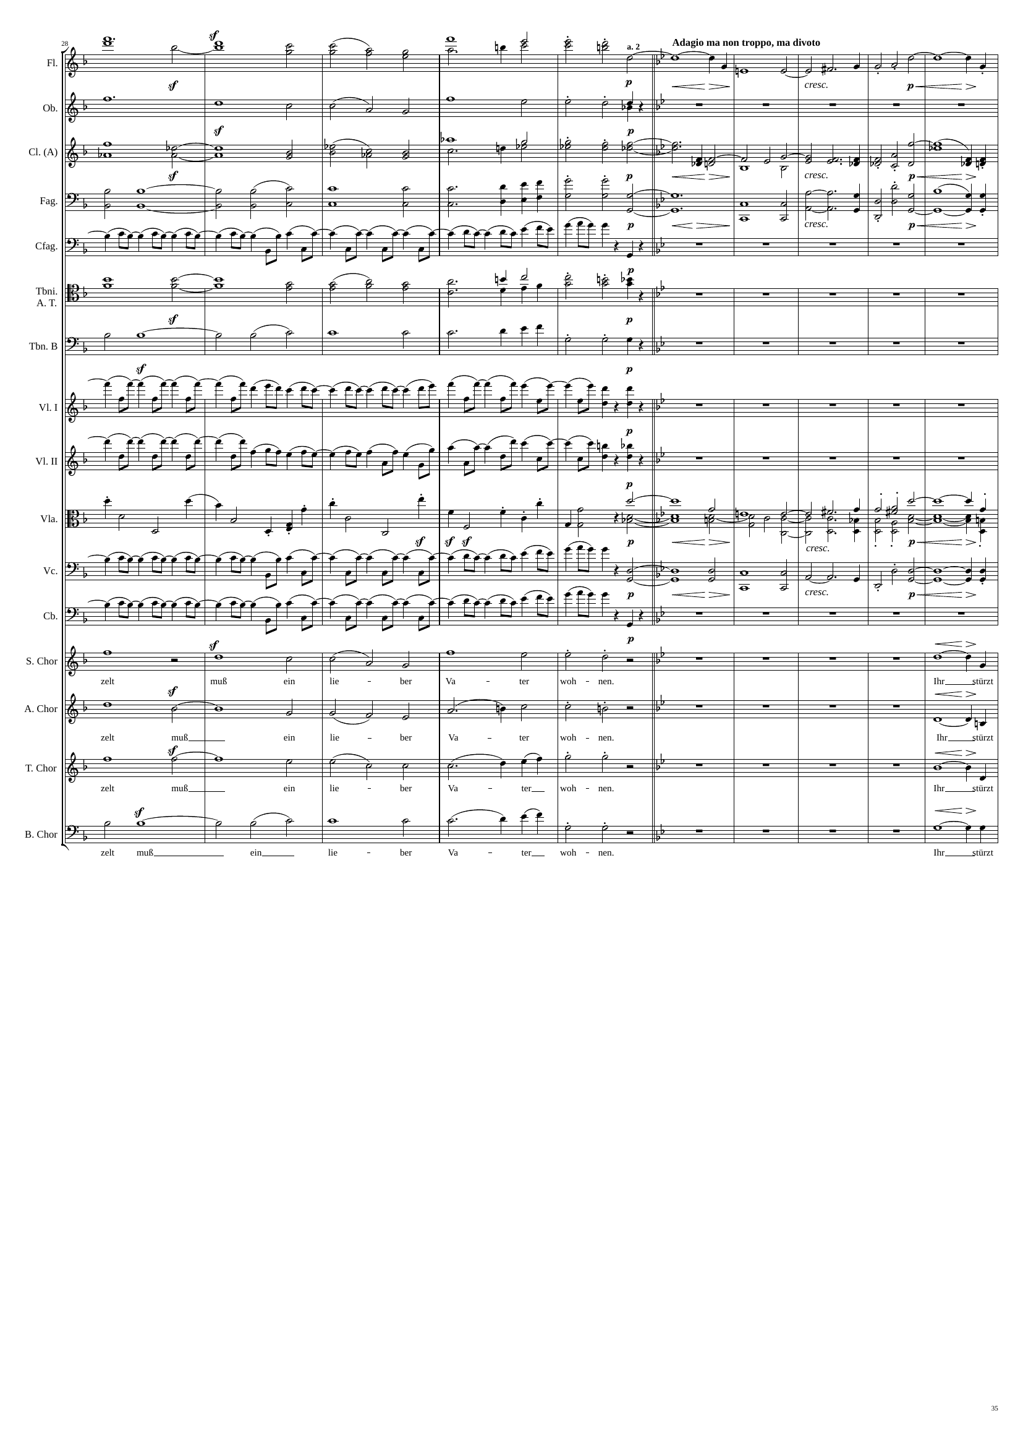
mel+harm
harm
mel+harm
mel+harm
mel+harm
harm
mel+harm
mel+harm
harm
mel+harm
rhythm
mel+harm
mel+harm
rhythm
rhythm
rhythm
harm
mel+harm
rhythm
harm
mel+harm
rhythm
mel+harm
mel+harm
mel+harm
mel+harm
mel+harm
mel+harm
mel+harm
mel+harm
2155
2185
2215

Slide 36
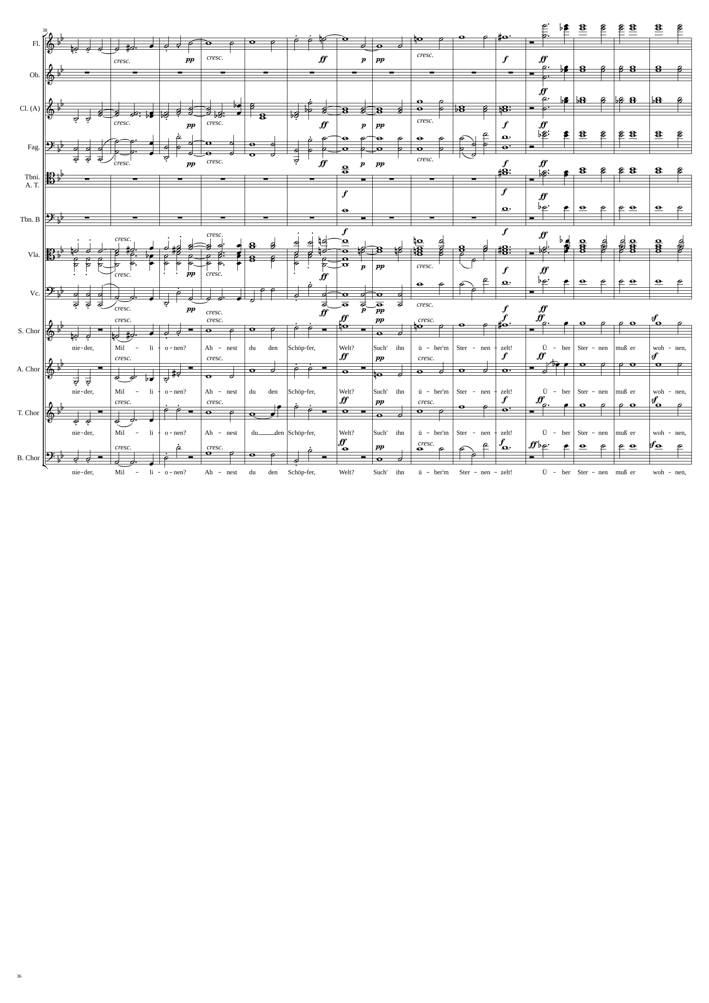
mel+harm
rhythm+harm
rhythm+harm
mel+harm
rhythm+harm
mel+harm
rhythm+harm
harm
rhythm+harm
harm
rhythm+harm
mel+harm
rhythm+harm
mel+harm
rhythm+harm
mel+harm
rhythm+harm
mel+harm
rhythm+harm
mel+harm
rhythm+harm
mel+harm
rhythm+harm
2215
2281
2305

Slide 37
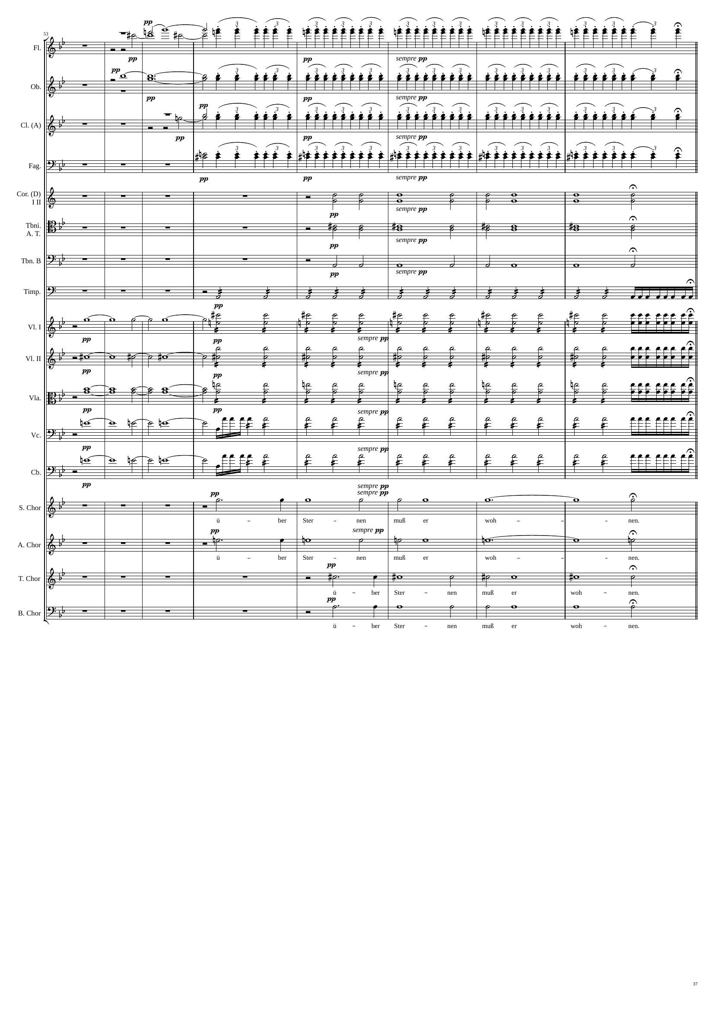
harm
rhythm
harm
v
rhythm
harm
v
rhythm
rhythm
harm
harm
harm
rhythm+harm
harm
rhythm+harm
harm
rhythm+harm
harm
rhythm+harm
harm
rhythm+harm
harm
rhythm+harm
harm
harm
harm
harm
2305
2323
2353

Slide 38
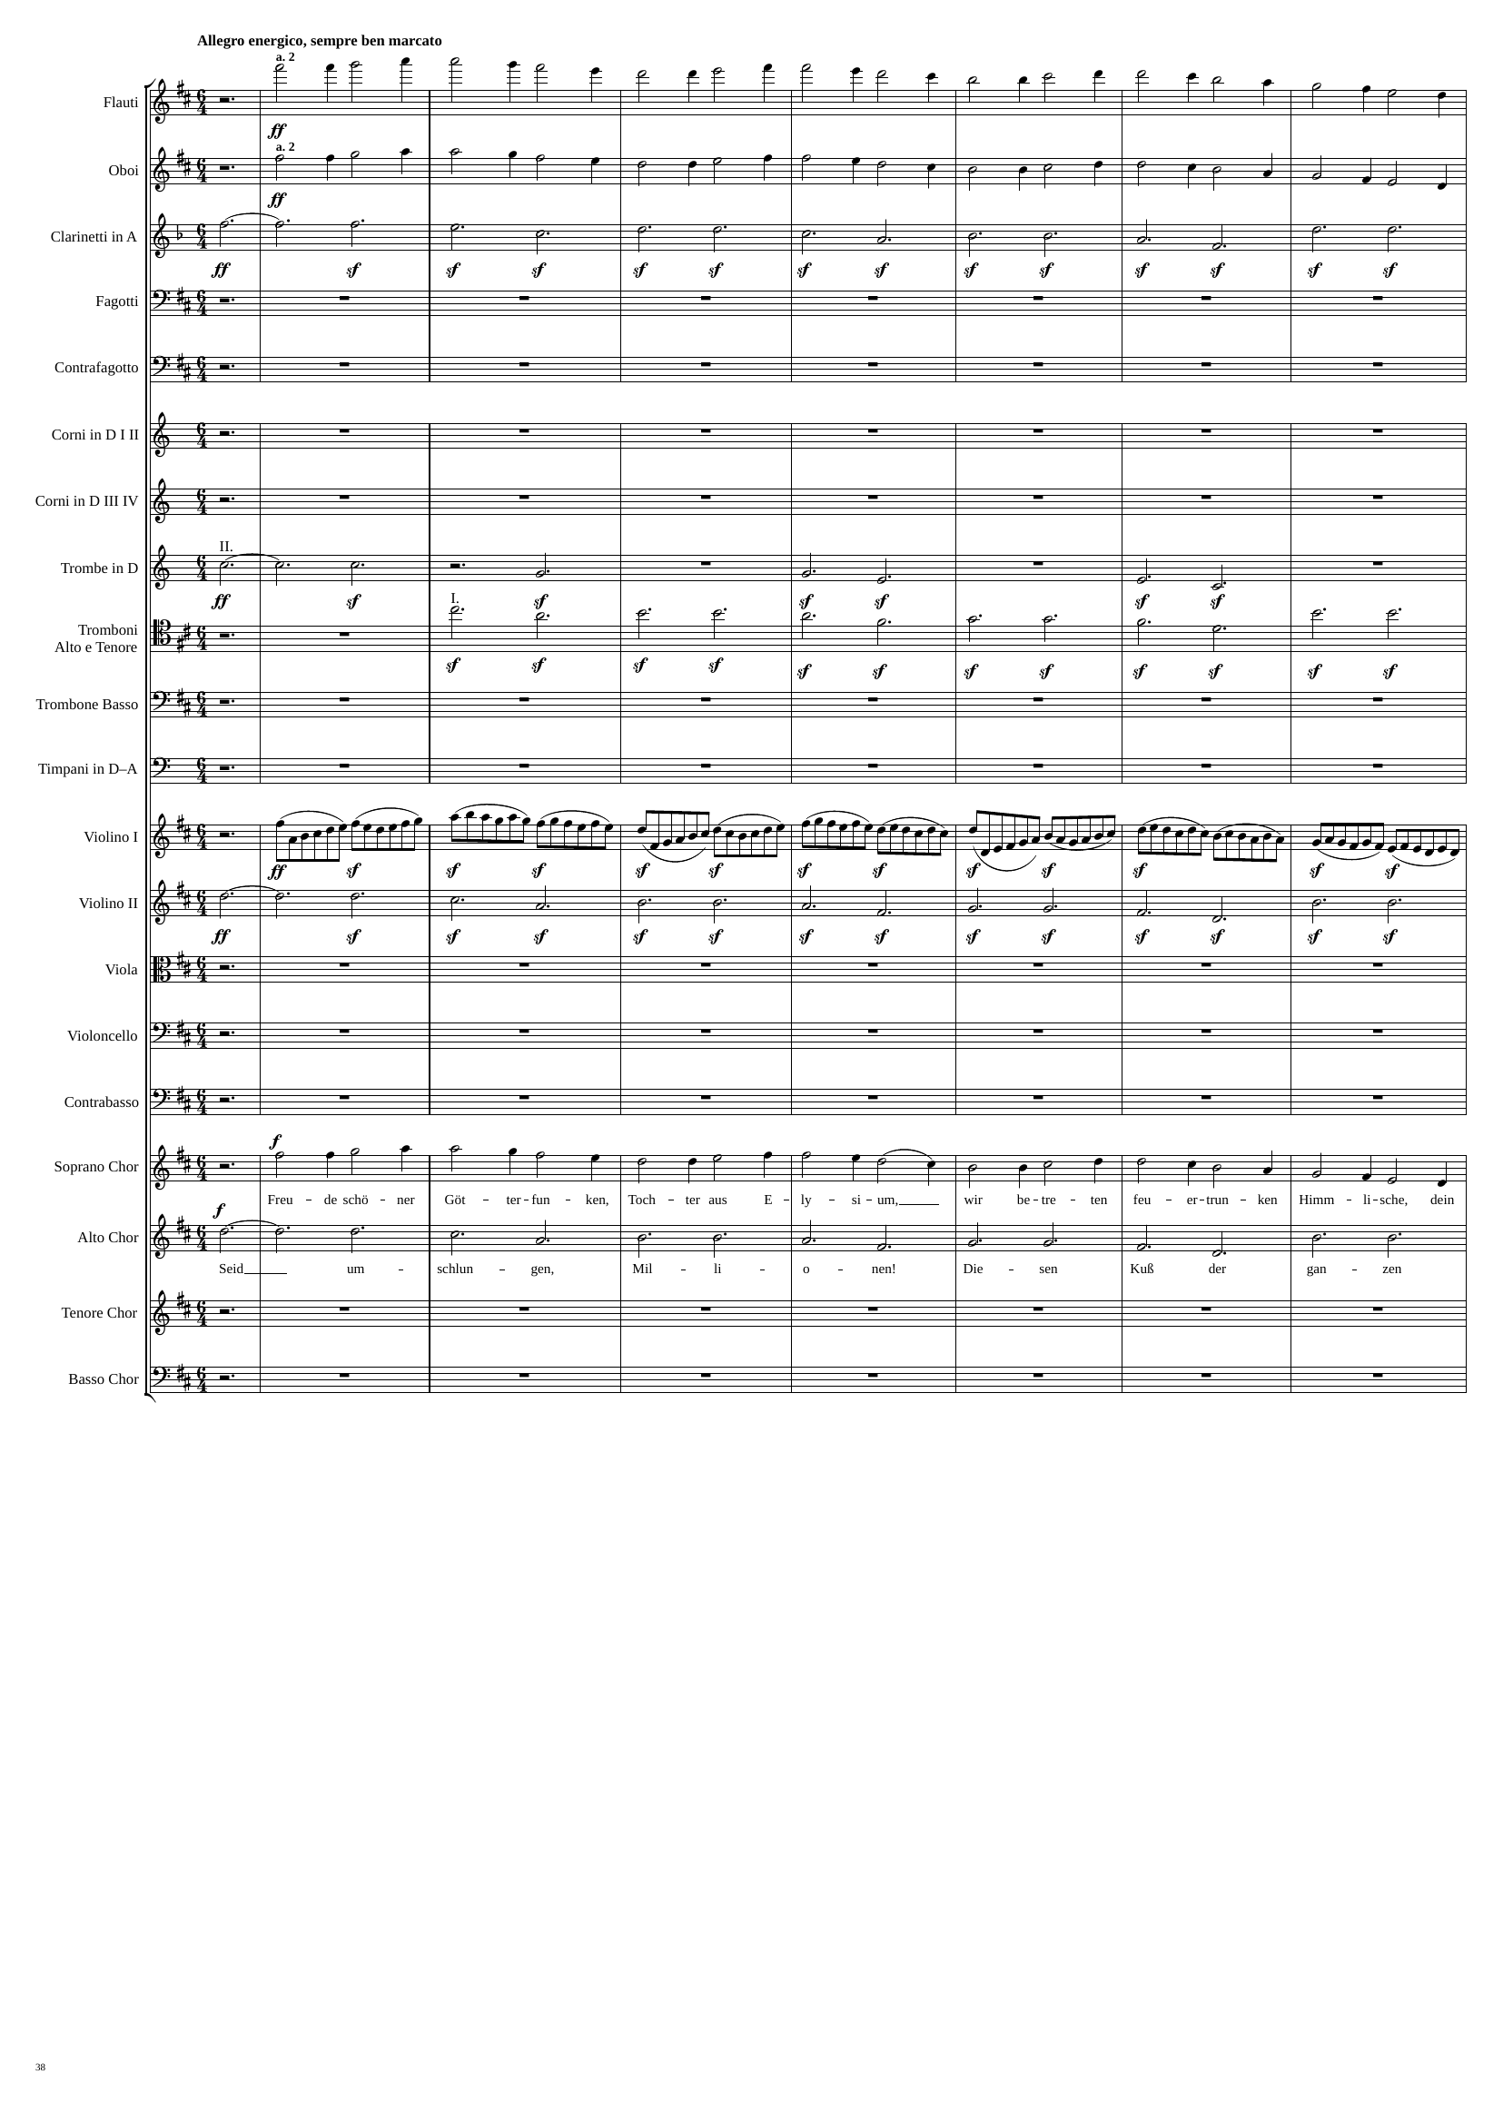
mel+rhythm
mel+rhythm
rhythm+harm
rhythm+harm
rhythm+harm
rhythm
rhythm+harm
mel+rhythm
rhythm+harm
2353
2356
2398

Slide 39
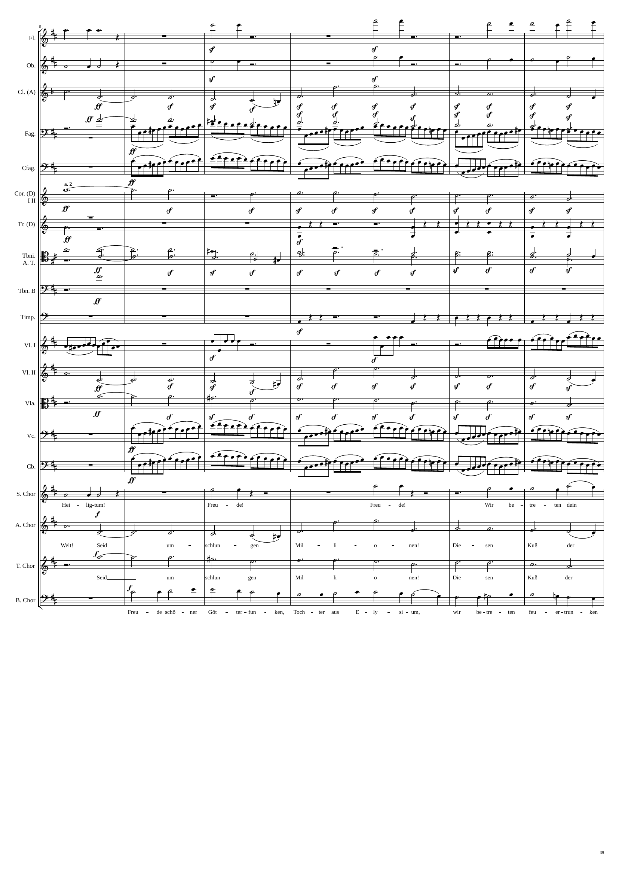
mel+rhythm
rhythm+harm
mel+rhythm
mel+rhythm
rhythm+harm
mel+rhythm
rhythm+harm
rhythm+harm
rhythm
rhythm
rhythm+harm
rhythm+harm
rhythm
v
rhythm+harm
rhythm+harm
rhythm
v
rhythm
v
rhythm
v
rhythm+harm
rhythm+harm
rhythm
v
rhythm
v
mel+rhythm
rhythm+harm
mel+rhythm
rhythm+harm
rhythm+harm
mel+rhythm
2398
2404
2440

Slide 40
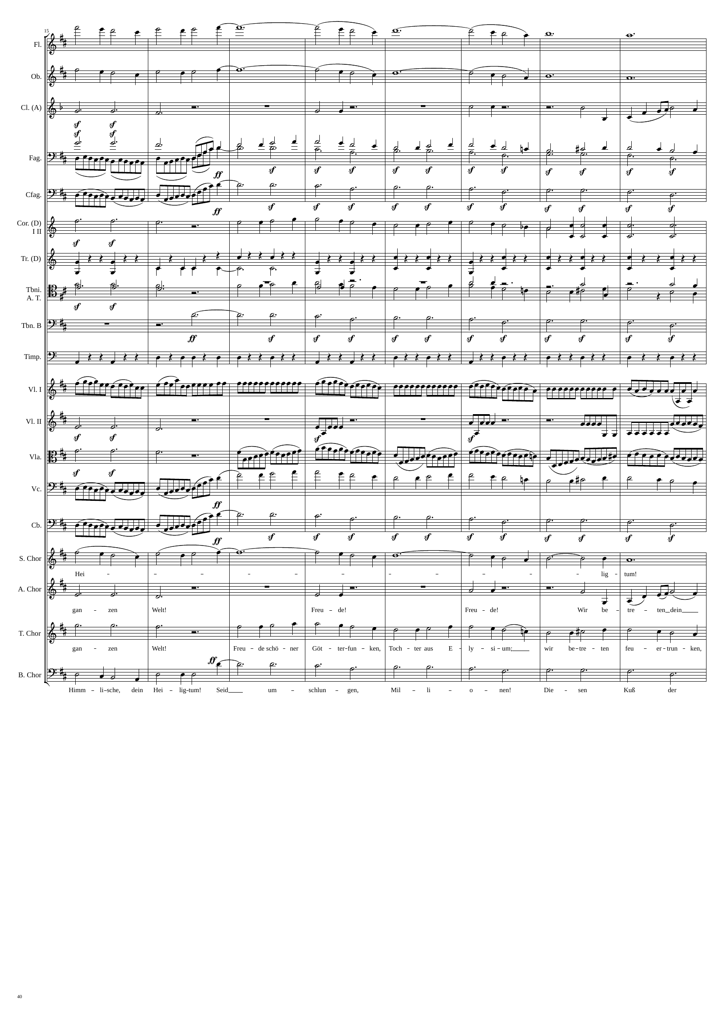
mel+rhythm
mel+harm
mel+rhythm
mel+harm
rhythm+harm
rhythm+harm
mel+rhythm
rhythm+harm
mel+rhythm
rhythm
rhythm+harm
rhythm
rhythm+harm
rhythm+harm
mel+rhythm
rhythm
rhythm
rhythm
rhythm+harm
mel+rhythm
rhythm+harm
rhythm
rhythm
rhythm
rhythm
rhythm+harm
rhythm
rhythm+harm
rhythm
rhythm
mel+rhythm
rhythm
rhythm+harm
mel+rhythm
mel+harm
rhythm+harm
rhythm+harm
mel+rhythm
rhythm+harm
mel+rhythm
mel+rhythm
rhythm+harm
2440
2452
2488

Slide 41
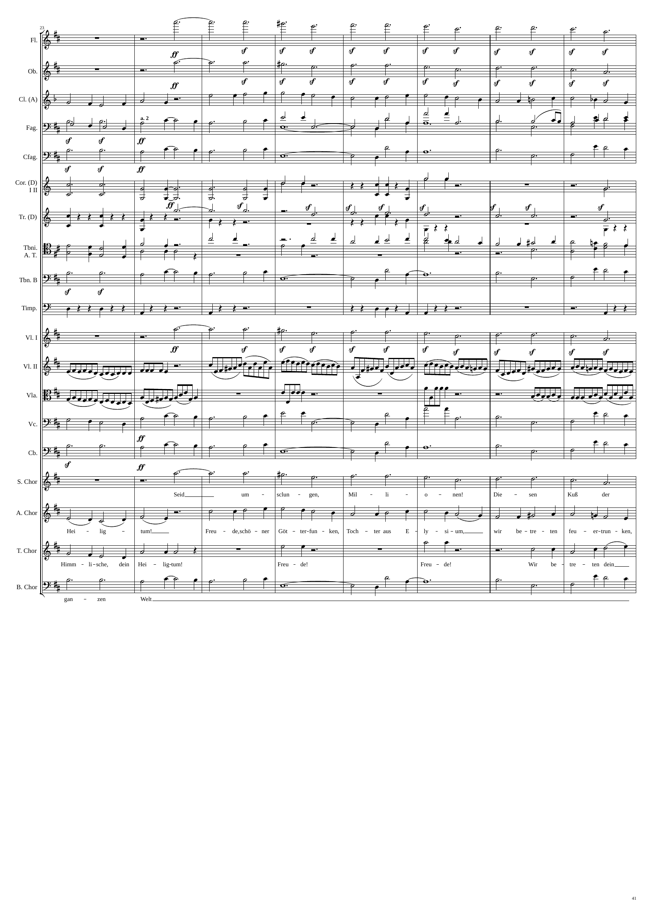
rhythm+harm
rhythm+harm
mel+rhythm
mel+rhythm
mel+rhythm
rhythm+harm
mel+harm
rhythm+harm
rhythm+harm
mel+harm
rhythm
rhythm
rhythm
rhythm+harm
rhythm
mel+rhythm
rhythm+harm
rhythm+harm
mel+harm
rhythm
rhythm
rhythm+harm
rhythm
rhythm
rhythm
rhythm
mel+rhythm
mel+harm
rhythm+harm
mel+harm
rhythm+harm
mel+rhythm
mel+rhythm
mel+rhythm
rhythm+harm
rhythm+harm
mel+harm
2488
2500
2536

Slide 42
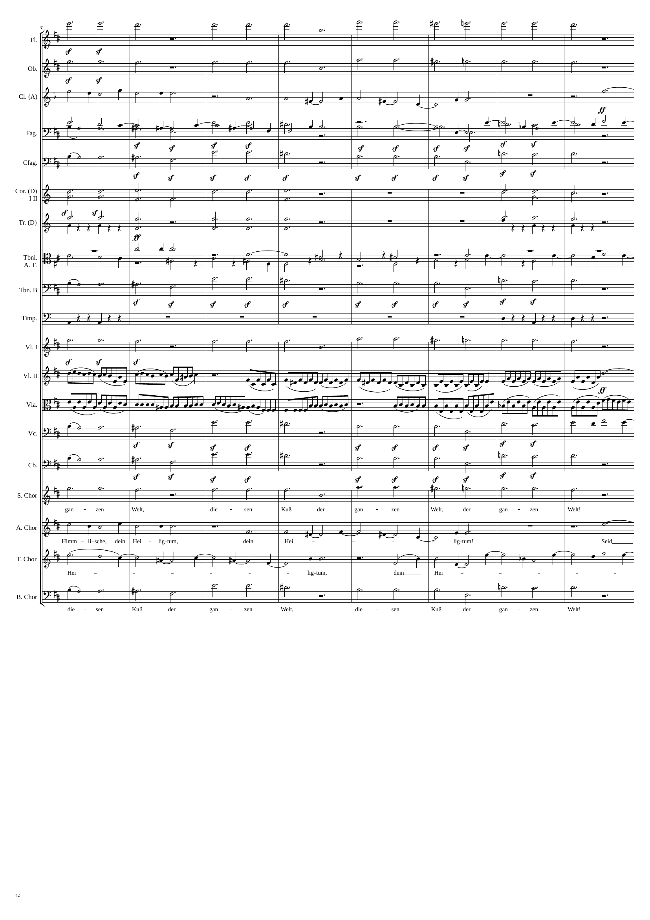
rhythm+harm
rhythm+harm
mel+rhythm
rhythm+harm
rhythm+harm
rhythm+harm
mel+rhythm
rhythm+harm
rhythm+harm
rhythm+harm
rhythm+harm
rhythm
rhythm+harm
mel+rhythm
rhythm+harm
rhythm
rhythm+harm
rhythm
rhythm+harm
rhythm
rhythm
rhythm+harm
mel+rhythm
rhythm+harm
rhythm+harm
mel+rhythm
rhythm+harm
rhythm+harm
rhythm+harm
rhythm+harm
2536
2542
2584

Slide 43
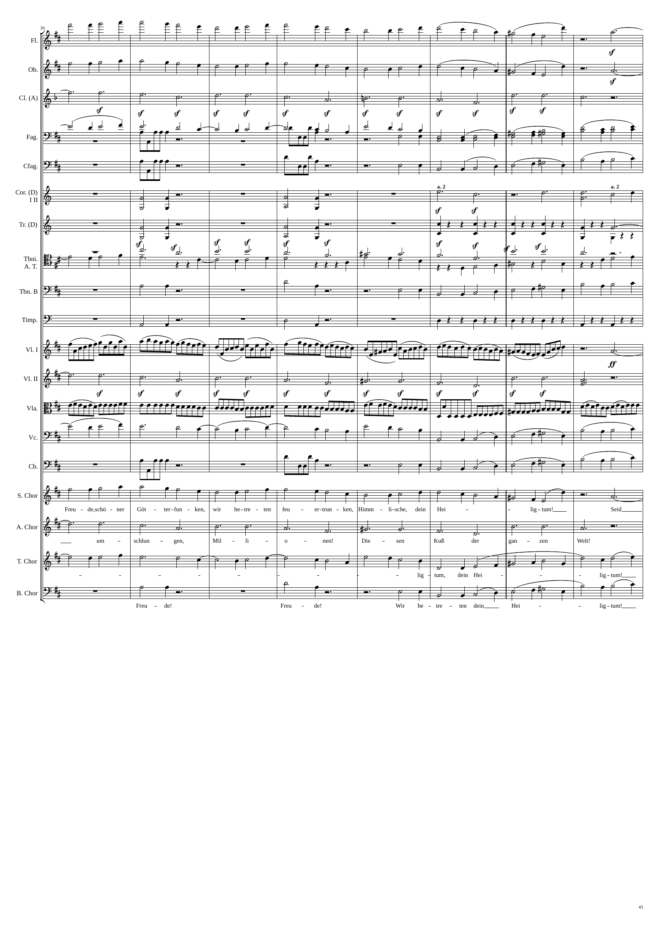
mel+rhythm
rhythm+harm
mel+rhythm
rhythm+harm
rhythm+harm
mel+rhythm
mel+rhythm
rhythm
rhythm
mel+rhythm
rhythm
rhythm+harm
rhythm
rhythm
mel+rhythm
rhythm+harm
mel+rhythm
rhythm+harm
mel+rhythm
rhythm
rhythm
rhythm+harm
rhythm+harm
rhythm
mel+rhythm
rhythm
mel+rhythm
mel+rhythm
rhythm+harm
rhythm+harm
mel+rhythm
rhythm+harm
mel+rhythm
2584
2608
2632

Slide 44
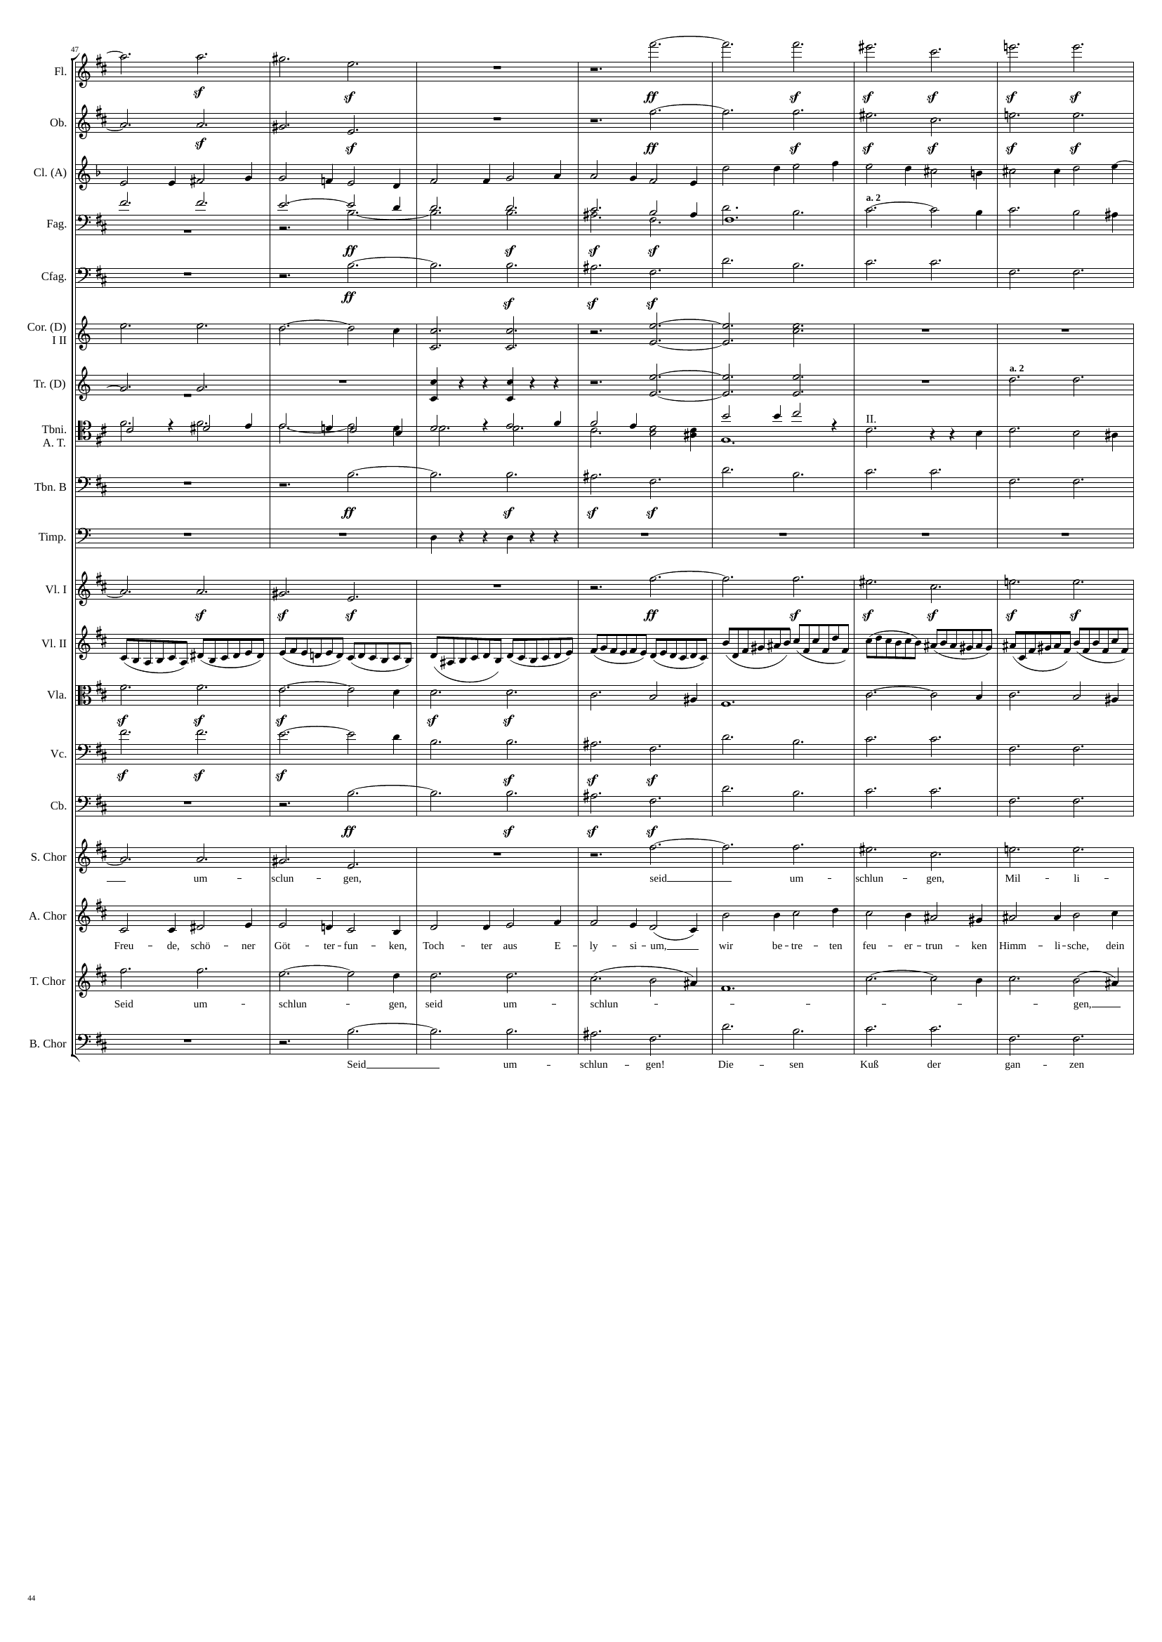
rhythm+harm
rhythm+harm
mel+rhythm
rhythm+harm
rhythm+harm
rhythm+harm
rhythm
rhythm+harm
rhythm+harm
mel+rhythm
rhythm+harm
mel+rhythm
rhythm+harm
rhythm+harm
v
rhythm
rhythm+harm
v
rhythm
rhythm+harm
v
rhythm+harm
v
rhythm+harm
v
rhythm+harm
v
mel+rhythm
rhythm+harm
v
rhythm+harm
v
2632
2662
2674

Slide 45
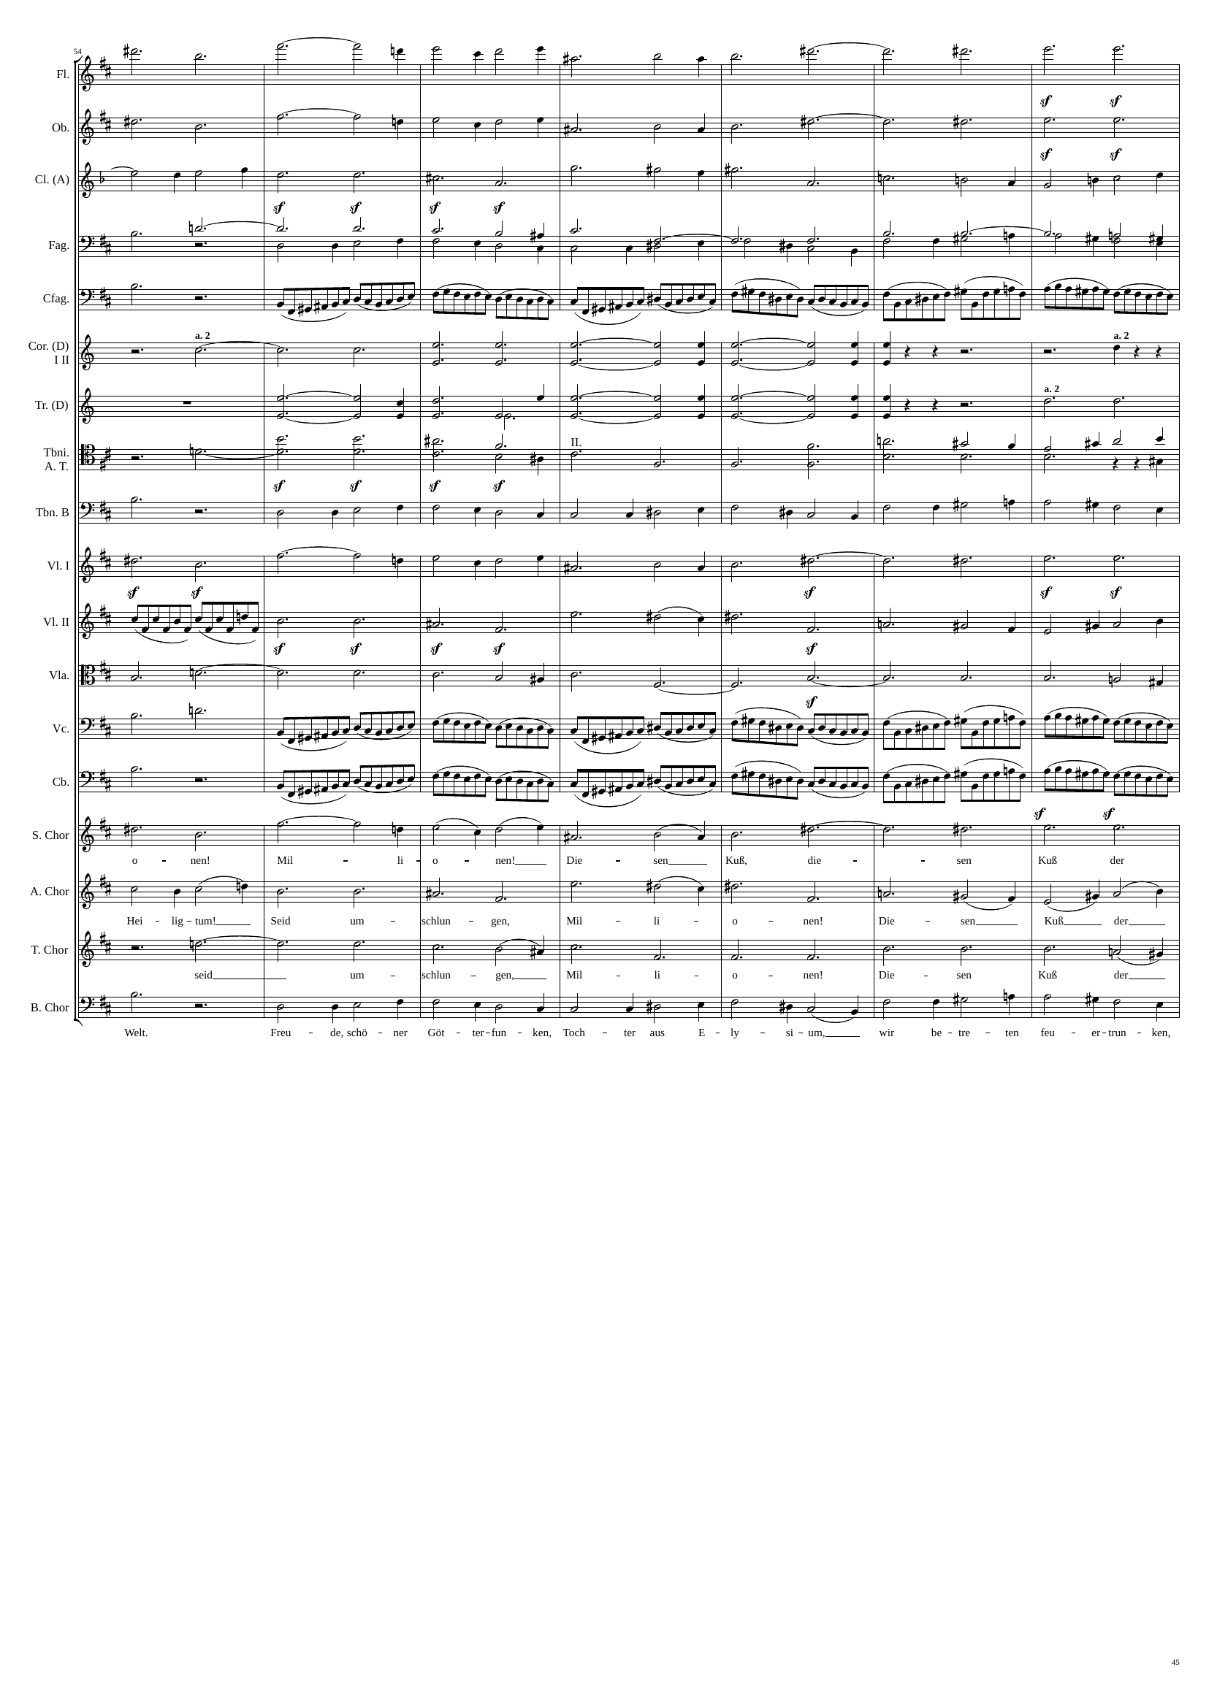
rhythm+harm
rhythm+harm
rhythm+harm
rhythm+harm
mel+rhythm
rhythm+harm
mel+rhythm
rhythm+harm
rhythm+harm
rhythm+harm
mel+rhythm
rhythm
rhythm
rhythm
rhythm+harm
rhythm+harm
rhythm+harm
mel+rhythm
rhythm+harm
rhythm+harm
rhythm
rhythm+harm
rhythm+harm
rhythm+harm
rhythm+harm
rhythm
rhythm+harm
rhythm
rhythm+harm
rhythm+harm
mel+rhythm
rhythm+harm
rhythm+harm
rhythm+harm
rhythm+harm
mel+rhythm
2674
2680
2716

Slide 46
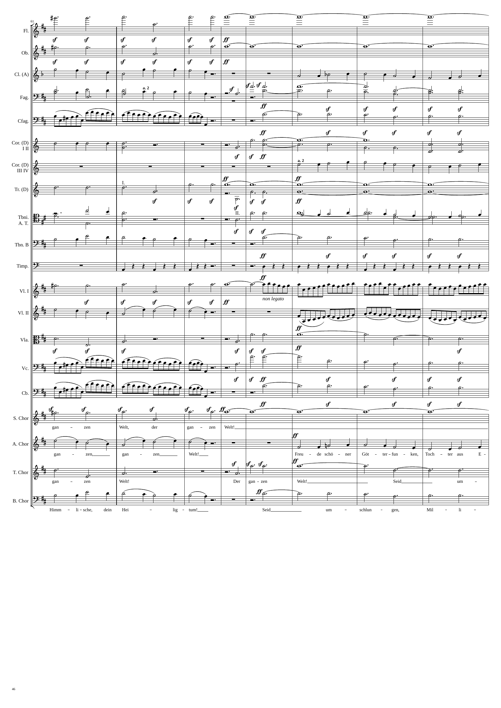
rhythm+harm
harm
rhythm+harm
harm
mel+rhythm
mel+rhythm
rhythm+harm
rhythm+harm
mel+rhythm
rhythm
rhythm+harm
rhythm
rhythm+harm
mel+rhythm
rhythm+harm
harm
harm
V
rhythm+harm
rhythm+harm
rhythm+harm
mel+rhythm
rhythm+harm
mel+rhythm
rhythm+harm
rhythm
rhythm
rhythm+harm
harm
V
rhythm
mel+rhythm
rhythm
rhythm+harm
rhythm+harm
harm
V
rhythm
rhythm+harm
rhythm
rhythm+harm
rhythm
harm
V
mel+rhythm
mel+rhythm
rhythm+harm
rhythm+harm
harm
V
mel+rhythm
rhythm+harm
2716
2734
2764

Slide 47
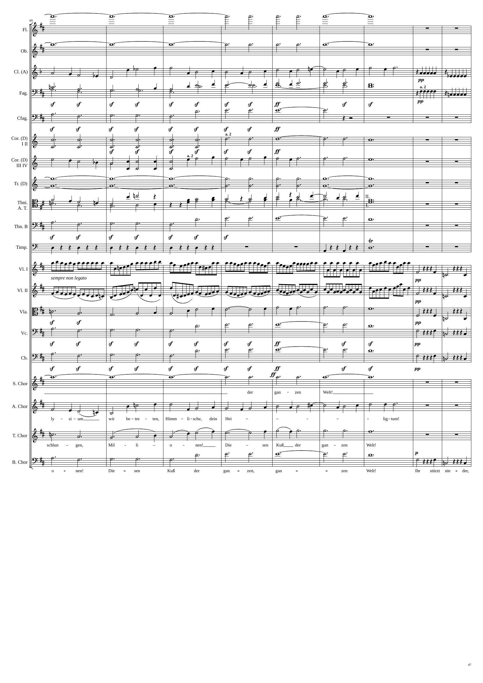
harm
rhythm+harm
harm
VV
rhythm+harm
mel+rhythm
rhythm
rhythm+harm
rhythm
rhythm+harm
rhythm
mel+rhythm
rhythm
mel+rhythm
rhythm+harm
harm
VV
rhythm+harm
mel+rhythm
rhythm+harm
rhythm+harm
rhythm
rhythm
V
mel+rhythm+harm
rhythm
V
mel+rhythm+harm
mel+rhythm
mel+rhythm+harm
rhythm+harm
mel+rhythm+harm
rhythm+harm
mel+rhythm+harm
harm
V
rhythm+harm
V
mel+rhythm
mel+rhythm
rhythm+harm
mel+rhythm+harm
2764
2782
2806
2818

Slide 48
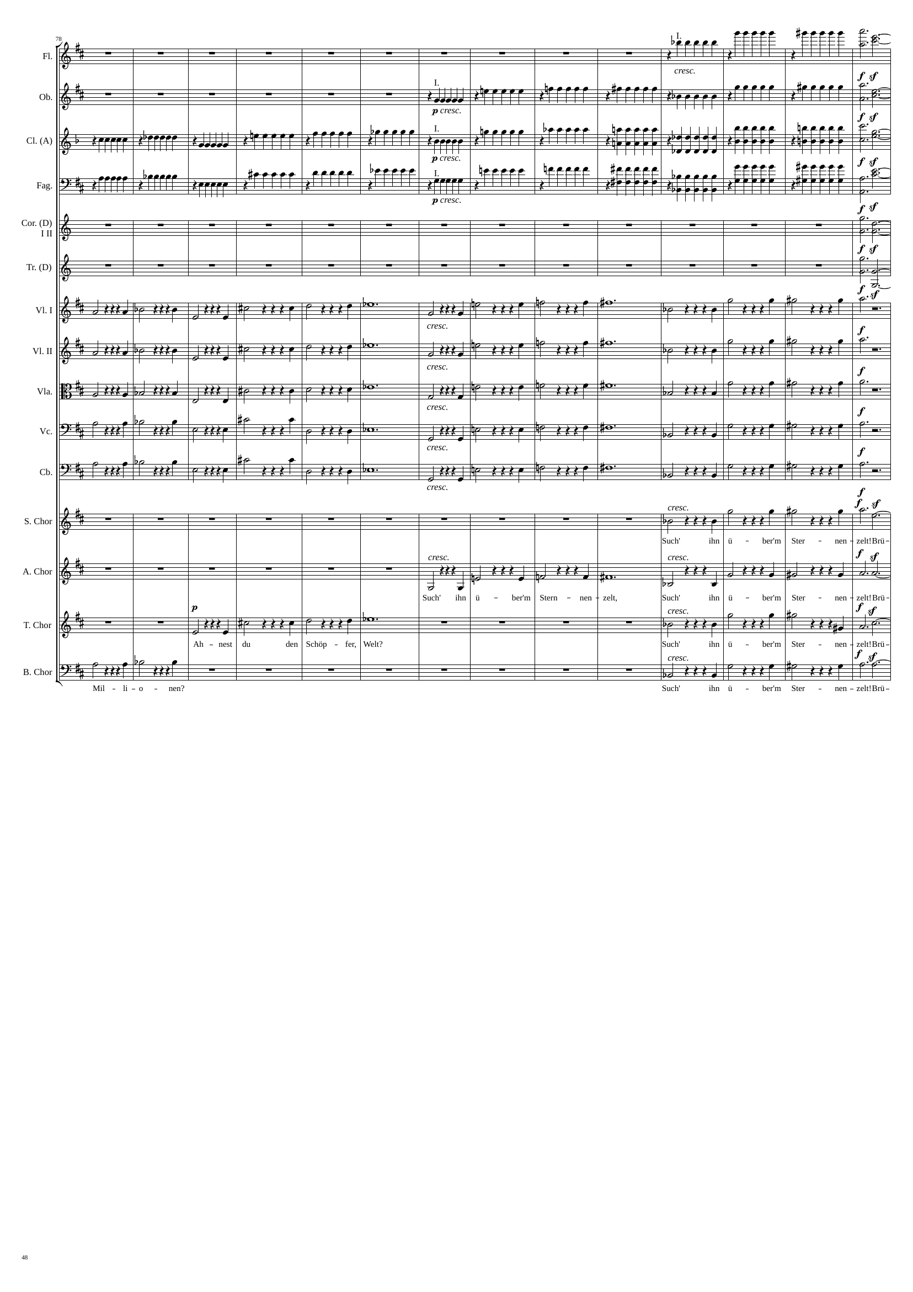
rhythm
rhythm+harm
rhythm
rhythm+harm
rhythm
rhythm+harm
rhythm
rhythm+harm
rhythm+harm
rhythm+harm
mel+rhythm+harm
rhythm+harm
mel+rhythm+harm
rhythm+harm
mel+rhythm+harm
rhythm+harm
mel+rhythm+harm
rhythm+harm
mel+rhythm+harm
rhythm+harm
mel+rhythm+harm
rhythm+harm
mel+rhythm+harm
mel+rhythm+harm
rhythm+harm
mel+rhythm+harm
mel+rhythm+harm
rhythm+harm
mel+rhythm+harm
mel+rhythm+harm
rhythm+harm
2818
2896
2902

Slide 49
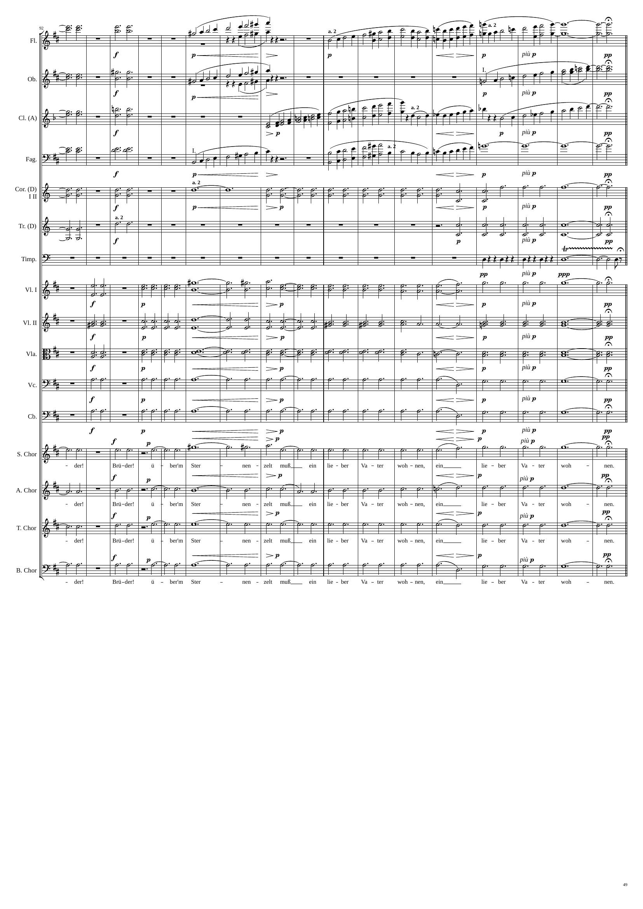
rhythm+harm
mel+rhythm
mel+rhythm
rhythm+harm
mel+rhythm
mel+rhythm
rhythm+harm
mel+rhythm
rhythm+harm
mel+rhythm
mel+rhythm
harm
rhythm+harm
harm
rhythm+harm
rhythm+harm
rhythm+harm
rhythm+harm
rhythm+harm
rhythm+harm
rhythm+harm
rhythm+harm
rhythm+harm
rhythm+harm
rhythm+harm
rhythm+harm
rhythm+harm
rhythm+harm
rhythm+harm
rhythm+harm
rhythm+harm
rhythm+harm
rhythm+harm
rhythm+harm
rhythm+harm
rhythm+harm
2902
2932
3004

Slide 50
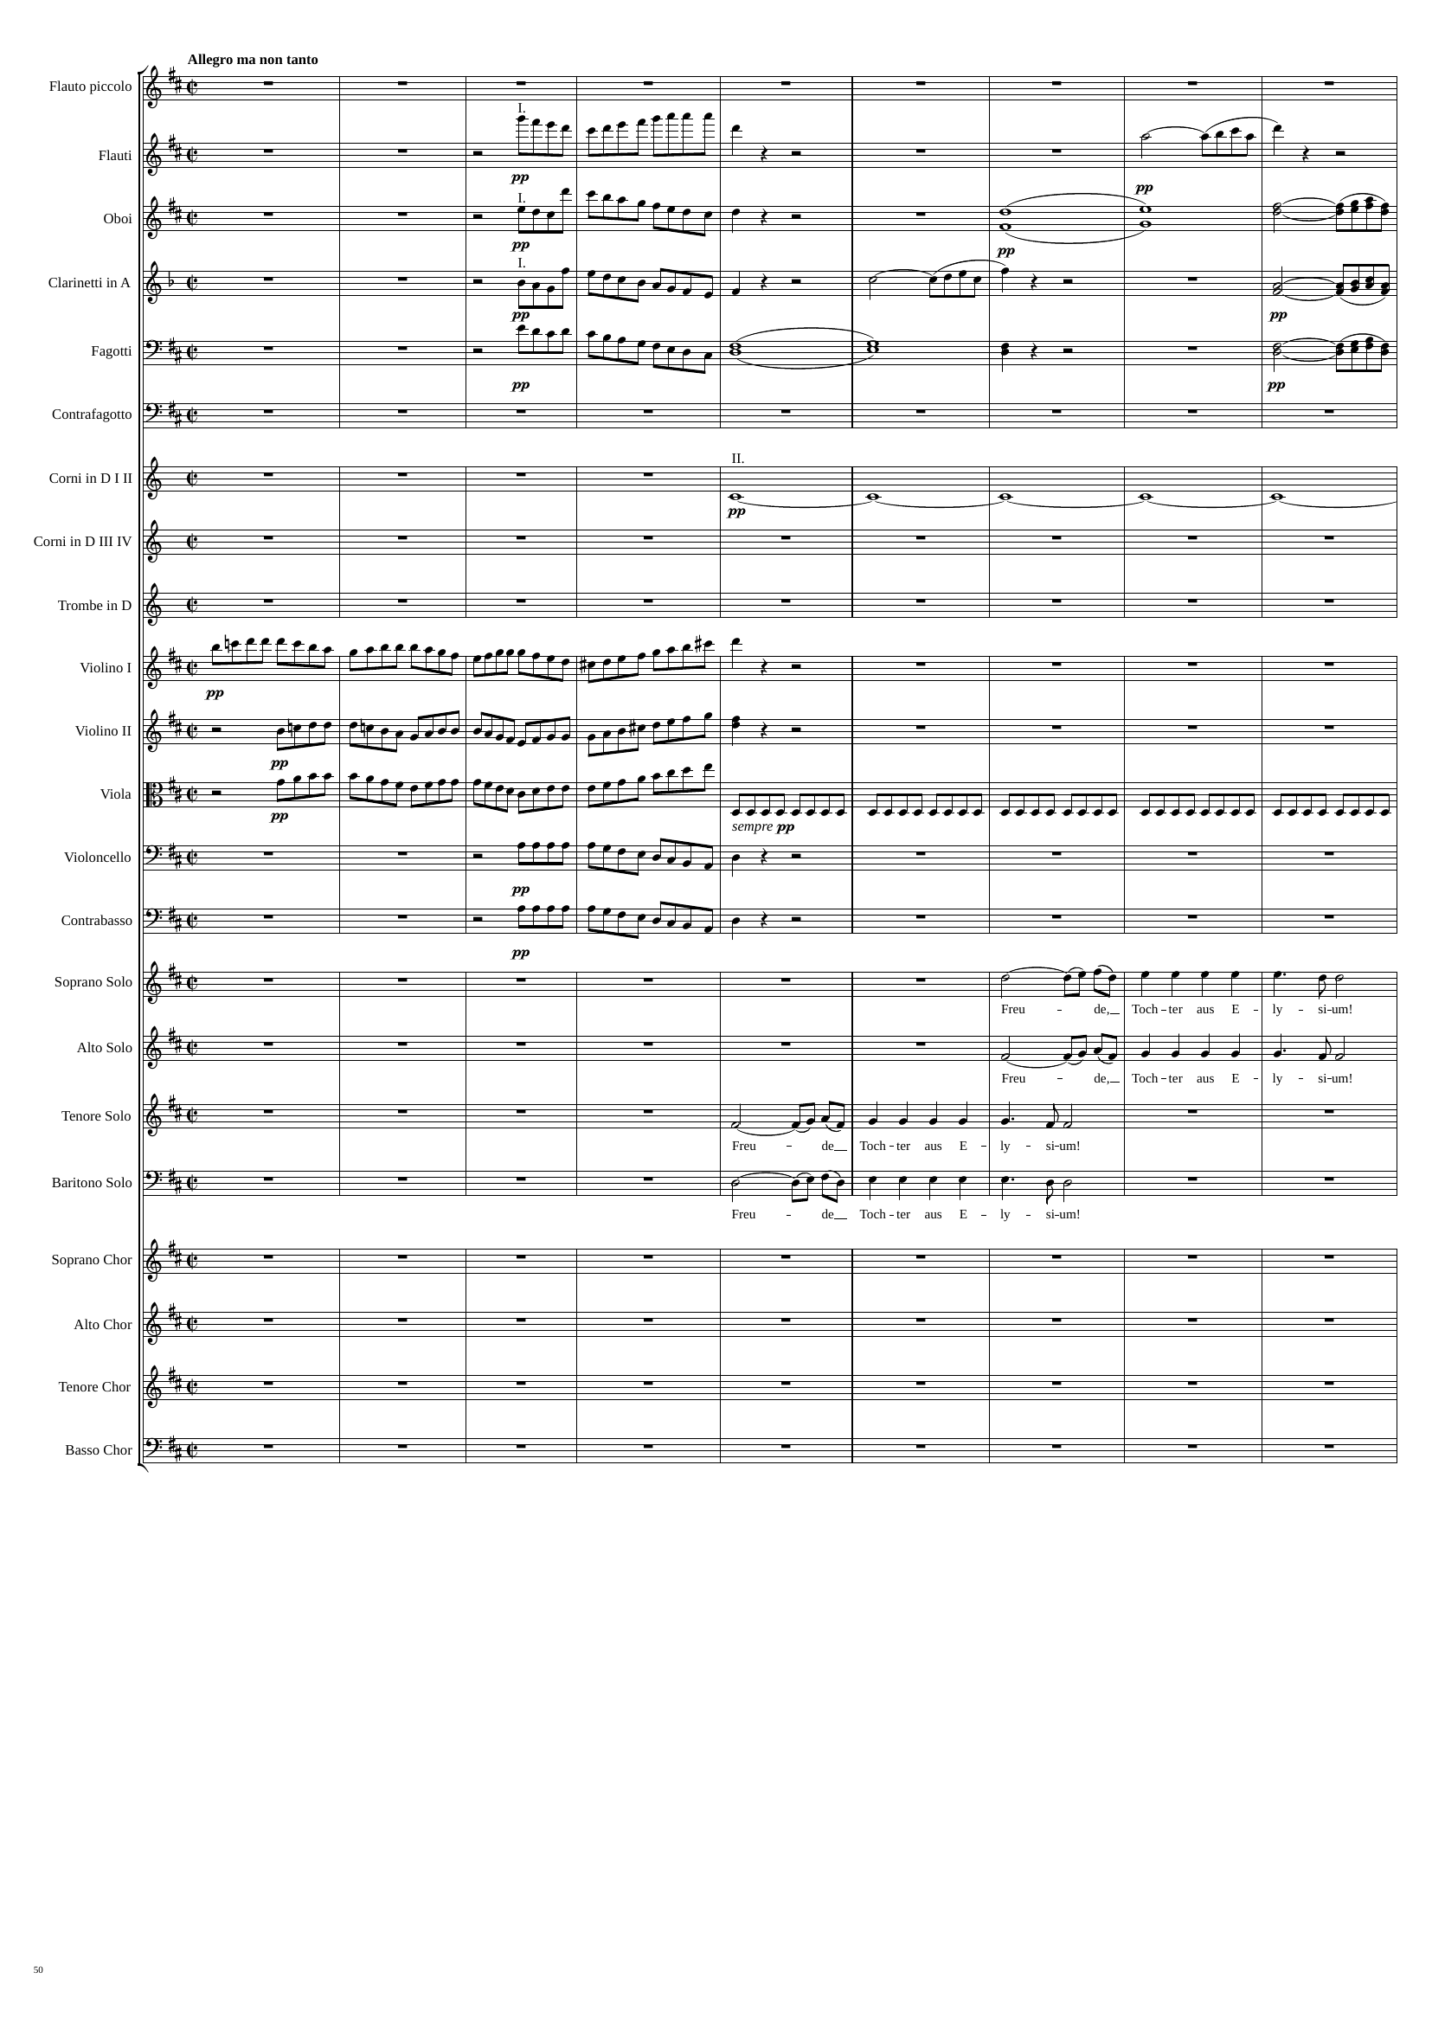
rhythm
harm
rhythm
harm
rhythm
rhythm
harm
rhythm
rhythm
harm
rhythm
harm
rhythm
rhythm
rhythm
rhythm
rhythm
rhythm
mel
mel
mel
mel
3004
3020
3040

Slide 51

rhythm
rhythm
rhythm
rhythm
rhythm
rhythm
harm
rhythm
rhythm
rhythm
harm
harm
harm
rhythm
rhythm
rhythm
rhythm
rhythm
mel
mel
mel
mel
3040
3060
3076

Slide 52

rhythm
rhythm
rhythm
rhythm
rhythm
harm
rhythm
rhythm
rhythm
harm
harm
harm
rhythm
rhythm
rhythm
rhythm
rhythm
rhythm
rhythm
rhythm
rhythm
rhythm
mel+rhythm
mel+rhythm
rhythm
mel
mel+rhythm
mel
mel+rhythm
3076
3100
3124

Slide 53

rhythm
mel+rhythm
rhythm
mel+rhythm
harm
rhythm
mel+rhythm
rhythm
rhythm
mel+rhythm
harm
rhythm
harm
rhythm
rhythm
rhythm
rhythm
mel+rhythm
rhythm
mel+rhythm
rhythm
mel+rhythm
rhythm
mel+rhythm
rhythm
mel+rhythm
mel+rhythm
rhythm
rhythm
mel+rhythm
rhythm
mel+rhythm
rhythm
mel+rhythm
mel
mel+rhythm
mel
mel+rhythm
mel
mel+rhythm
mel
3124
3140
3156
3172

Slide 54

mel+rhythm
mel
rhythm+harm
mel+rhythm
mel+rhythm
mel
rhythm+harm
mel+rhythm
mel+rhythm
mel
rhythm+harm
harm
mel+rhythm
mel
rhythm+harm
rhythm
rhythm
rhythm+harm
harm
rhythm
rhythm+harm
mel+rhythm
rhythm
rhythm
mel+rhythm
rhythm
mel+rhythm
mel+rhythm
rhythm
mel+rhythm
mel+rhythm
rhythm
rhythm
mel+rhythm
rhythm
rhythm
mel+rhythm
rhythm
rhythm
mel
rhythm+harm
mel
mel
rhythm+harm
mel
mel
rhythm+harm
mel
mel
rhythm+harm
3172
3192
3216

Slide 55

mel+rhythm
mel+rhythm
mel
mel+rhythm
mel+rhythm
mel
harm
mel+rhythm
mel+rhythm
mel
mel+rhythm
mel+rhythm
mel
harm
rhythm
rhythm
mel
mel+rhythm
rhythm
mel
rhythm
rhythm
rhythm
mel+rhythm
rhythm
rhythm
mel+rhythm
rhythm
rhythm
mel+rhythm
rhythm
rhythm
mel+rhythm
rhythm
rhythm
mel+rhythm
rhythm
mel+rhythm
mel
mel+rhythm
mel
mel+rhythm
mel
mel+rhythm
mel
3216
3240
3264

Slide 56

mel
rhythm+harm
mel
rhythm+harm
mel
rhythm+harm
harm
mel
rhythm+harm
harm
mel
rhythm+harm
mel
rhythm+harm
rhythm
rhythm
rhythm
rhythm+harm
rhythm
rhythm+harm
rhythm
rhythm+harm
rhythm
rhythm+harm
rhythm
rhythm+harm
rhythm
mel
rhythm
mel
mel+harm
rhythm
mel
mel+harm
rhythm
mel
mel+harm
mel
mel
mel
mel
3264
3280
3296

Slide 57

harm
rhythm+harm
harm
harm
rhythm+harm
harm
rhythm+harm
rhythm+harm
rhythm+harm
rhythm+harm
rhythm+harm
mel
mel+harm
mel
mel+harm
mel
mel+harm
mel
mel+harm
c
mel
mel+harm
mel
mel+harm
mel
3296
3324
mel+rhythm
mel+rhythm
mel+rhythm
mel+rhythm
mel+rhythm
mel+rhythm
rhythm
rhythm
rhythm
rhythm
mel+rhythm
mel+rhythm
mel+rhythm
mel+rhythm
mel+rhythm
3324
3356

Slide 58

mel
rhythm
mel
mel
mel
rhythm
mel
mel
mel
rhythm
mel
mel
mel
rhythm
mel
mel
mel
mel
mel
mel
mel
mel
rhythm
harm
rhythm
mel
rhythm
harm
rhythm
rhythm
rhythm
rhythm
rhythm
rhythm
mel+rhythm
mel
rhythm
rhythm
mel+rhythm
mel
rhythm
mel+rhythm
mel+rhythm
mel
rhythm
mel+rhythm
mel+rhythm
mel
rhythm
mel
mel+rhythm
mel
rhythm
mel
mel
harm
mel
harm
mel
harm
mel
harm
3356
3400

Slide 59

mel
rhythm
mel
mel
mel
mel
mel
mel
mel
mel
mel
mel
mel
mel
mel
harm
mel
rhythm
harm
rhythm+harm
mel
rhythm+harm
harm
rhythm
V
rhythm
rhythm
V
rhythm
rhythm
V
rhythm
rhythm
V
rhythm
rhythm
rhythm
rhythm
mel+rhythm
mel+rhythm
rhythm
mel+rhythm
mel+rhythm
mel+rhythm
rhythm+harm
mel
rhythm
mel
rhythm
harm
mel
harm
rhythm+harm
harm
mel
rhythm+harm
harm
mel
rhythm+harm
3400
3428
3444

Slide 60

mel
rhythm+harm
mel
rhythm+harm
mel
rhythm+harm
mel
rhythm+harm
mel
rhythm+harm
rhythm
rhythm+harm
rhythm+harm
rhythm+harm
rhythm+harm
rhythm+harm
rhythm
rhythm+harm
rhythm
rhythm+harm
rhythm
rhythm+harm
rhythm
rhythm
rhythm
rhythm
mel+rhythm
mel
rhythm+harm
mel+rhythm
mel
rhythm+harm
rhythm
mel
rhythm+harm
rhythm
mel
rhythm+harm
rhythm
mel
rhythm+harm
mel
mel
mel
rhythm+harm
mel
mel
mel
rhythm+harm
rhythm+harm
mel
mel
rhythm+harm
rhythm+harm
mel
mel
rhythm+harm
3444
3472
3492

Slide 61

rhythm+harm
rhythm+harm
rhythm+harm
rhythm+harm
rhythm+harm
rhythm
rhythm+harm
rhythm
rhythm+harm
rhythm
rhythm+harm
mel
rhythm+harm
harm
rhythm+harm
harm
rhythm+harm
harm
rhythm+harm
harm
rhythm+harm
harm
rhythm
rhythm
rhythm
rhythm
rhythm
rhythm+harm
rhythm+harm
rhythm+harm
rhythm+harm
mel+rhythm
rhythm+harm
mel+rhythm
rhythm+harm
mel+rhythm
rhythm+harm
mel+rhythm
rhythm+harm
harm
rhythm+harm
mel
rhythm+harm
mel
rhythm+harm
mel
3492
3532
3540

Slide 62

rhythm
rhythm+harm
rhythm
rhythm
rhythm+harm
rhythm
rhythm+harm
rhythm
rhythm
rhythm+harm
rhythm
rhythm+harm
rhythm
rhythm
rhythm+harm
rhythm
rhythm+harm
rhythm
rhythm
rhythm+harm
rhythm
rhythm+harm
rhythm
mel
rhythm
harm
rhythm+harm
harm
rhythm+harm
rhythm
harm
rhythm+harm
harm
rhythm+harm
rhythm
harm
rhythm+harm
harm
rhythm+harm
rhythm
harm
rhythm+harm
harm
rhythm
harm
rhythm+harm
harm
rhythm
rhythm
rhythm
rhythm
rhythm
rhythm+harm
rhythm
mel+rhythm
rhythm
mel+rhythm
rhythm
mel+rhythm
rhythm
mel+rhythm
rhythm
harm
mel
mel
mel
mel
3540
3564
3576

Slide 63

rhythm
mel
rhythm
mel
rhythm
mel
rhythm
mel
rhythm
rhythm
rhythm
mel
mel
rhythm
mel
mel
rhythm
mel
harm
mel
rhythm
mel+rhythm
rhythm
mel+rhythm
rhythm
rhythm
rhythm
rhythm
rhythm
rhythm
rhythm
rhythm
rhythm
mel
rhythm+harm
mel
rhythm+harm
mel
rhythm+harm
mel
rhythm+harm
3576
3604
3616

Slide 64

mel
rhythm
mel
C
mel
C
rhythm+harm
mel
C
mel
C
rhythm+harm
mel+rhythm+harm
mel
C
mel
C
rhythm+harm
mel+rhythm+harm
mel
C
rhythm+harm
mel+rhythm+harm
mel
C
rhythm
mel
C
rhythm
rhythm+harm
mel
C
mel
C
rhythm+harm
mel
C
mel
C
rhythm+harm
mel
C
mel
C
mel+rhythm+harm
rhythm
mel
C
rhythm
rhythm
rhythm
rhythm
rhythm
rhythm
rhythm
rhythm
rhythm
rhythm
rhythm
rhythm
rhythm
rhythm
rhythm
rhythm
rhythm+harm
mel
rhythm+harm
mel
rhythm+harm
mel
rhythm+harm
mel
3616
3628
3636

Slide 65

mel
C
mel+rhythm
rhythm+harm
mel
C
mel+rhythm
rhythm+harm
mel
C
mel+rhythm
rhythm+harm
mel
C
mel+rhythm
rhythm+harm
mel
C
mel+rhythm
rhythm+harm
rhythm
rhyth
rhythm+harm
mel
C
mel+rhythm
rhythm+harm
mel
C
mel+rhythm
rhythm+harm
mel
C
mel+rhythm
rhyth
rhythm+harm
rhythm
rhythm+harm
rhythm
rhythm+harm
rhythm
rhythm
rhythm
rhythm
rhythm
mel+rhythm
rhythm+harm
rhythm
mel+rhythm
rhythm+harm
rhythm
mel+rhythm
rhythm+harm
rhythm
rhythm
rhythm+harm
rhythm
rhythm
rhythm+harm
3636
3660
3680

Slide 66

rhythm+harm
mel+rhythm
rhythm+harm
mel+rhythm
rhythm+harm
mel+rhythm
rhythm+harm
mel+rhythm
rhythm+harm
mel+rhythm
rhythm+harm
rhythm+harm
rhythm+harm
harm
rhythm+harm
rhythm+harm
harm
rhythm+harm
rhythm+harm
rhythm+harm
rhythm
rhythm
rhythm
rhythm
rhythm+harm
rhythm+harm
rhythm+harm
rhythm+harm
rhythm+harm
3680
3692
3712

